Slide 1
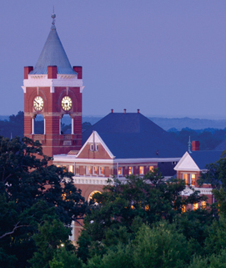
Maintaining An Historic
Architectural Campus
Senate Finance Committee Higher Education Special Study Committee
A Review of Institutional Planning, Management, and Funding of Facility Maintenance Needs by Public Institutions of Higher Learning

Slide 2
Winthrop Maintains One Of The Oldest Campuses In South Carolina
54% of WU sq. ft. is older than 48 years
34% of WU sq. ft. is are older than 78 years
18% of WU sq. ft. is older than 108 years

Slide 3
What Is Deferred Maintenance?
Deferred Maintenance is a term from the 1980’s which no longer is pertinent in today’s world.
(“Deferred” implies neglect.)

Slide 4
Maintenance Has Many Components
Routine Repair and Preventive Maintenance (annual)
Preventive Maintenance (periodic)
Repurposing (to suit program needs and changes)
Maintenance Needs for component life cycle replacement

Slide 5
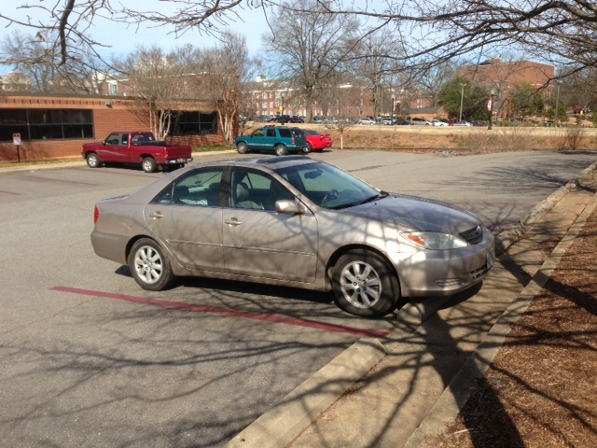
This is a 2002 Camry. It is driven daily, has 70,000 miles on it and is 11 years old.

Slide 6
It is well maintained (routine repair and maintenance) and it is extremely dependable.
If we used the same methodology to calculate its maintenance needs as the State does for our facilities:
The engine is 50% used up
The transmission is 50% used up
Trim, paint and interior are 50% used up

Slide 7
Its maintenance needs would add up to over 50% of the replacement cost or about $15,000.
But all it really needs currently is a set of tires, new brake pads and it is ready to go years more.
Which is about $600 or about 2% of its replacement cost.

Slide 8
How we handle our maintenance needs:
Bi-Annual project lists with input from all the stakeholders
These lists include items beyond routine repair and maintenance
Includes basic facility needs (roofs, mechanical and electrical systems, etc.)
Departmental Program needs (renovations, repurposing)

Slide 9
The lists are fleshed out with cost estimates which are then sent to the WU Executive Officers for review and prioritization.
This system allows us to identify
Near Term and Long Term Needs and keeps them on the radar.

Slide 10
How do we pay for it?
Institutional Capital Project Funds (ICPF) or short term debt from existing fees.
One time funds appropriated by General Assembly.

Slide 11
Why these sources?
There has not been a Capital Improvement Bond (CIB) for institutions like Winthrop since 2000.
One time funds from the General Assembly are not always available and cannot be depended upon.
Association of Physical Plant Administrators formula indicates Winthrop should allocate $10,018,594 just for E&G routine repair and maintenance annually.
Our total state appropriation is only $13,106,029.

Slide 12
What happens to Winthrop fees when projects have been paid for?
Winthrop uses newly open debt capacity to pay for the next maintenance priorities on the list without raising or adding new fees.

Slide 13
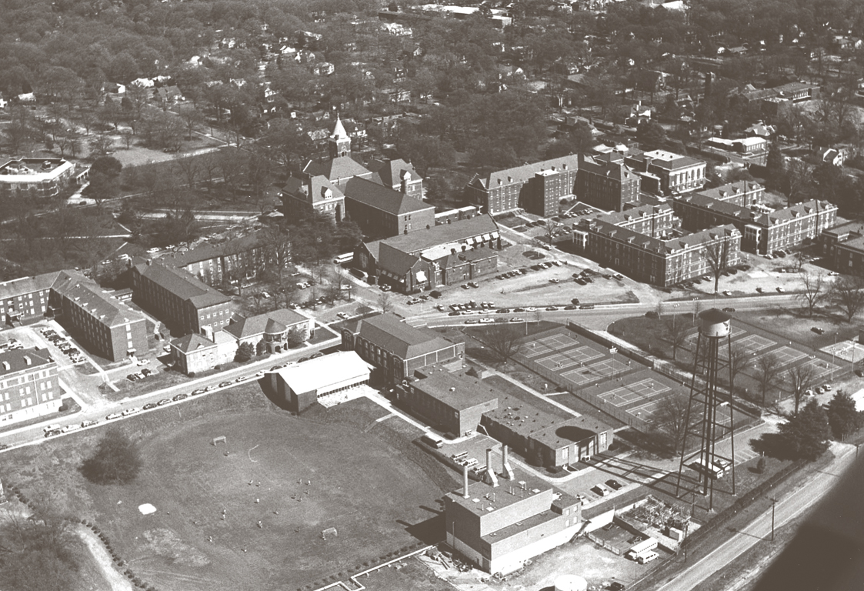
Here is our campus as it looked before 2000.

Slide 14
Here is the same shot today . . .

Slide 15
Why is it so important to keep our campuses maintained?
70% of high school seniors choose the college they attend based on that first visit (first impression).
Winthrop’s in-state enrollment is 89%, indicating WU is doing a good job keeping SC students at home.
Campus maintenance is an indicator of attention to detail in academic activities as well as facilities.

Slide 16
QUESTIONS?

