Slide 1
Mr. Loftis vs. The Facts
Greg Ryberg, COO
February 25, 2014

Slide 2
“I can’t speak. I get ruled out every time I go to speak.”1-30-14
ASKED A QUESTION, HAD THE FLOOR, OR MADE A MOTION IN 2013
Allen Gillespie – 38
Edward Giobbe – 28
Travis Pritchett – 25 (last meeting was October)
Curtis Loftis – 24 (stormed out of May and October meetings and left halfway through the November meeting)
Rebecca Gunnlaugsson – 12 (joined in September)
James Powers – 11 (last meeting was May)
David Avant – 6
Ron Wilder – 2 (joined in November)
MOTIONS MADE BY TREASURER LOFTIS – 11
1 motion did not pass
10 motions passed
*Based on 2013 Commission Meeting Minutes
2

Slide 3
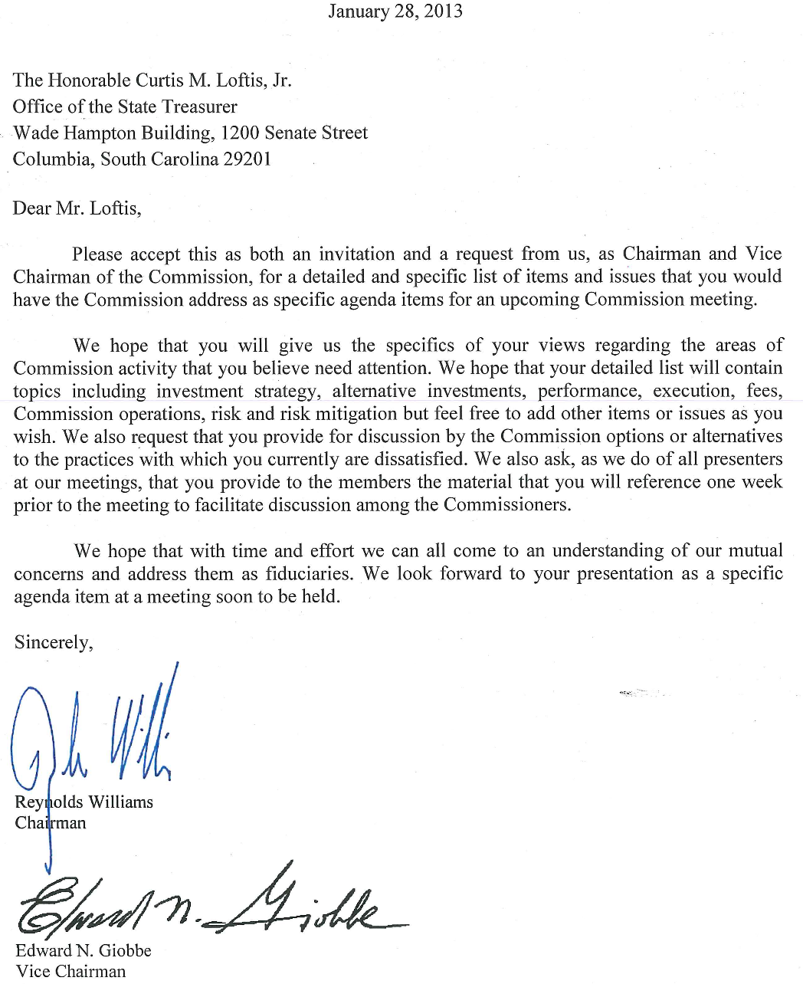
“I can’t get anything on the agenda.” 1-30-14
3

Slide 4
Asset Allocation Plan
Mr. Loftis: “I mean, I will go and do one for you, if you can assure me I can get it on the floor, I can assure you I can get it there.”
1-30-14
Senator Bryant: “Nobody would expect you to draw up a whole new asset allocation, but if you have a proposal, and you are getting denied at least a vote on, certainly, I will back you 100 percent. Your proposal ought to get consideration.” 1-30-14
Mr. Loftis: “Well I am going to take this under consideration. I might just actually do one, but I am gonna call you and I would like to have you there, because if I can get it on the floor, I will certainly do it. --- So, I will be more than happy to.” 1-30-14
4

Slide 5
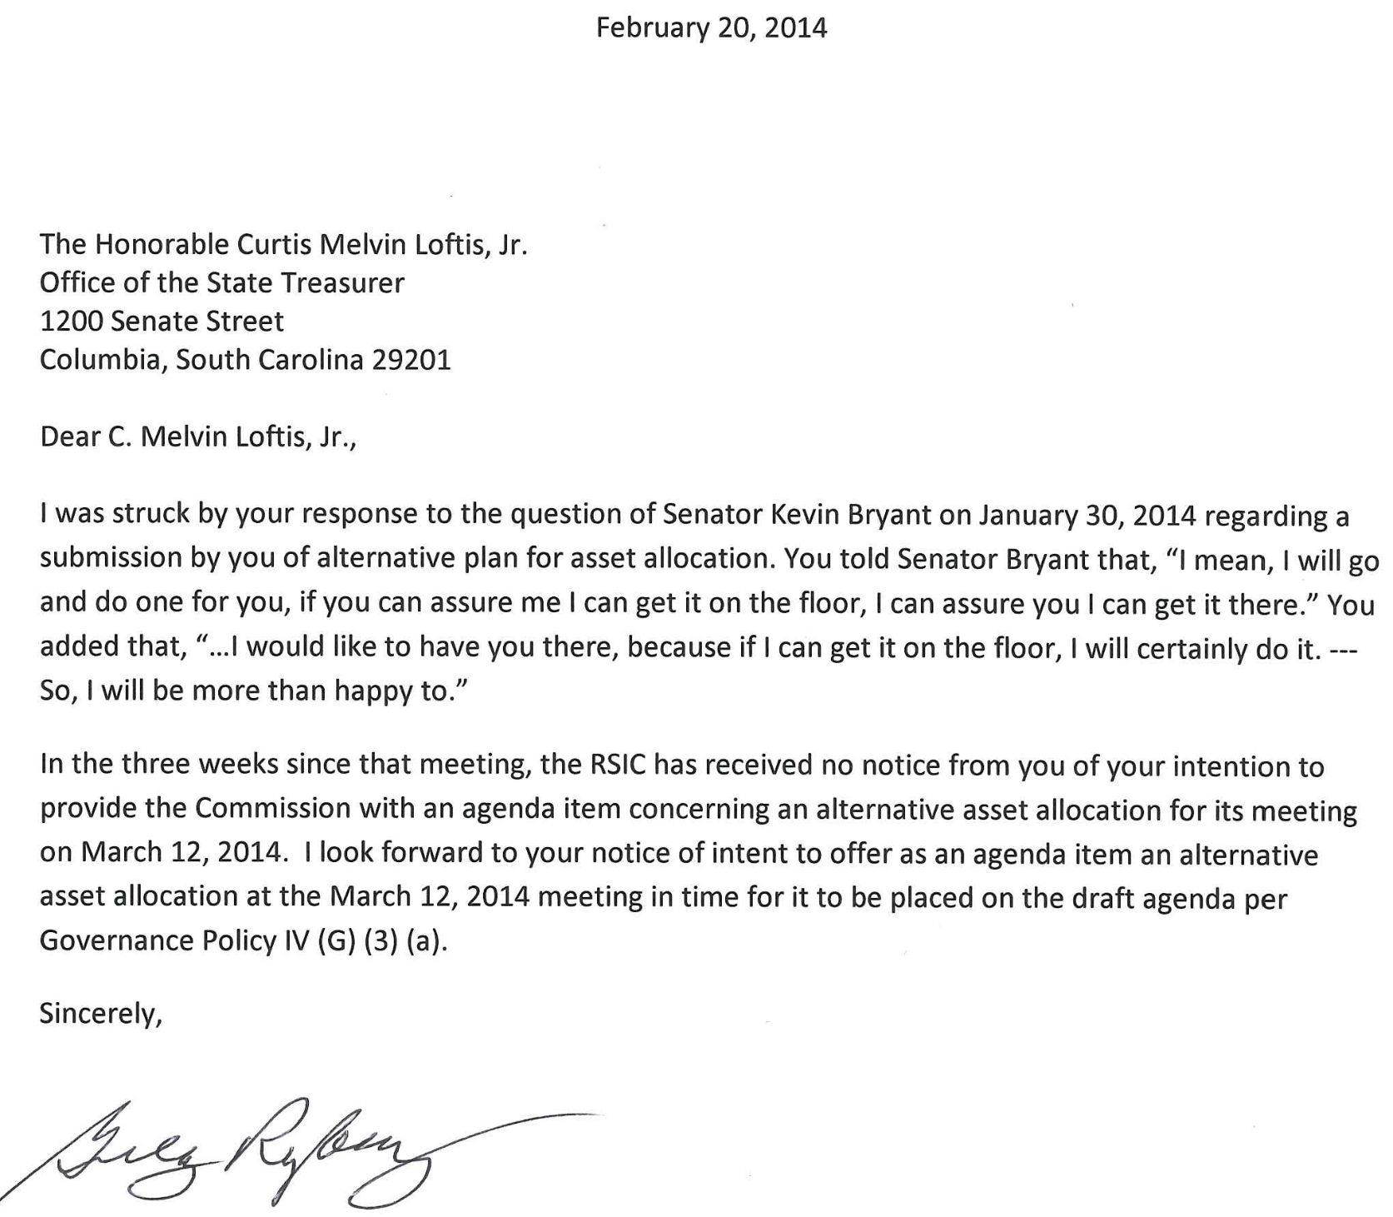
5

Slide 6
“They don’t speak to me.” 1-30-14
From: Loftis, Curtis [Curtis.Loftis@sto.sc.gov]
Sent: Wednesday, July 31, 2013 4:38 AM
To: Reynolds Williams
Subject: Re: OPEB - 4th request
Reynolds,
I quit reading, even opening, your snippy emails some time ago.
Any request you might have for the STO should be directed to the appropriate STO staffer. If in doubt, please send your request to the most efficient and ever pleasant Amy Wright.
CML
From: "Loftis, Curtis" <Curtis.Loftis@sto.sc.gov>
Date: December 6, 2013, 9:14:12 PM EST
To: "Smith, Lorrie" <lsmith@ic.sc.gov>
Cc: "Wright, Amy" <Amy.Wright@sto.sc.gov>, "Allen R. Gillespie CFA" <agillespie@ediadvisors.com>, "Avant, David" <davant@peba.sc.gov>, "Dr. Rebecca Gunnlaugsson" <rgunnlaugsson@gmail.com>, "Ronald P. Wilder" <ronwilder@mindspring.com>, Reynolds Williams <Reynolds@willcoxlaw.com>, "Edward N. Giobbe" <engiobbe@hotmail.com>
Subject: Re: Letter from Sen. Ryberg
Lorrie,
Please do not send any communication from Mr. Ryberg to me, my staff or my office.
Please route email through Mr. Williams.
Thank you very much,
Curtis Loftis
Curtis M. Loftis, Jr.
State Treasurer, South Carolina
Sent from my iPhone
6

Slide 7
“We did write GFOA…” 1-30-14
From Subcommittee Questions and Answers
After the IG released his report, I contacted the Governmental Financial Officers Association (GFOA) to inquire whether the Financial Statements, and particularly the underreporting of investment fees and expenses, were materially misstated. Upon review of the Financial Statements, a Director at the GFOA concluded, "The concept of materiality embraces both quantitative and qualitative factors. Given the sheer magnitude of the difference and the inherent political sensitivity of investment-related fees (which accounts for the GAAP requirement to report them separately), it is difficult to argue that a departure from GAAP in this case is 'immaterial'.” 9-19-13
7

Slide 8
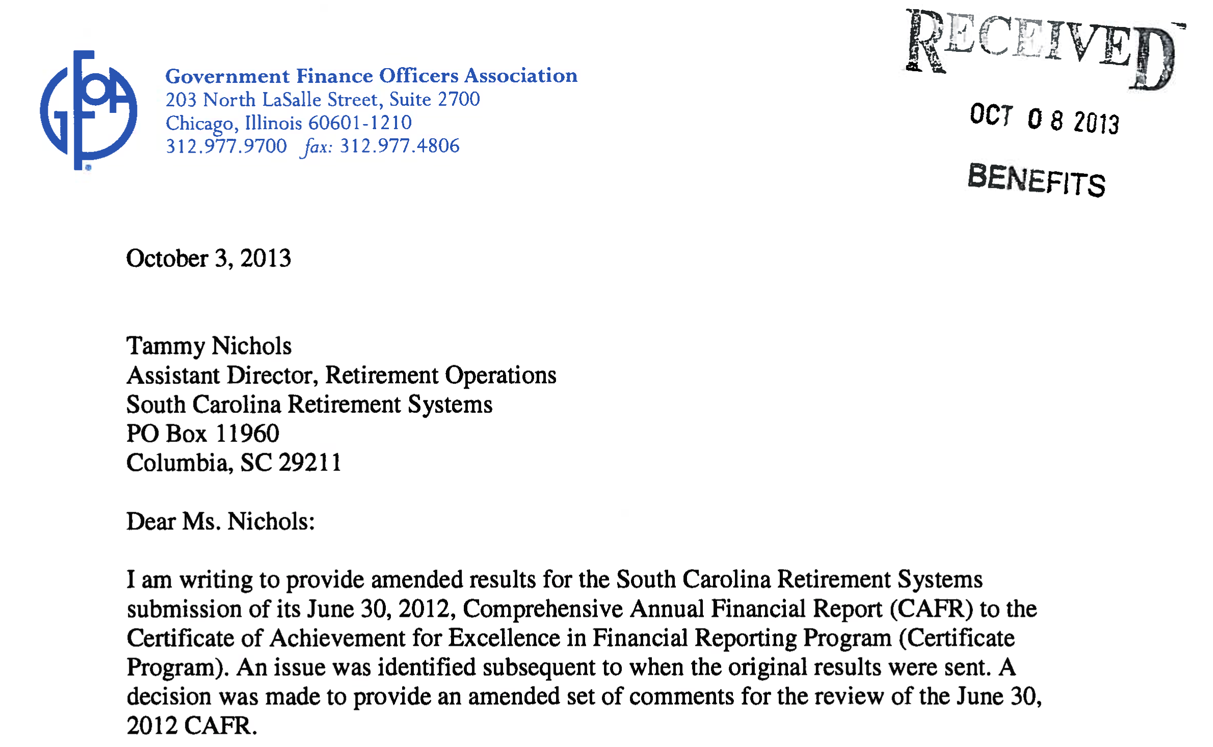
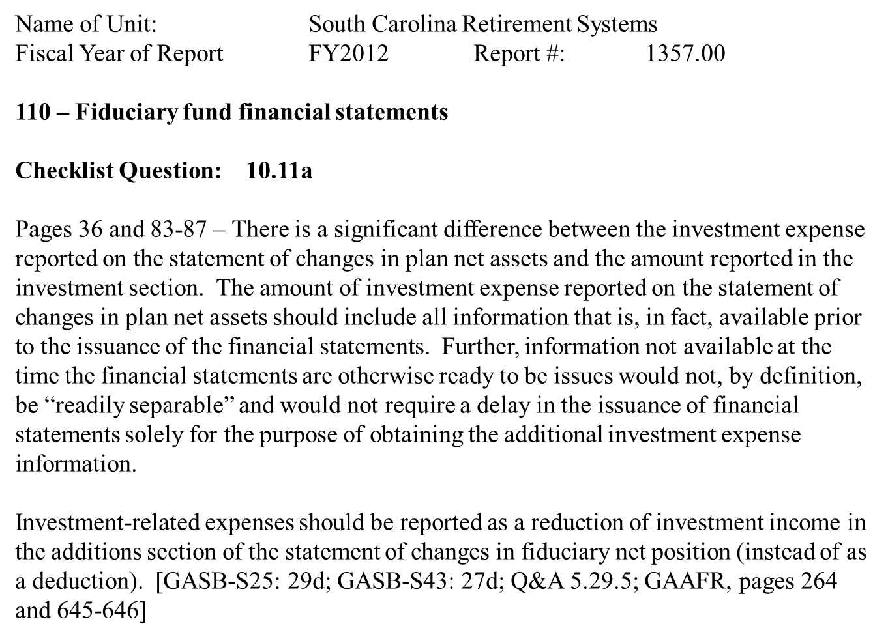
“We did write GFOA…” 1-30-14
8

Slide 9
“I am not allowed to be on a Committee.” 1-30-14
Mr. Loftis: “Senator, I am not allowed to be on a Committee. I am not allowed to even show up there…I don’t even know about these meeting until after, sometimes they pass. ---I have been taken off all the Committees, no explanation.” 1-30-14
9

Slide 10
“I am not allowed to be on a Committee.” 1-30-14
Compensation Committee; March 12, 2012
Committee Members Present: Mr. Allen Gillespie (via phone), State Treasurer Curtis Loftis, Dr. Travis Pritchett (via phone)
  After discussion, on a motion made by Dr. Pritchett and seconded by Mr. Loftis, the Committee unanimously agreed to target total compensation equal to the 90th percentile of public plans.
  Mr. Loftis made six subsequent motions concerning the PIC plan.
Full Commission Meeting; March 23, 2012
All Commissioners present in person or via phone
  Mr. Williams made a motion to accept all of the recommendations of the Compensation Committee, with the exception of the highwater mark. Mr. Loftis seconded the motion for further discussion. The motion passed unanimously.
10

Slide 11
“I am not allowed to be on a Committee.” 1-30-14
July 2, 2012
To: Members of the Investment Commission
From: Reynolds Williams, Chairman
Re: Standing Committee Appointments
The Commission’s Governance Policies establish three standing committees: Budget Committee, Audit Committee, and Compensation Committee. As outlined in Section VI (B), the Chairman appoints members utilizing the following considerations:
The need to maintain an appropriate level of continuity in committee membership;
The need to rotate the composition of the committees to provide diverse experience to Commission’s members; and
The need to ensure that committee appointments reflect the Commission members’ interests and areas of expertise.
In accordance with these guidelines, I have appointed members to the standing committees as outlined below, effective July 1, 2012. The appointments are listed by member and by committee.
Thank you for your service in the interests of the retirement systems’ participants and beneficiaries.
Allen Gillespie Audit Committee
Audit Committee Reynolds Williams Allen Gillespie
Reynolds Williams
Audit Committee Budget Committee
Curtis Loftis
Curtis Loftis Jim Powers
Budget Committee
Compensation Committee
Travis Pritchett Travis Pritchett
Compensation Committee Ed Giobbe
Jim Powers
Budget Committee
Ed Giobbe
Compensation Committee
11

Slide 12
“I am not allowed to be on a Committee.” 1-30-14
From: Loftis, Curtis [Curtis.Loftis@sto.sc.gov]
Sent: Sunday, December 16, 2012 10:14 PM
To: Travis Pritchett; jim powers; Blume, William
Cc: agillespie@ediadvisors.com; Edward Giobbe; Reynolds Williams
Subject: Budget Committee
Mr. Williams,
Please accept this as my resignation from the budget committee. I can no longer rationalize placing my name on a budget request. I apologize to Jim for this inconvenience and I stand ready to serve on any committee as needed.
To my fellow Commissioners I note that my requests for information and to receive it in a manner that is useful to me, and for advance notification of committee meetings (to the extent possible), continue to be “slow-walked” or ignored. My request for enquiries into the due diligence and operational aspects of the Timberlands investment and the apparent differences concerning fees in the Light House agreement (and others) and those actually charged are also ignored. I consider this inaction indefensible and intend to pursue a remedy in an alternate forum.
Regards,
CML
No meetings ever were held
No meetings ever were called
12

Slide 13
“…I don’t even know about these meetings, until after, sometimes after they pass.” 1-30-14
Audit Committee Meeting Minutes
Others present for all or a portion of the meeting on Tuesday, February 12, 2013:
  The Honorable Curtis Loftis and David Padgett from the State Treasurer’s Office;
Others present for all of a portion of the meeting on Tuesday, April 30, 2013:
  Bill Leidinger from the State Treasurer’s Office
Others present for all of a portion of the meeting on Tuesday, August 13, 2013:
  Clarissa Adams, Wes Hill and David Padgett from the State Treasurer’s Office
Others present for all of a portion of the meeting on Tuesday, September 10, 2013:
  Clarissa Adams, Wesley Hill and David Padgett from the State Treasurer’s Office
Compensation Committee Meeting Minutes
  Others present for all or a portion of the meeting on Wednesday, February 13, 2013:
    Mr. Curtis M. Loftis, Jr., Commissioner
Others present for all or a portion of the meeting on Wednesday, September 25, 2013:
  No one from the State Treasurer’s Office attended
*From 2013 Audit Committee and Compensation Committee Minutes
13

Slide 14
Quote from Mr. Loftis
Mr. Loftis: “Now I’ve never heard of an investment even going through once when being voted down, but after the fourth time, Bob and Hershel took, the CIO and Deputy CIO, took that investment from them and said we’ll handle this, and they presented it to us, the Commissioners, without any knowledge that Reynolds’ firm had done the legal work. Reynolds’ firm had already done the title work.” 1-16-2014
14

Slide 15
South Carolina Retirement System Investment Commission Meeting Minutes
November 17-18, 2011
Wampee Training and Conference Center
Commissioners Present:
Mr. Allen Gillespie, Chairman; Mr. Reynolds Williams, Vice Chairman; State Treasurer Curtis Loftis; Mr. Edward Giobbe; Mr. James Powers; and Dr. Travis Pritchett.
Others present for all or a portion of the meeting on Thursday, November 17, 2011: Mike Addy, Dunkin Allison, Harris Chewning, Geoff Berg, Bob Borden, Jonathan Boyd, James Manning, Sarah Corbett, Dori Ditty, Robert Feinstein, Brenda Gadson, Rebecca Gunnlaugsson, Adam Jordan, Dave Klauka, Doug Lybrand, James Manning, Jared O’Connor, David Phillips, Kathy Rast, Nancy Shealy, Nicole Waites, Brian Wheeler, and James Wingo from the South Carolina Retirement System Investment Commission; Bill Condon, Brian DeRoy, Rick Harmon, Bill Leidinger, and Shakun Tahiliani from the State Treasurer’s Office; Tammy Nichols from the South Carolina Retirement Systems; Ashli Aslin, Rhett Humphreys, and Tim McCusker from New England Pension Consultants; John Schneider and Josh Roberts from Vermillion Asset Management; Joseph Brandt from Contour Global; Joseph Lillie and Patrick McGarvey from Grosvenor Capital Management; Jon Vaccaro from Ranieri Real Estate Partners; Chris Harris from Phibro; Barry Cohen, Joe Azrack, Simons Swanson, and Avi Katz from Apollo Global Management; Dan Heflin from Torchlight Investors; Sassan Alizadeh and Deepa Sarkar from Highbridge Capital Management; Jeff Fox from J.P. Morgan; Bill Maddux from Greystar Real Estate Partners, LLC; Alan Bowser, Jeff Gardner, and Joel Whidden from Bridgewater Associates; Neeti Bhalla and Chris Lvoff From Goldman Sachs Asset Management; Jeff Knight and Lauren Silk from Putnam Fiduciary Trust Company; and Michelle Cook from the Bank of New York Mellon.
Others present for all or a portion of the meeting on Friday, November 18, 2011: Dunkin Allison, Geoff Berg, Bob Borden, Jonathan Boyd, Harris Chewning, Sarah Corbett, Dori Ditty, Robert Feinstein, Brenda Gadson, Rebecca Gunnlaugsson, Adam Jordan, Dave Klauka, Doug Lybrand, James Manning, Jared O’Connor, David Phillips, Kathy Rast, Nancy Shealy, Nicole Waites, and Brian Wheeler from the South Carolina Retirement System Investment Commission; Bill Condon, Brian DeRoy, Shakun Tahiliani, Rick Harmon, Bill Leidinger from the State Treasurer’s Office; Tammy Nichols and Faith Wright from the South Carolina Retirement Systems; Sean McGould and Kelly Perkins from Lighthouse Investment Partners; Joseph Lillie, David Richter, Pat McGarvey, and Michael Sacks from Grosvenor Capital Management; Jordan Bergmen and Gregg Hymowitz from EnTrust Capital; Mike Purvis and Trina Spear from Blackstone Alternative Asset Management; and Michelle Cook from the Bank of New York Mellon.
*Minutes from November 17-18, 2011 Commission Meeting
15

Slide 16
Unfunded Liability
Mr. Loftis: “They’ve (retirees) watched the unfunded liability go from $300 million to $17 billion dollars, over $17 billion dollars, in less than 14 years.” 1-30-14
16

Slide 17
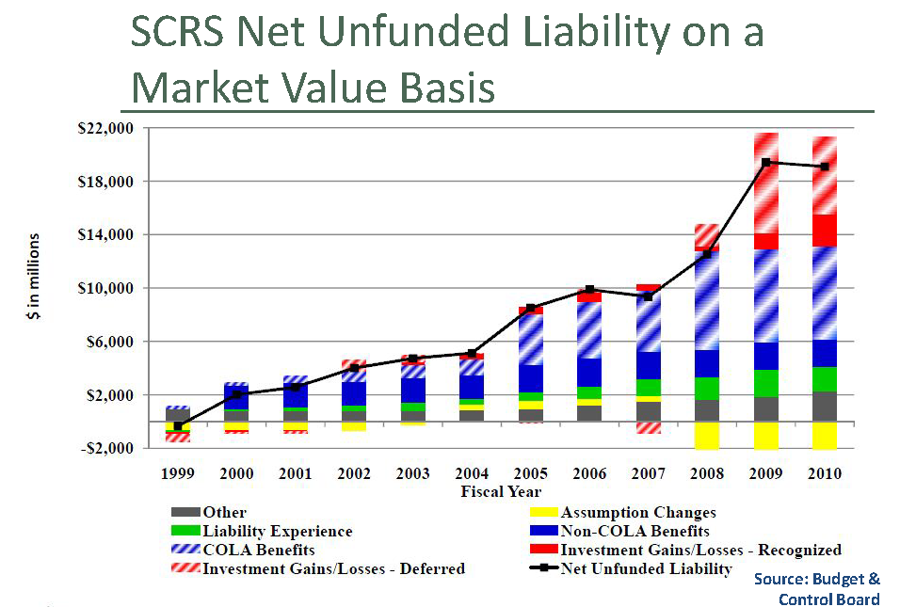
From 2011 Pension Plan Presentation
17

Slide 18
Custody and Securities Lending
Senator Lourie: “Has the Treasurer’s Office looked at another bank to do custody and securities lending?” 1-30-14
Mr. Loftis: “We had a big RFP, a consultation with procurement office, Investment Commission, PEBA, and the Treasurer’s Office.” --- They decided to stay with the Bank of New York as a primary custodian and that was with all facts being known, and it was before the case started deteriorating from our side.” 1-30-14
18

Slide 19
Custody and Securities Lending
Senator Bryant: “…I have an issue with our continued commitment to do business with Bank of New York Mellon, when we just claimed that they broke their contract.” 1-30-14
Mr. Loftis: “We had a RFP Committee; PEBA, RSIC, and Treasurer’s Office. They voted to keep the Bank of New York. They said, ‘hey, we’ll keep the Bank.’” 1-30-14
19

Slide 20
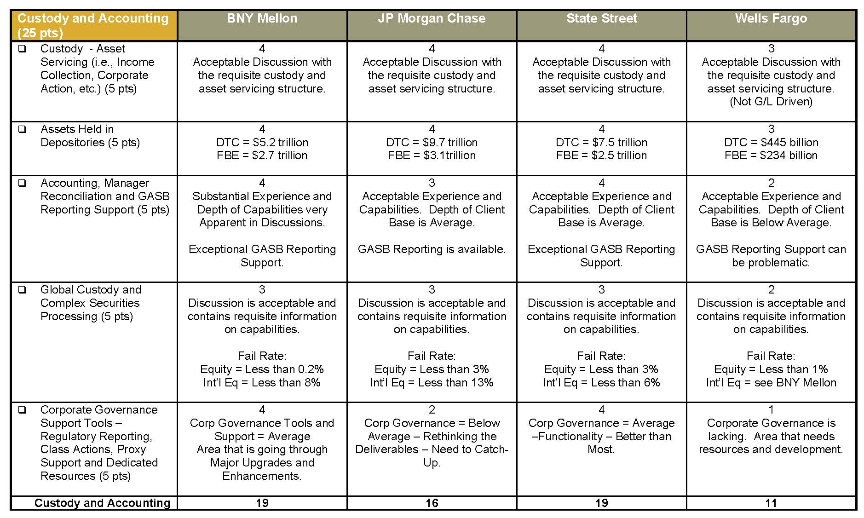
Custody and Securities Lending
*From 2012 Trust/Custody and Securities Lending Evaluation by Callan
20

Slide 21
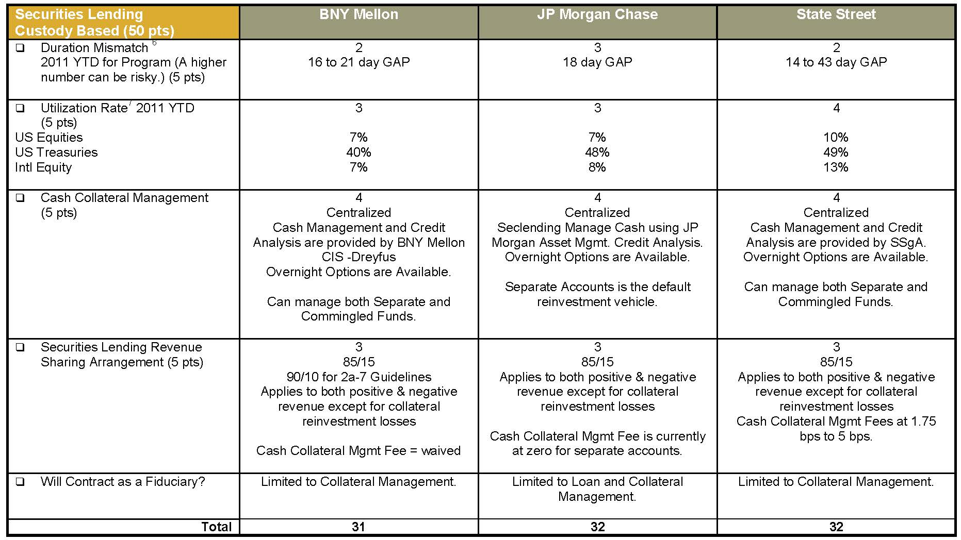
Custody and Securities Lending
*From 2012 Trust/Custody and Securities Lending Evaluation by Callan
21

Slide 22
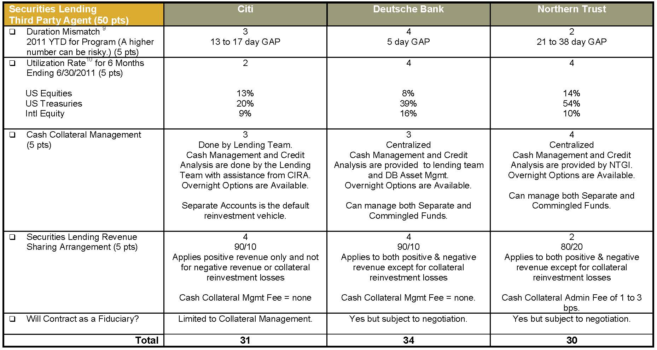
Custody and Securities Lending
*From 2012 Trust/Custody and Securities Lending Evaluation by Callan
22

Slide 23
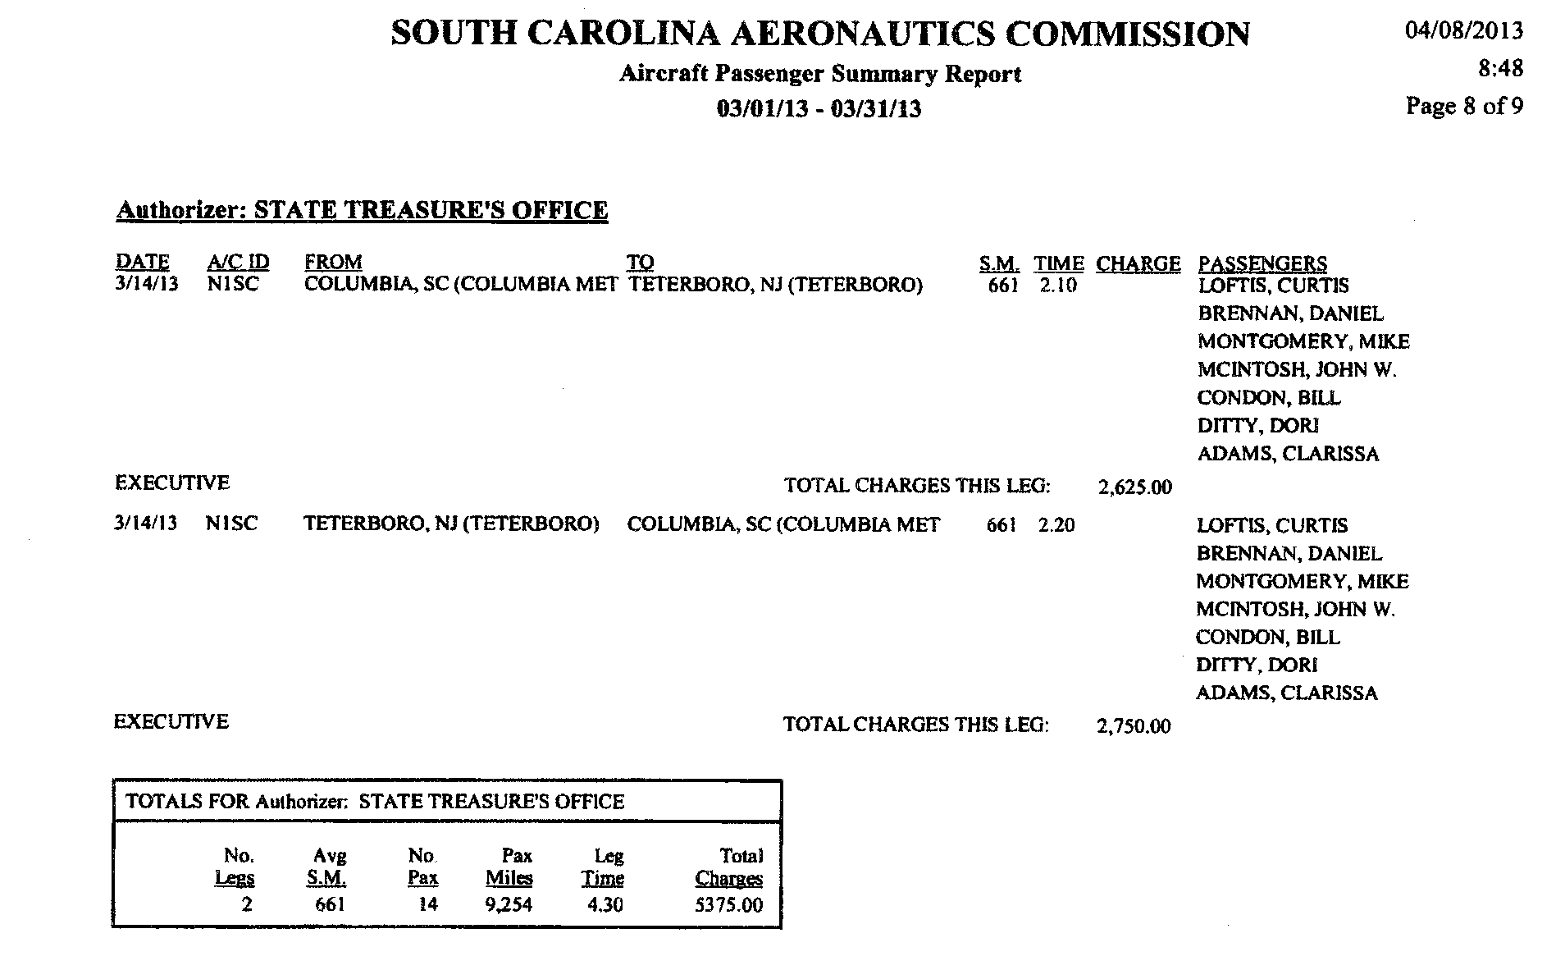
Final Negotiation
23

Slide 24
HedgeMark
Mr. Loftis: “…Hershel Harper had been there and had talked to the HedgeMark people, he was favorable, at the time.” 1-30-14
From: Hershel Harper
Sent: Thursday, March 14, 2013 11:07 AM
To: Curtis Loftis; Darry Oliver; Dori Ditty
Subject: RE: Hi from New York Re hedge mark
We do not have any assets with HedgeMark. We do not have any immediate plans for utilizing HedgeMark as our next step is to determine what we will do with hedge funds overall based on HEK's asset allocation recommendation.
-----Original Message-----
From: Curtis Loftis [mailto:curtis@curtisloftis.com]
Sent: Thursday, March 14, 2013 10:41 AM
To: Hershel Harper; Darry Oliver; Dori Ditty
Subject: Hi from New York Re hedge mark
Do you guys have assets on Hedgemark? If so...how much? ( roughly)
Do you plan to utilize it in the future
Curtis M. Loftis, Jr.
State Treasurer of South Carolina
Sent from my iPad
24

Slide 25
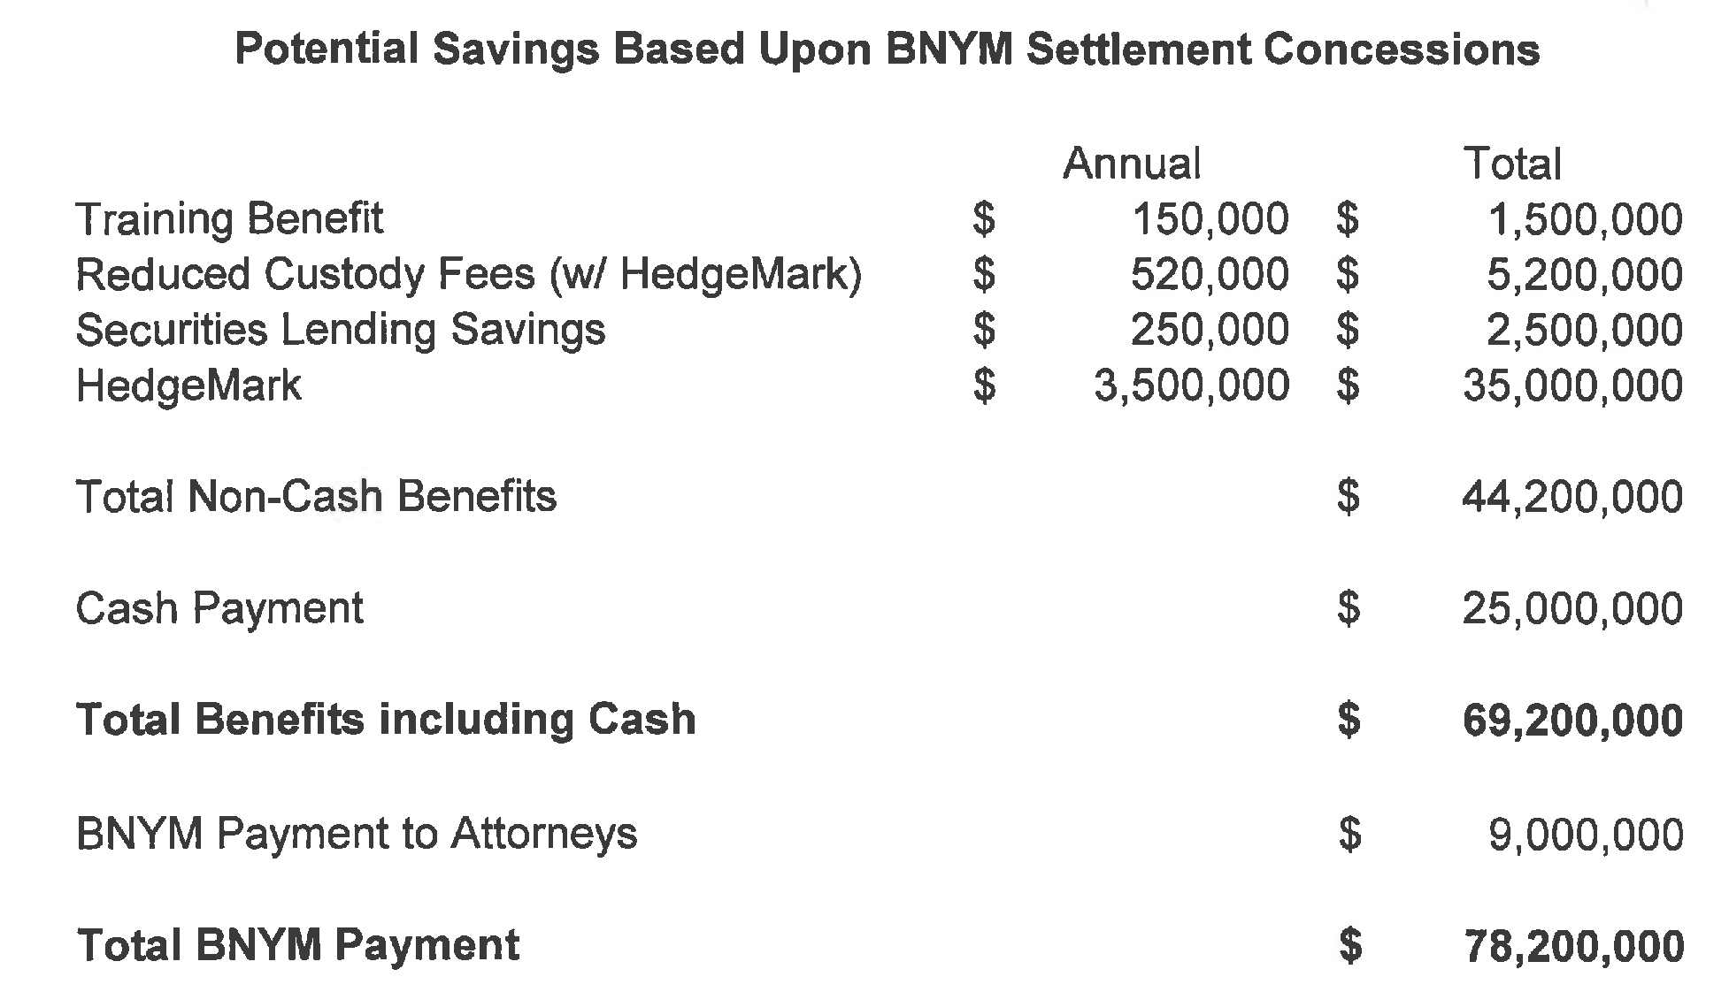
Subcommittee Question for Mr. Loftis
Responses Revised 1-17-2014
Exhibit G
25

Slide 26
Actual Value
RSIC
$ 0
$ 0
$ 0
$ 0
$ 0
$ 25,000,000
$ 25,000,000
$ 5,030,000
$ 30,030,000
Exhibit G
26

Slide 27
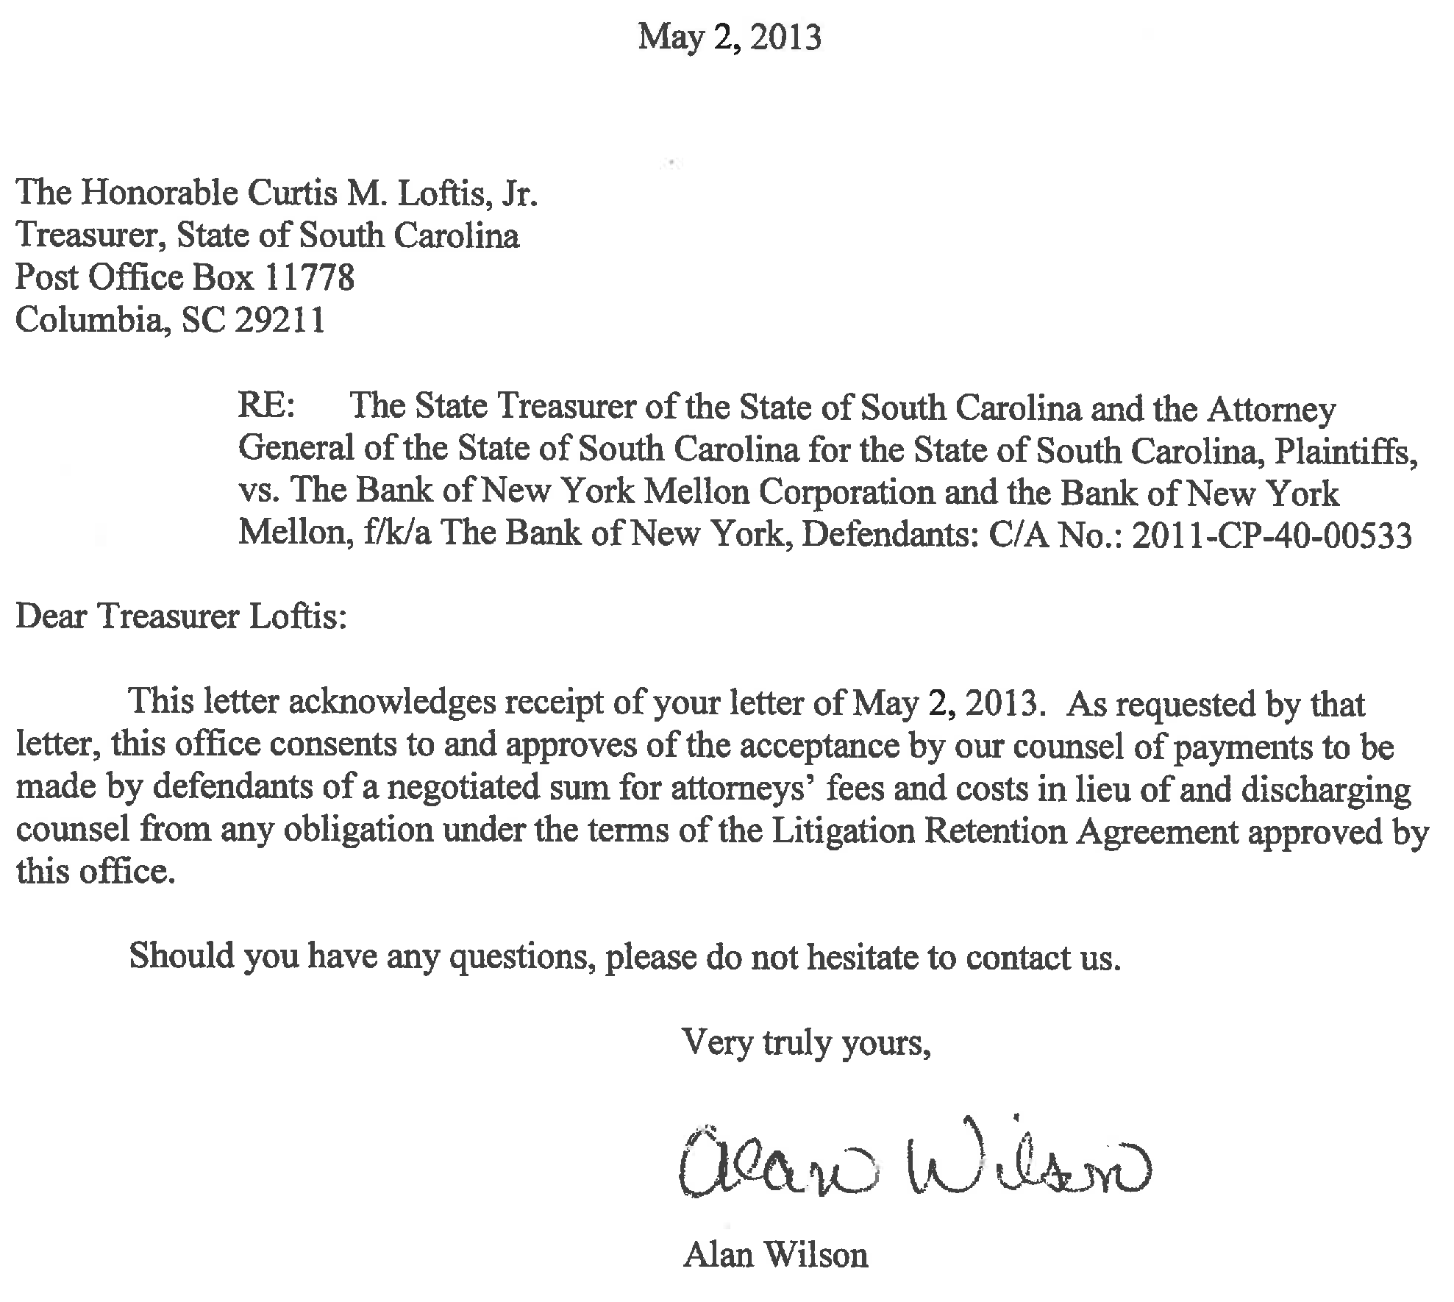
*Litigation Retention Agreements: Exhibit F5
27

Slide 28
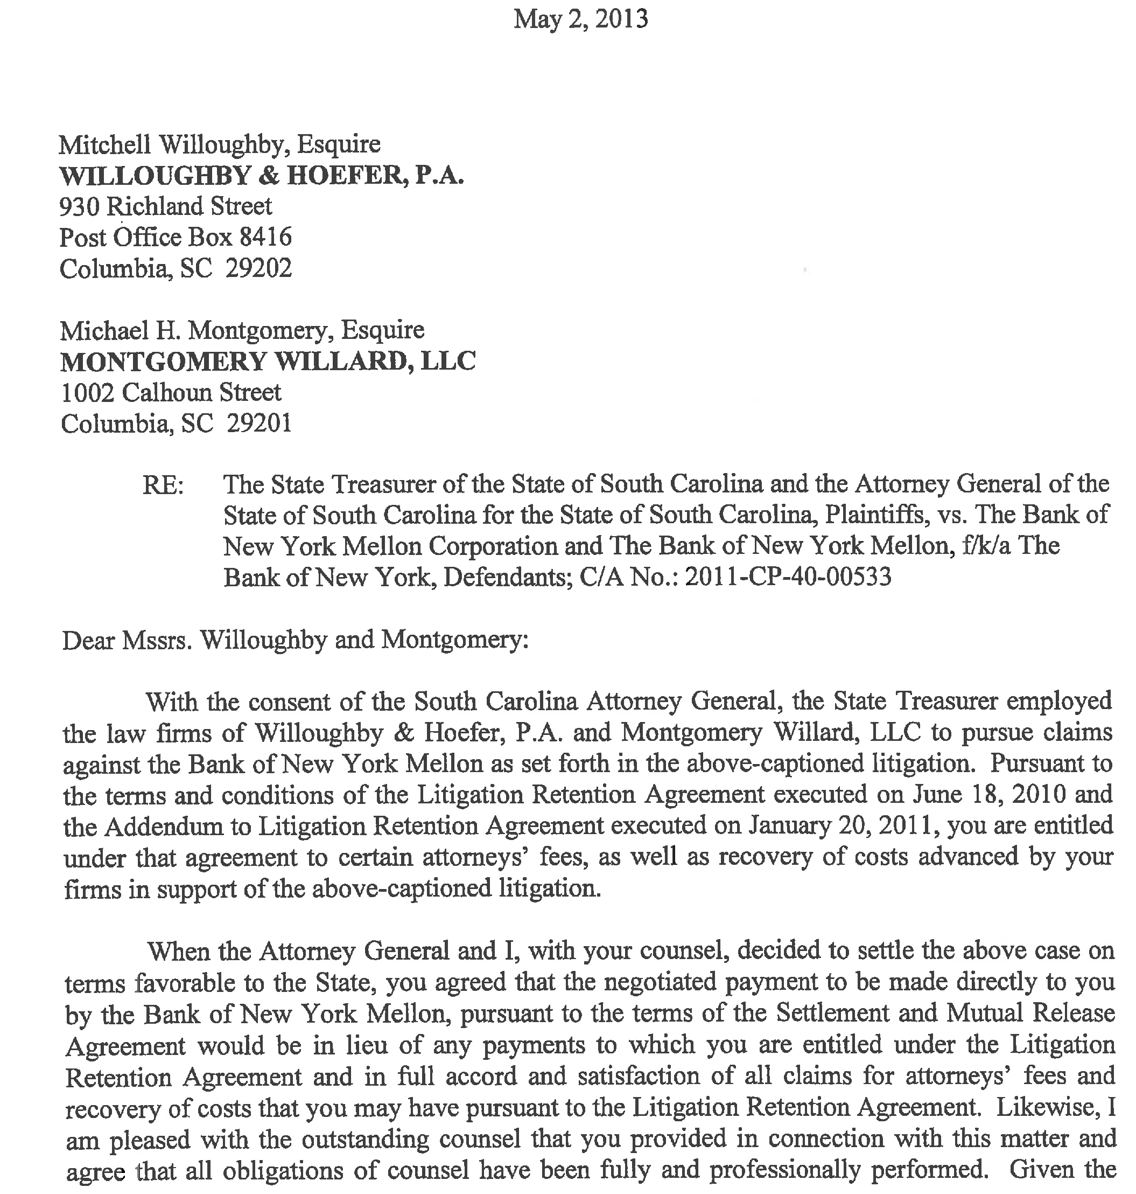
*Page 1 Litigation Retention Agreements: Exhibit F5
28

Slide 29
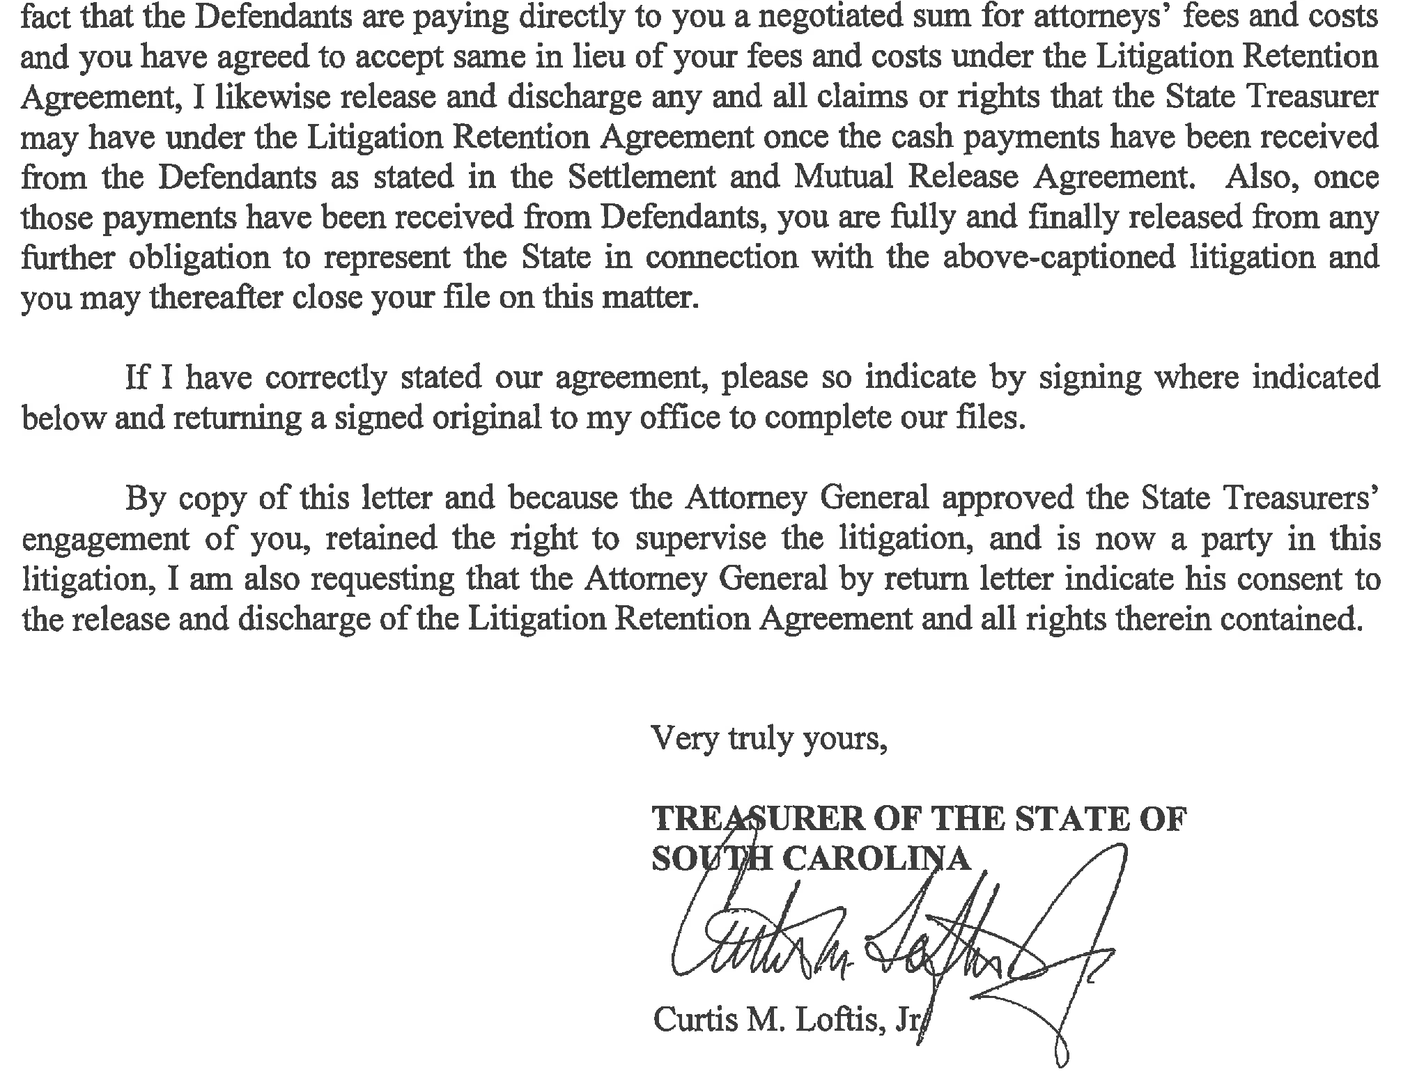
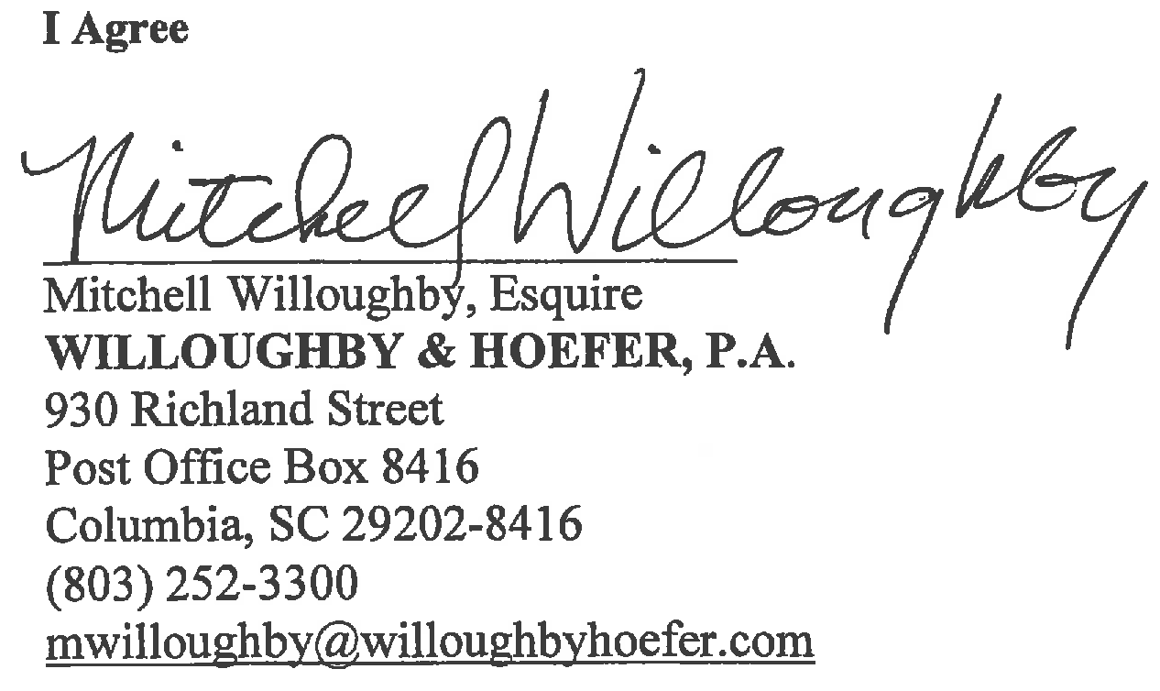
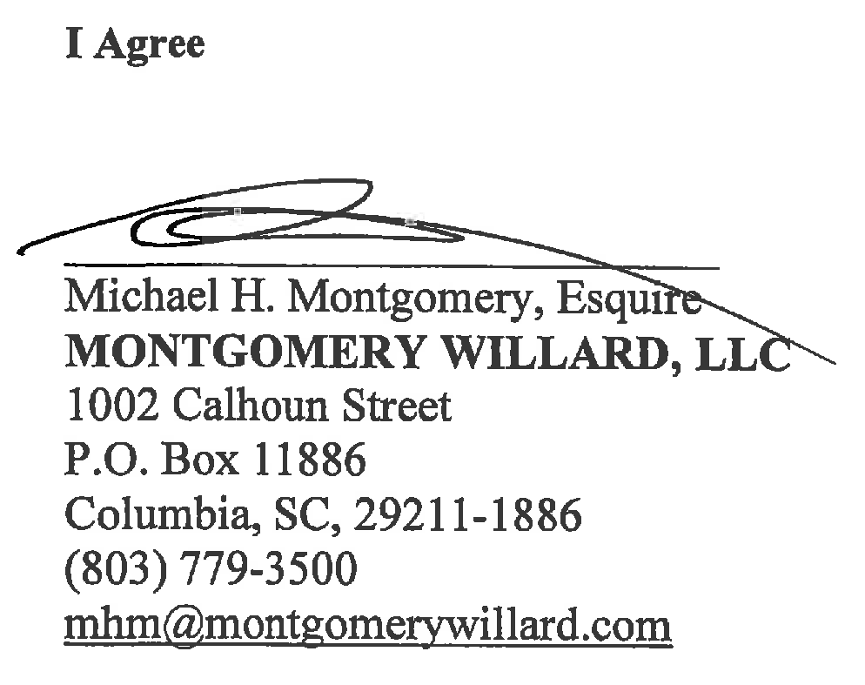
*Page 2 Litigation Retention Agreements: Exhibit F5
29

Slide 30
Brief History of the BNYM Affair
Suspended the lawsuit and then reinstated it after very close friend is added as counsel.
Refused input from the largest user of the service.
Negotiated for services after being told they likely never will be used.
Used the supposed value of those irrelevant services to pay his lawyers.
Became enraged each time he was asked about the value of the settlement and the value of the services.
Refused to explain the value of the services until two weeks ago, and then offered no official documents.
Signed a ten-year deal when the initial proposal was for five.
30

Slide 31
“In summary, Ken Phillips has never had any client complaints and has never been charged by the SEC.”
1-17-2014
“Not only did the SEC decline to charge Ken Phillips with any infraction, but in fact stipulated that he assume the roles of both President and CEO of PMC as part of the settlement agreement. The SEC went further in specifically carving out a provision in the settlement stating clearly that Mr. Phillips was not involved in the trading matter in which they were litigating. Ken Phillips was not barred and was not suspended from the industry. Also, his supervisory privileges were not suspended in any way and he did not pay any fines.”
*Response from Treasurer Loftis to subcommittee question #27
31

Slide 32
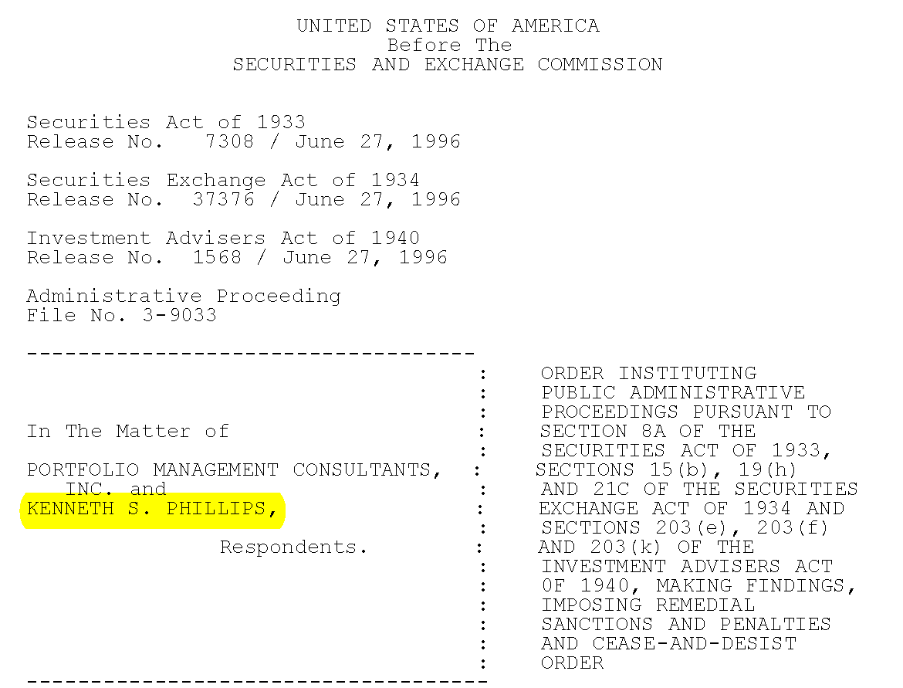
Kenneth Phillips SEC Order
*From Kenneth Phillips SEC Order
32

Slide 33
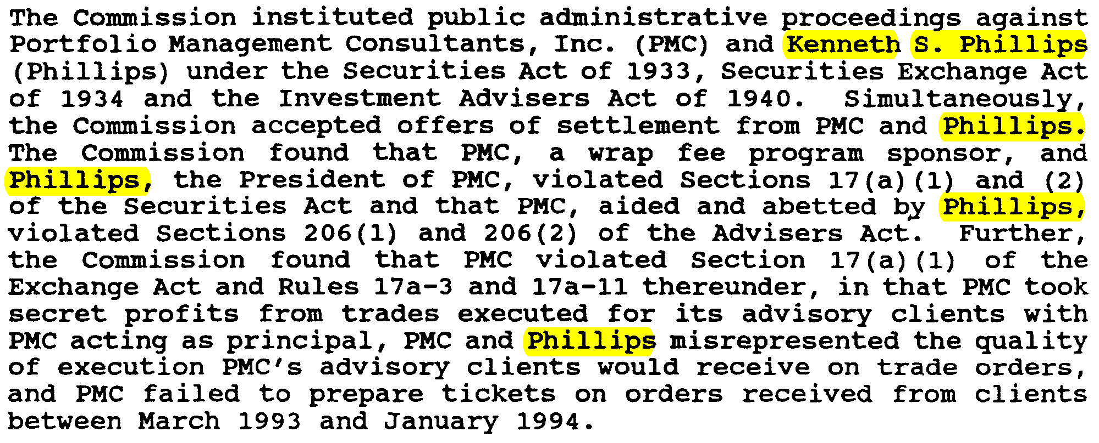
Kenneth Phillips SEC Order
*From SEC News Digest, Issue 96-121, June 27, 1996
33

Slide 34
“…those who didn’t open their envelopes…” 1-30-14
From: Tahiliani, Shakun [mailto:Shakun.Tahiliani@sto.sc.gov]
Sent: Friday, July 31, 2009 11:36 AM
To: Hershel Harper
Subject: South Carolina TsyAccounts at 6-30-09.xls
Hershel, as discussed in the meeting last week, here is the list of asset backed securities held in cash collateral investment portfolio for the State accounts. Please have this reviewed and give us the necessary information.
Thanks,
Shakun
Shakun Tahiliani
Senior Assistant State Treasurer
Phone (803) 734-2641
Fax (803) 734-2697
Email: Shakun.Tahiliani@sto.sc.gov
34

Slide 35
Quote from Mr. Loftis
Mr. Loftis: ...“the Investment Commission, elected not to be a party to this. You know what it took to become a party of this? It took one phone call or one email saying we’d like to be a party of this. They chose not to.” 1-30-14
Neither RSIC nor PEBA was a party to the
contract with BNYM.
RSIC and PEBA had no standing, as the Treasurer is the Custodian.
35

Slide 36
A Pattern of Abuse
SC Inspector General: “The SIG determined that there was no criminal conduct or wrongdoing at the RSIC pertaining to these (remaining) six allegations.”
July 2013
Mr. Loftis: “We lack a moral core….” Loftis continued to state that certain members of the commission have been using the $27 billion as their own cash cow. “These unelected bureaucrats like the way they’ve been doing business,” Loftis said. “They treat the commission like it’s their own baby.”
12-02-2013
36

Slide 37
A Pattern of Abuse
SC Attorney General’s Office: “Based upon my review of this report and its attachments, this Office is declining to proceed with respect to the issues contained in the report.” 10-23-2013
Mr. Loftis: “The conflict of interest was not prosecuted because the investigation did not utilize subpoenas or sworn testimony.”
10-23-2013
37

Slide 38
A Pattern of Abuse
The State (newspaper): “The State Ethics Commission has dismissed conflict-of-interest allegations against the chairman of the South Carolina agency that invests public workers' pension money.”
2-11-2013
Mr. Loftis: “This opinion speaks more to the poor ethics laws in our state than to Mr. Williams’ character. Ultimately, these decisions will be decided in the court of public opinion."
2-11-2014
38

Slide 39
A Pattern of Abuse
SC State Retirees Association President Emeritus,
Wayne Bell: “Since April 2013 the Treasurer has attempted to gain access to our membership and accounting records. When we declined to share the information he reported us to the Ethics Commission, Attorney General’s Office, and the Secretary of State’s Office. We were accused of being unregistered lobbyists, not complying with state laws governing non-profit organizations, and receiving un-reported donations. We met with staff of all three organizations and satisfactorily answered their questions. We are guilty of none of the things of which we had been accused.”
39

Slide 40
A Pattern of Abuse
From: Curtis Gmail <treasurer.loftis@gmail.com<mailto:treasurer.loftis@gmail.com>>
Date: April 11, 2013, 7:48:34 PM EDT
To: Darry Oliver <DOliver@ic.sc.gov<mailto:DOliver@ic.sc.gov>>
Subject: Re: 240-4701
U have forgotten that u wirk for ms. I understand u rendered a legal opinion on my service to thd press, That is disloyally and unethical. Reynolds can talk trash bug u can't.
Curtis M. Loftis, Jr.
State Treasurer, South Carolina
Sent from my iPhone
On Apr 11, 2013, at 7:31 PM, Darry Oliver <DOliver@ic.sc.gov<mailto:DOliver@ic.sc.gov>> wrote:
Curtis, I don't want to ignore your emails but counsel has advised me that if you want to talk about the Warburg funding matter, since the matter is now in litigation all communications should be handled through counsel.
If you want to talk about something else, I can do that. Let me know.
40

Slide 41
A Pattern of Abuse
From: Darry Oliver [mailto: Doliver@ic.sc.gov]
Sent: Monday, September 30, 2013 5:45 PM
To: Loftis, Curtis
Subject: Re: Darry
I would like to speak with you right now if possible on my cell phone. Please call me.
Sent from my iPhone
On Sep 30, 2013, at 5:34 PM, “Loftis, Curtis” Curtis.Loftis@sto.sc.gov > wrote:
  You are responsible for the press operation at the Commission. The AP says it has seen an analysis. It has been referred to in the paper repeatedly. I expect you to get to the bottom of this.
  I am tired of you excuses…and that you know nothing about the press operation or Mr. Varat’s actions, etc. False and misleading information is going out under your watch and this analysis is just one bit of it.
  If you must call AP to get the info then call AP. You are responsible and I do not want more excuses…I want results.
  I want that analysis and I want it now.
  CML
41

Slide 42
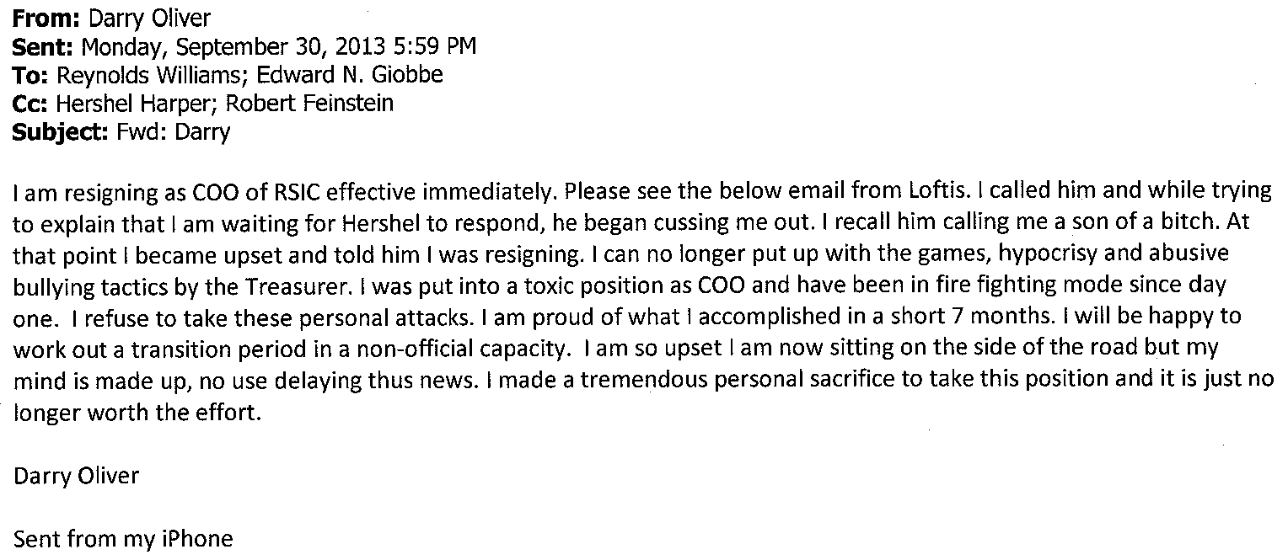
A Pattern of Abuse
42

Slide 43
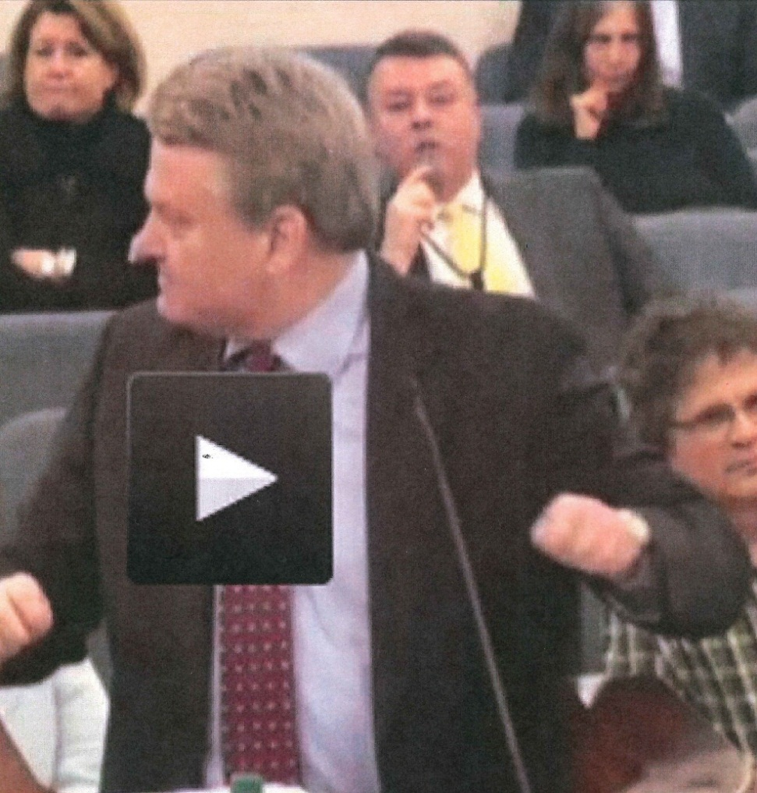
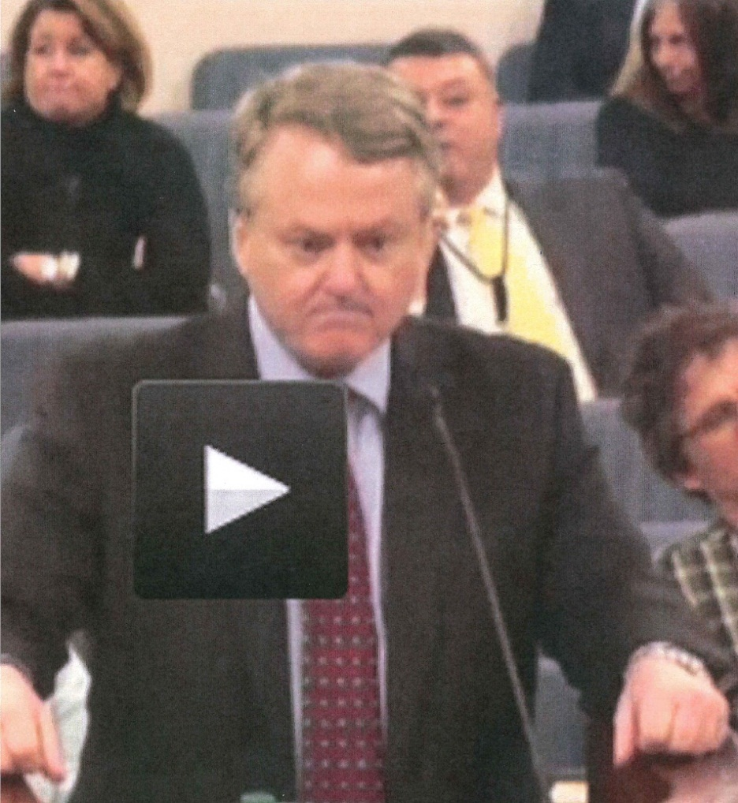
A Pattern of Abuse
Mr. Loftis: “…and this is exactly what I put up with.” 1-30-14
*Pulled from 1-30-2014 subcommittee video
43

Slide 44
Read for Yourself
  # 90-CP-40-0654
    Mr. Loftis (Plaintiff)
44

Slide 45
From SC Inspector General’s Report, July 2013
“This conflict has clearly entered into a counter-productive cycle where it has created workplace atmospherics so toxic that it is increasingly undermining RSIC’s energy and focus on its core mission.”
“The obvious harm is on the people involved in terms of stress, potential turnover, and morale. The less obvious harm can be measured in real dollars through opportunities lost or delayed having a material impact on operations as set forth in this report.”
“Without a doubt, the harm also involves the South Carolina Retirement System beneficiaries and the reputation of the RSIC and the South Carolina State Government.”
45

Slide 46
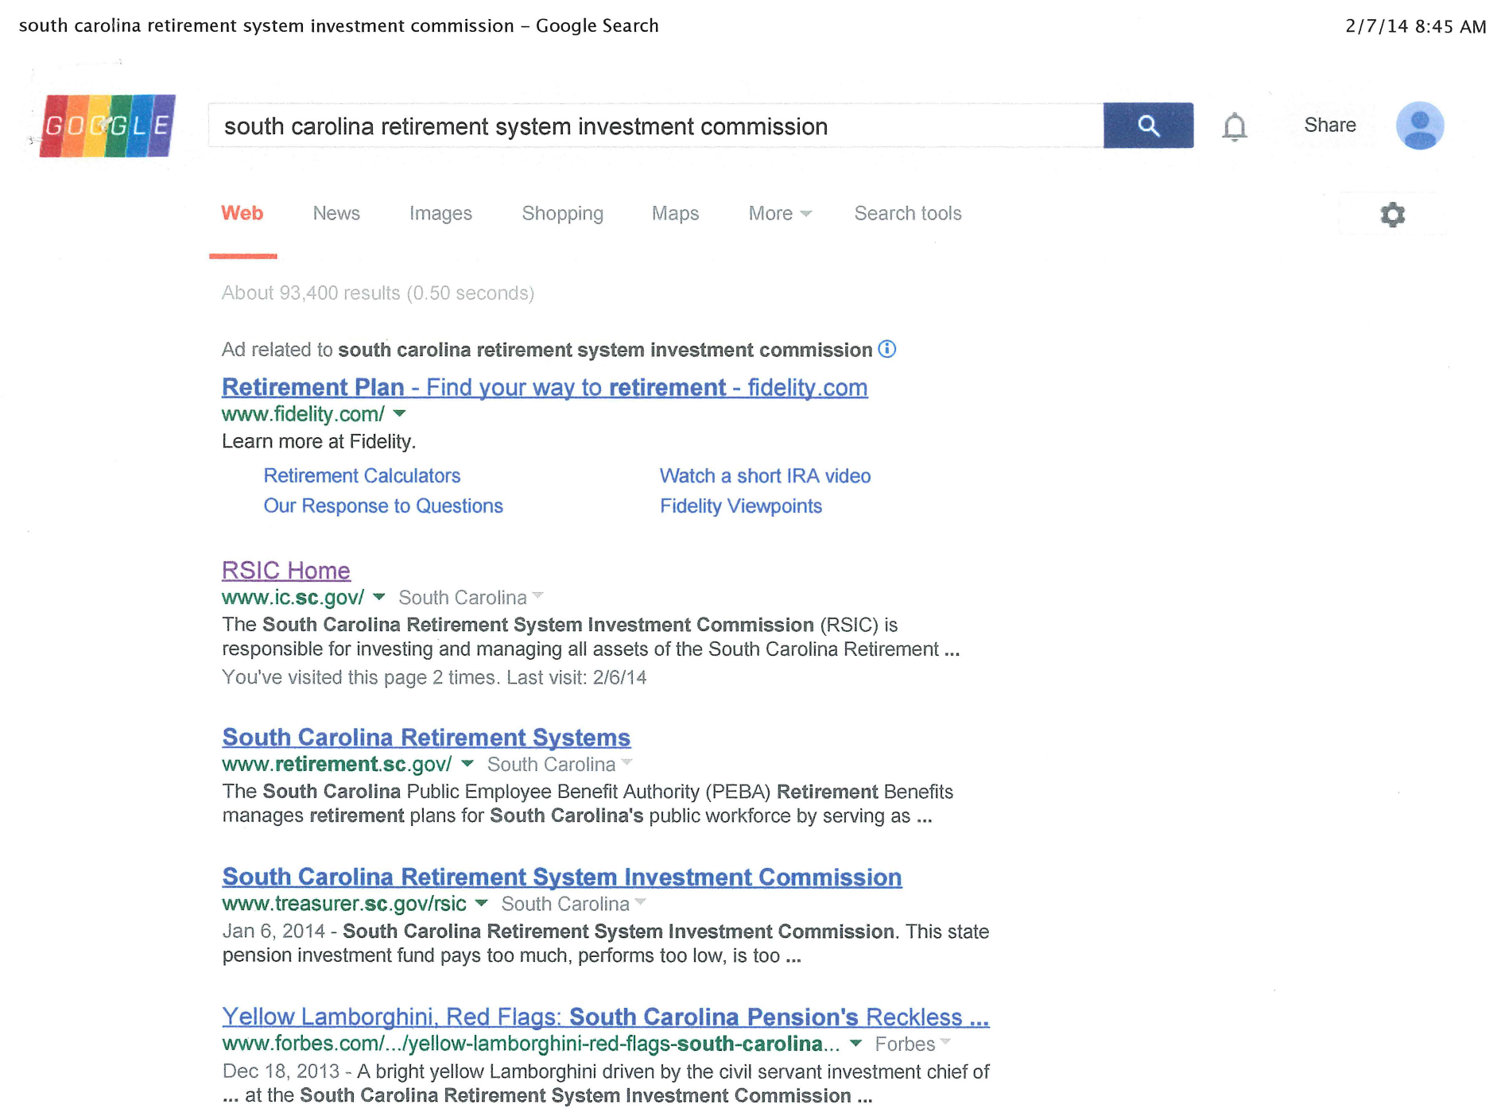
*Google search on 2-7-2014
46

Slide 47
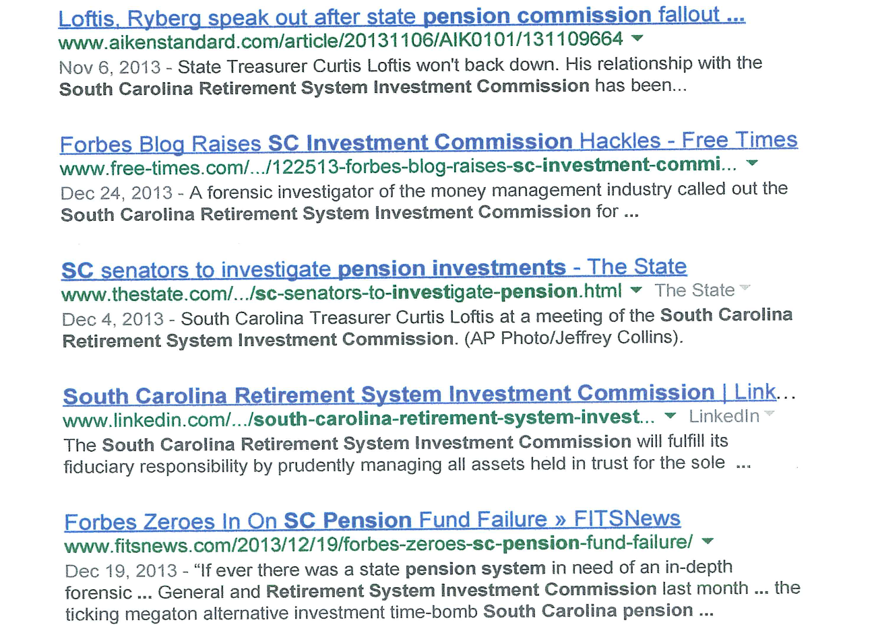
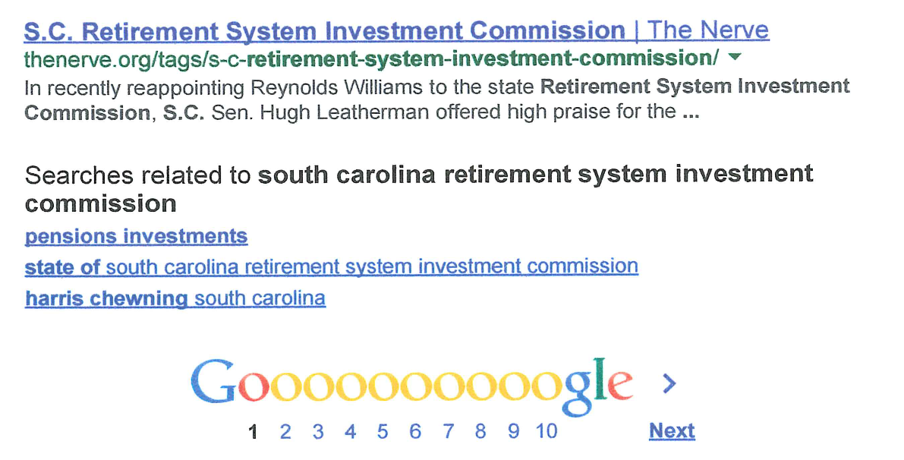
47
*Page 2 of Google Search

