Slide 1

Healthcare Budget Subcommittee
House Ways and Means Committee
South Carolina Department of Alcohol and
Other Drug Abuse Services (DAODAS)
Budget Request Fiscal Year 2019 -2020

Slide 2

OUR MISSION:
To ensure the availability and quality of a continuum of substance use services, thereby improving the health status, safety, and quality of life of individuals, families, and communities across South Carolina.
Notes:
The Agency’s WHAT is spelled out in our Mission, which I don’t expect to change anytime soon.
Our agency exits to ensure the availability and quality of a continuum of substance use services, thereby improving the health status, safety, and quality of life of individuals, families, and communities across South Carolina.

Slide 3
Notes:
Opioid crisis is still the most urgent issue because people are dying so quickly from this disease of addiction.
44k Americans died of an opioid overdose last year.
We again saw an increase in the number of lives lost to the opioid crisis in 2017,
ongoing work across the state to save lives and turn this trend around.
We look a lot at data and a lot at numbers in our work on this, and as you know, it is tremendously important that we not lose perspective that the numbers in this epidemic represent our neighbors, friends, people we love – and this issue (addiction) really disrupts families and communities in such serious and significant ways that can’t be seen in numbers and charts.
We don’t lose the humanitarian perspective in our work at DAODAS.

Slide 4
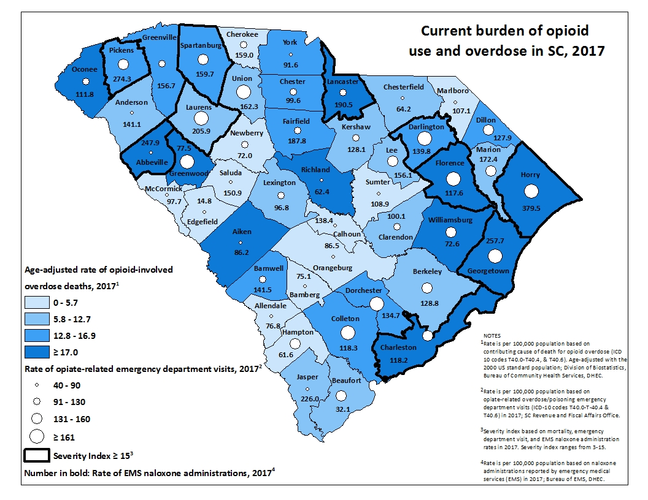
Notes:
Burden Map Trends
. All of the data looked at is applied to the population so that the rural and less populated areas of our state are considered with equity against the highly populated areas.

Slide 5

U.S. Senate Committee on Health, Education, Labor & Pensions
(HELP Committee)
21st Century Cures Act
Ongoing Hearings on the Opioid Crisis
Fiscal Year 2018 Omnibus Appropriations bill
  $3.3 billion to help fight the opioids crisis – increase of $2.55 billion or 244 percent
Notes:
Due to our efforts what we’ve been able to get done with Federal funding

Slide 6

State Targeted Response Grant
State Opioid Response Grant
Recovery Community Organizations
Prevention Programming
Community Coalitions
Overdose Reversal
Peer Support
Treatment
Evidence-Based Practices
Data Collection
Notes:
A lot of support – opportunities – responsibility
Safety net cast out to the most vulnerable in our state.
STR Picking up where SOR left off
Requirements - Data Collection!!! Making sure that the funding, supporting services and programs is making an impact where it is needed

Slide 7

Medication-Assisted
Treatment and Recovery for Opioid Use Disorders
A combination of behavioral therapy and medications
(most commonly methadone, buprenorphine, and naltrexone)

Slide 8
MAT Demand
Treatment Provision
Methadone & Therapy access to 118 Pregnant Women
Notes:
Treatment
We have some hopeful news.
DAODAS has expanded its system’s capacity to provide medication-assisted treatment (MAT) to opioid use disorder patients. A total of 26 local providers and state agency partners are approved to offer MAT therapies and medication access.
We have seen over a 200 percent increase in the last year in the number of patients we are supporting financially to receive the evidence-based treatment for opioid use disorder. These are uninsured patients who would likely not otherwise receive high quality care. This is possible because and of course thanks to the General Assembly and the Governor supporting our budget increase in the last two years. And we are also expanding with the federal funds we have received.
We know medication-assisted treatment is an effective, essential tool in fighting the opioid crisis, and DAODAS has continued working to expand access to it. So far we have been able to greatly increase the number of providers delivering or coordinating this treatment (from only 3 of the county commissions, to nearly all 32). Additionally, we’ve been able to pay for the services of pregnant and postpartum women at the private Opioid Treatment Providers in the state. We know methadone is the gold standard of care for that population in particular. And we’ve expanded coverage beyond those vulnerable women to include indigent patients who need those services.

Slide 9
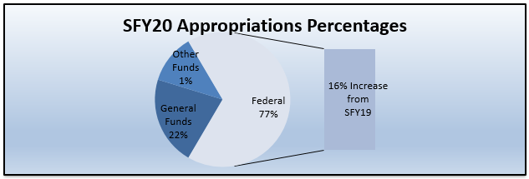
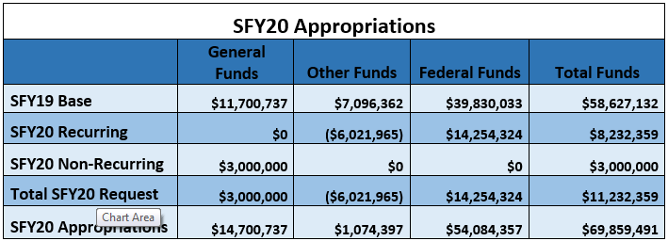
FY2020 Request Overview

Slide 10
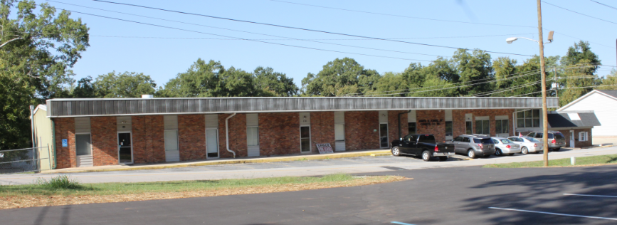
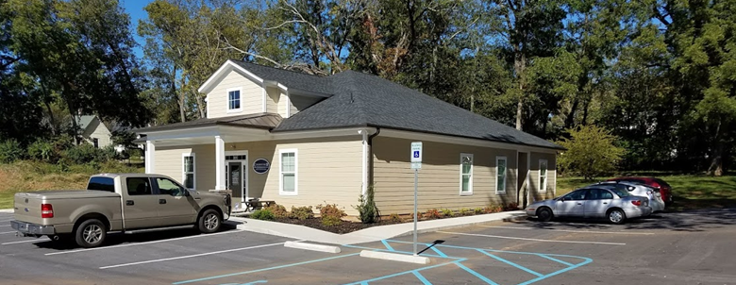

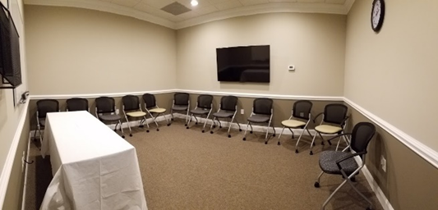
Cornerstone in Abbeville

Slide 11
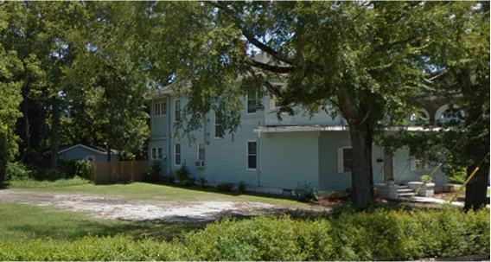
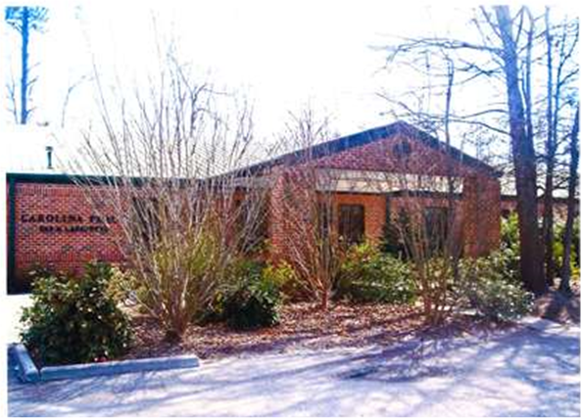
Sumter Women’s Residential

Slide 12
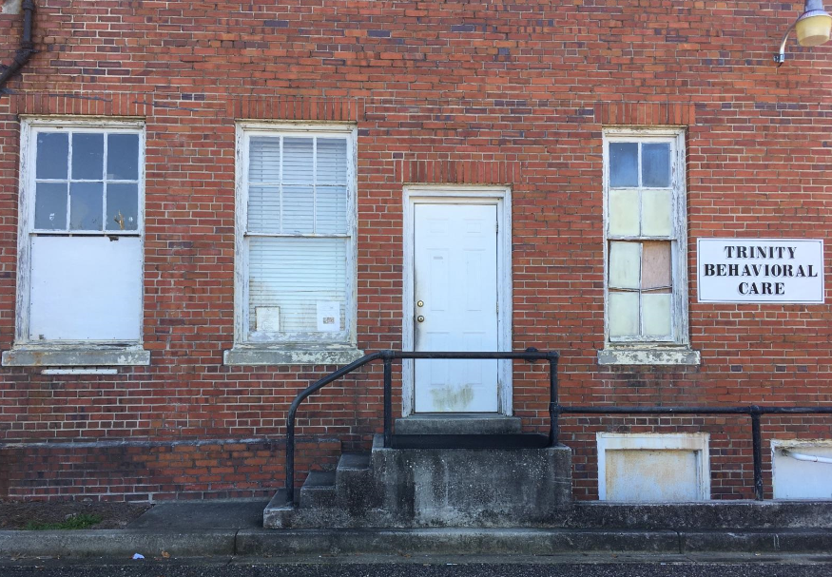
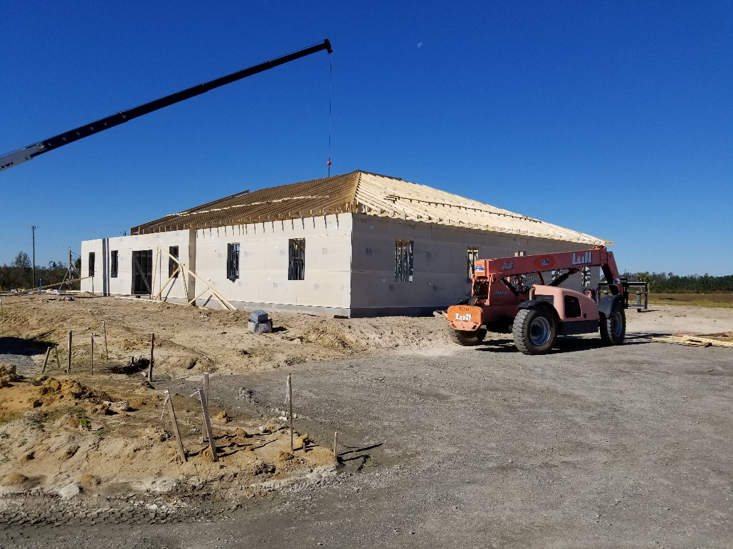
Trinity Behavioral Care in Marion

Slide 13
Summary Budget Request FY 2019-2020
$14.2 Million Increase in Federal Authorizations
(State Opioid Response)
$3 Million for Facility Infrastructure Development
County Alcohol and Drug Authorities
$50,000 Allocation from the Lottery’s Unclaimed
Prize Fund [Section 59-150-230(I)]
$6.2 Million Decrease in Other Fund Authorization
(DSS Drug Testing Program, DHHS Recovery Program
Treatment & Innovation)
Notes:
*** may change

Slide 14

Twelve Step Groups (A.A./N.A)
Church-Based Groups
Outpatient Treatment
Intensive Outpatient Treatment
Medication Assisted Treatment
Residential/Inpatient Treatment
Notes:
Thanks and Closing Remarks
I have brought our Medical Director Dr. Jack Emmel, Board Certified in Family and Addiction Medicine. Has been treating addiction medically for 38 years - available to the committee as a resource today or moving forward.

