Slide 1

SC House Ways and Means
Healthcare Budget Subcommittee
January 29, 2019

Slide 2
South Carolina Center for Rural and Primary Healthcare
Established in 2017 at USC School of Medicine
Mission
Support and develop rural and primary care education, delivery, and sustainability in South Carolina through clinical practice, training and research.
Vision
All South Carolinians will have access to high quality and high value healthcare regardless of where they live.
Collaborative partners
SC DHHS, SC Office of Rural Health, SC AHEC, SC educational institutions
Supported by an Advisory Committee comprised of key stakeholders

Slide 3
South Carolina Center for Rural and Primary Healthcare
Core Objectives:
Support rural and underserved healthcare providers
Provide access to specialized services in rural areas
Improve rural health workforce
Inform rural health strategy, investment, and policy
Innovate to address rural health challenges
Support rural health professions education
Collaborate to address rural health issues

Slide 4
Review of Statewide Rural Health Initiatives
SC CRPH
Policy and Collaboration
ICARED
Workforce Development and Rural Provider Student Loan Program
Evaluation and Research
Multi-disciplinary Collaboration
Practice Micro- Loans and Innovation Projects

Slide 5
Statewide Rural Health Initiatives:
ICARED Program
Rural Practice Student Loan Program
Rural Innovations Program
Rural Practice Micro-Grant Program
Workforce Development
Educational Development
Evaluation and Research
Collaborative projects and initiatives

Slide 6
ICARED
Clinical services delivered to rural communities through “boots on the ground” subspecialists and primary care providers
Pediatric subspecialties
Adult Cardiology
Psychiatry
Immunology/Infectious Disease
Family Medicine
Impact: Close care gaps, improve local access to healthcare

Slide 7
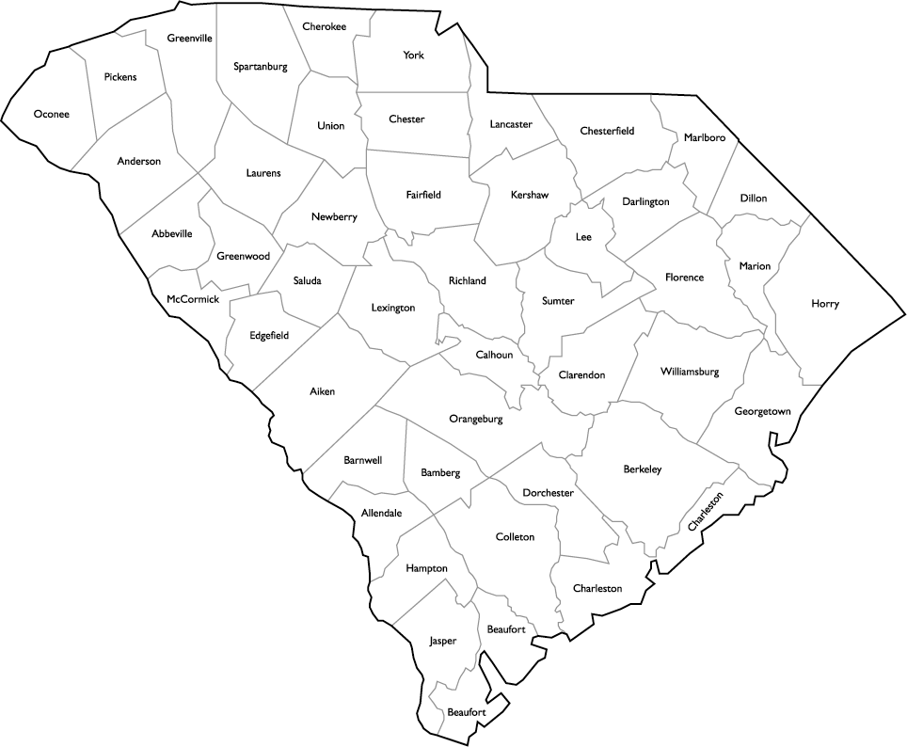

ICARED Sites 2017

Slide 8
ICARED Sites 2018

Slide 9
ICARED Sites 2019

Slide 10
Recruiting Rural Providers
Statewide Loan Program:
Piloted at USC School of Medicine
Statewide program launched 2018
All state-affiliated health professions schools:
MD
Nurse Practitioner
Physician’s Assistant
Requires one year of practice for each year of support
4 years for MD, 3 years for APRN and PA
Primary care and critical need specialties
Impact: Increase rural healthcare workforce

Slide 11
Rural Innovations
A competitive program awarding support to projects statewide
Projects that enhance rural health and healthcare:
Chesterfield Coordinating Council – Community health engagement with local employers to improve health and wellness in the workplace
John A. Martin Primary Health Care Center – Evaluate a weight loss program in a small, rural practice
USC College of Social Work – Training social work students in interprofessional teams to improve rural practice competency and ability to deliver behavioral care
McLeod Family Medicine Residency – improve rural physician capability through enhanced resident procedure training
USC School of Pharmacy – expand pharmacy education into rural practices/communities
USC Infectious Disease – evaluate barriers to HIV PreP (pre-exposure prophylaxis)
Impact: Seed rural health innovation to improve efficiencies, capacity, and access to health services

Slide 12
Collaborative Projects
Micro-grant program supporting rural practices
Enhancing mental and behavioral Health Training
Statewide Maternal-Fetal Medicine collaboration
CVS Pharmacy Pilot
AHEC SCRIPT

Slide 13
SCCRPH Impact Sites 2019

Slide 14
Evaluation and Research
Conducting a detailed analysis of rural health resources in SC
Leverage into a public use database
Help inform
Communities
Policy makers
Providers
Leaders
Impact: Inform rural interventions

Slide 15
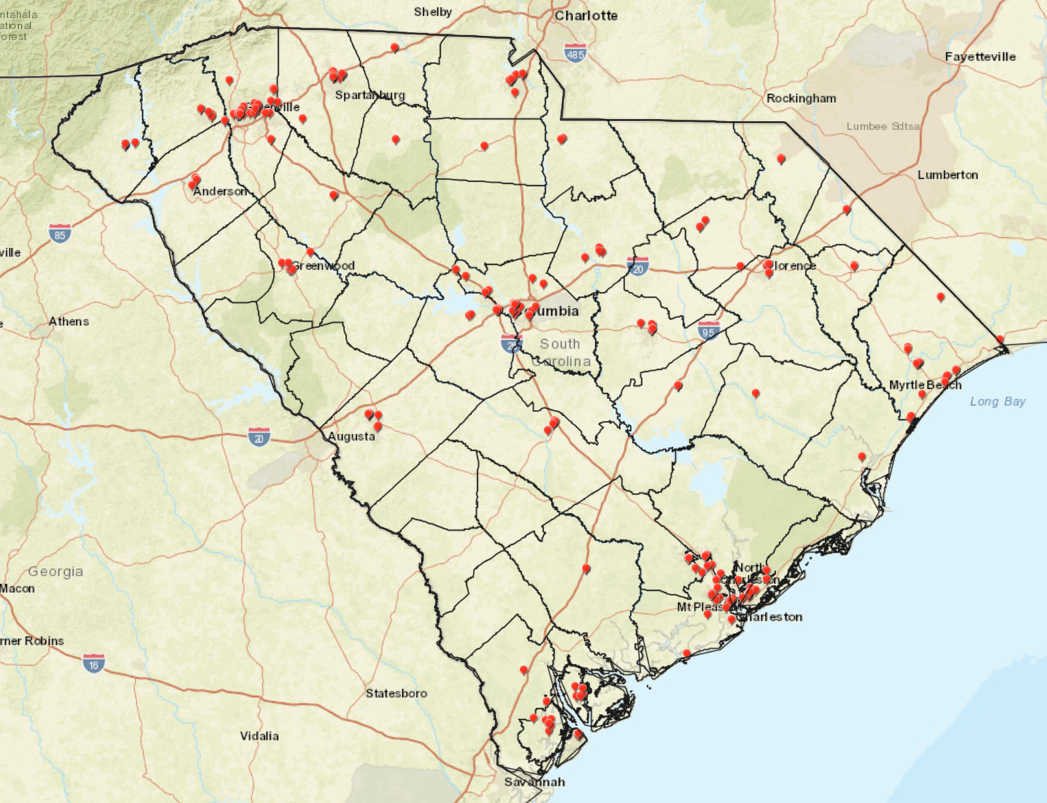
Obstetric/Gynecology Providers in SC, 2018

Slide 16
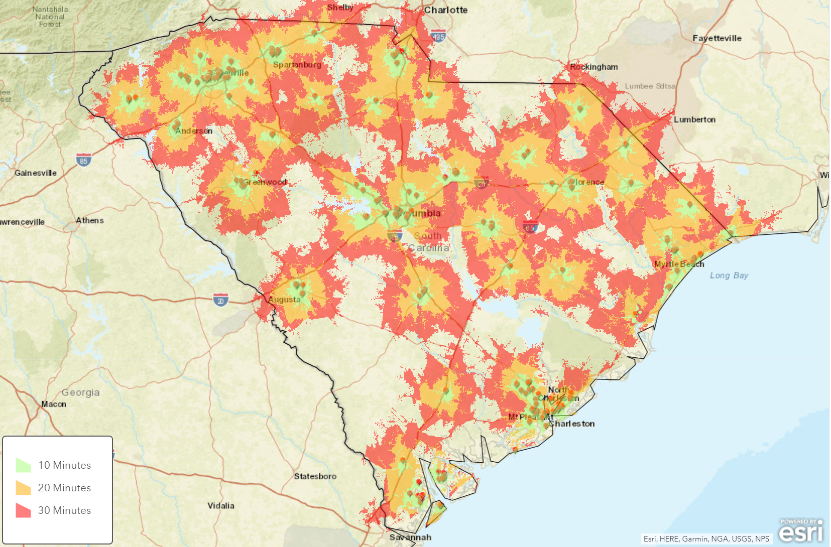
Travel Times to Closest Obstetric/Gynecology Providers in SC, 2018*
*Travel time based on traffic
at 9 am Monday morning

Slide 17
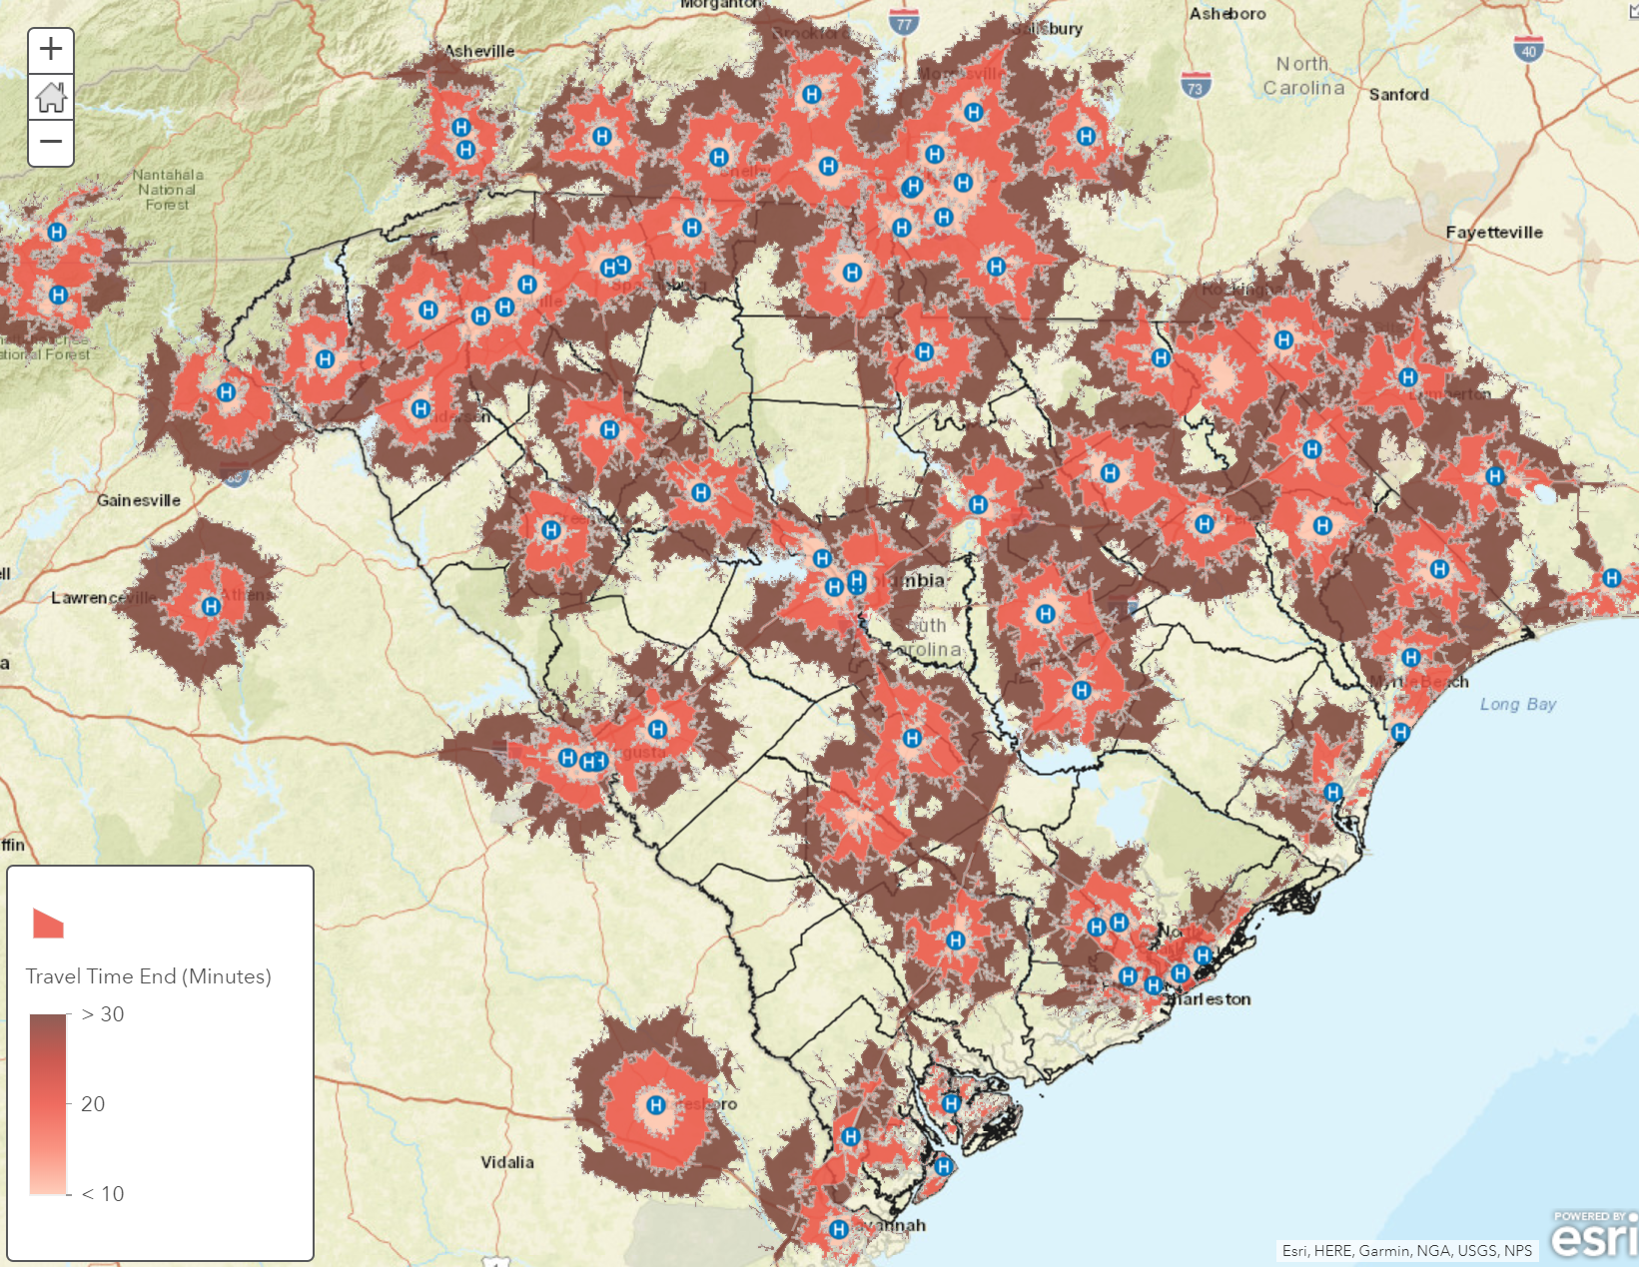
Travel time to Hospitals with Obstetric Units in SC and surrounding areas, 2018

Slide 18
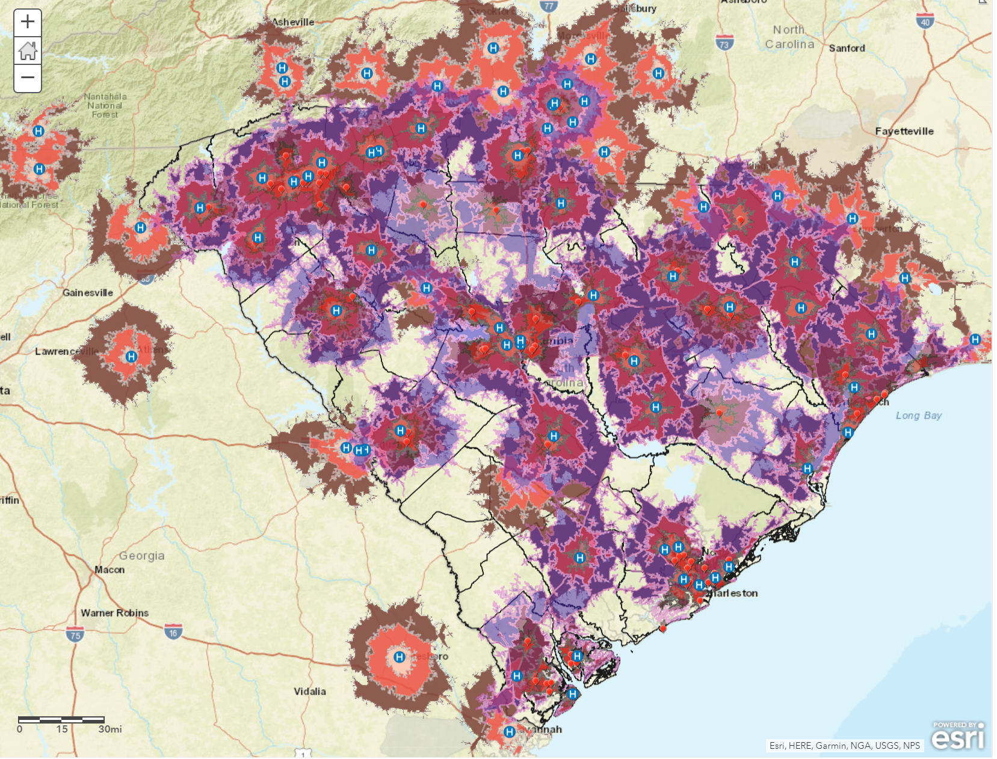
Travel time to Either Obstetric Units or Obstetric/Gynecology Providers in SC, 2018

Slide 19
Thank you We welcome any questions www.sc.edu/ruralhealthcare

