Slide 1
Public Involvement
Email subscriptions
Contact@psc.sc.gov
Public Testimony prior to Merits Hearing
Public Night Hearings
Intervention
Public Comments
Consumer Information Tab
Twitter
Press Releases

Slide 2
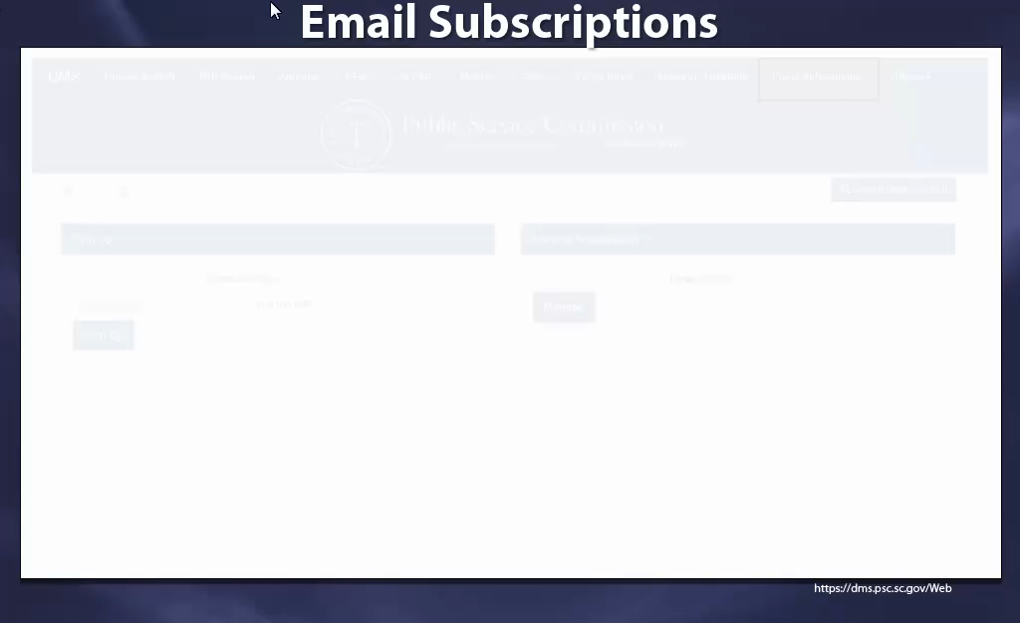
Email Subscriptions

