Slide 1
Renewable Portfolio Standards Across U.S.
WA: 15% x 2020*
VT: (1) RE meets any increase in retail sales x 2012; (2) 20% RE & CHP x 2017
ME: 30% x 2000
New RE: 10% x 2017
MT: 15% x 2015
MN: 25% x 2025
(Xcel: 30% x 2020)
NH: 23.8% x 2025
OR: 25% x 2025 (large utilities)*
5% - 10% x 2025 (smaller utilities)
ND: 10% x 2015
MI: 10% + 1,100 MW x 2015*
MA: 22.1% x 2020 New RE: 15% x 2020 (+1% annually thereafter)
SD: 10% x 2015
WI: Varies by utility; 10% x 2015 statewide
NY: 29% x 2015
RI: 16% x 2020
NV: 25% x 2025*
IA: 105 MW
CT: 23% x 2020
OH: 25% x 2025†
PA: ~18% x 2021†
CO: 30% by 2020 (IOUs)
10% by 2020 (co-ops & large munis)*
WV: 25% x 2025*†
CA: 33% x 2020
IL: 25% x 2025
NJ: 22.5% x 2021
UT: 20% by 2025*
KS: 20% x 2020
VA: 15% x 2025*
MD: 20% x 2022
MO: 15% x 2021
DE: 20% x 2020*
AZ: 15% x 2025
OK: 15% x 2015
NC: 12.5% x 2021 (IOUs)
10% x 2018 (co-ops & munis)
DC
DC: 20% x 2020
NM: 20% x 2020 (IOUs)
10% x 2020 (co-ops)
TX: 5,880 MW x 2015
29 states + DC have an RPS
(7 states have goals)
HI: 40% x 2030
State renewable portfolio standard
Minimum solar or customer-sited requirement
State renewable portfolio goal
*
Extra credit for solar or customer-sited renewables
Solar water heating eligible
†
Includes non-renewable alternative resources
Notes:
29 states + DC have an RPS
(7 states have goals)
Availability of renewable resources varies significantly across the country. energy requirements are best addressed at the state level rather than the federal level
Renewable Portfolio Standards, Clean Energy Standards, Renewable Energy Standards have been adopted in 29 states

Slide 2
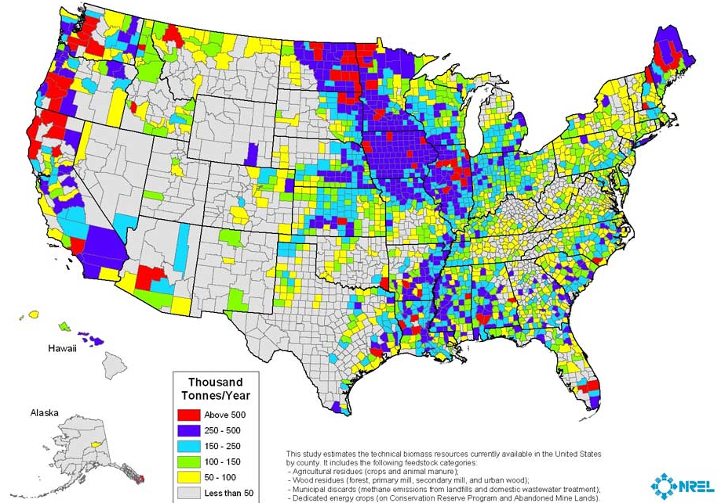
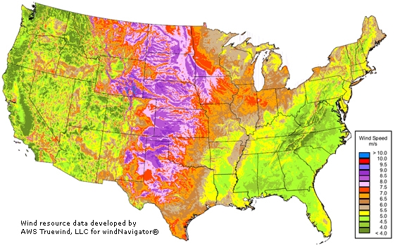
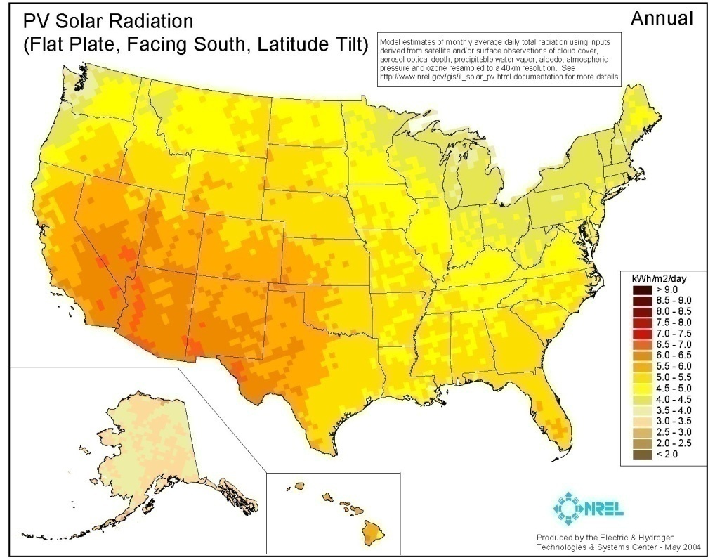
Renewable Resource Availability Varies by Region
Biomass
Renewable Portfolio Standards, Clean Energy Standards, Renewable Energy Standards have been adopted in 29 states
Renewable resources vary considerably nationally
Resource availabillity significant impacts feasibility and cost, as well as policy design
Renewable Resource Assessment tailored to South Carolina resource base is essential starting point
Solar PV is rapidly becoming cheaper but other resources, such as biomass direct firing, continue to face regulatory challenges
Wind
Solar
**Please see attached slides for clearer view
Notes:
Key trends we see related to specific renewable resources include:
Solar Photovoltaic prices are continuing a downward trend & becoming more cost competitive
Woody biomass is cost effective and abundant, but faces challenges on the regulatory front
Onshore wind will continue to dominate new development at the national level, but will be limited in certain regions (e.g. Carolinas, Kentucky) by either lack of wind resources or legal constraints

Slide 3
Wind

Slide 4
Biomass

Slide 5
Solar

