Slide 1



Getting There From Here:
State Options for Transportation Funding and Infrastructure Management
Presentation to the South Carolina House Transportation Infrastructure
and Management Ad-Hoc Committee
October 30, 2014
Jim Reed, Group Director – Environment, Energy and Transportation, NCSL

Slide 2
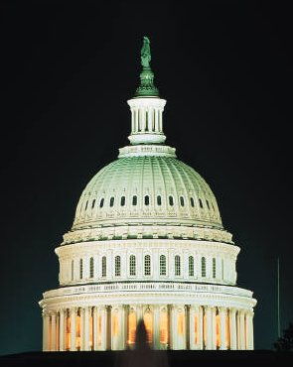
Transportation Funding Crisis
Chronic funding gaps
Years of underinvestment
Aging infrastructure
Growing transportation demand
Declining gas tax revenues
Political reluctance to raise gas tax
National recession
State budget shortfalls
Uncertainty of federal program
2

Slide 3
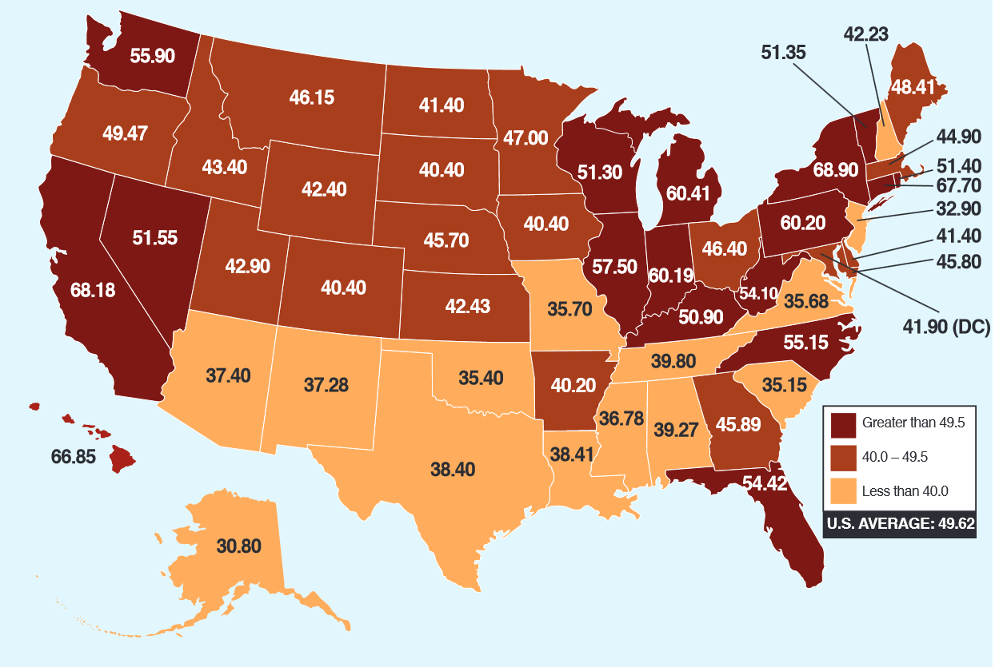
Combined Gasoline Tax Rates
As of July 1, 2014, state gas tax rates ranged from $0.08 in Alaska* to about $0.51 in New York.
Nationwide, the average state gas tax is 31.22 cents per gallon.
SC = $0.16
* Plus local sales taxes for cities and boroughs
Source: American Petroleum Institute, 2014.

Slide 4
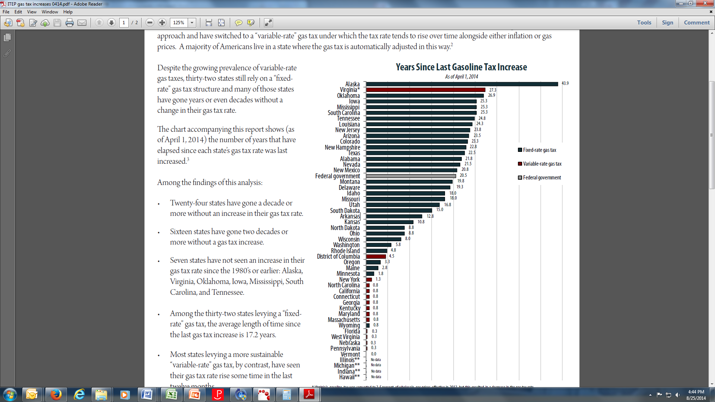
The Value of the Gas Tax has Fallen, South Carolina too.
As of April 2014, 16 states had not raised their gas taxes in more than 20 years
No state legislature raised a gas tax in 2010, 2011 or 2012
As of 2011, the value of the average state’s gas tax had fallen by 20 percent since it was last increased (a nationwide loss of $10 billion each year)
Small increases lagged behind funding needs
4
Sources: CSG, 2011; ITEP, 2011 and 2014; American Petroleum Institute, 2014.

Slide 5
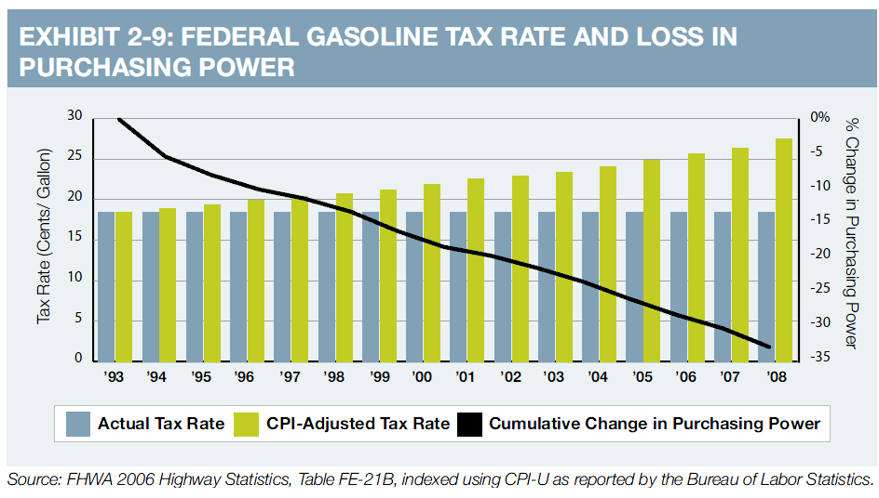
The Federal Gas Tax is Also Falling
For the Same Reasons as (Most) State Gas Taxes
5

Slide 6
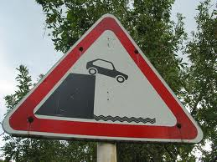
Transportation Faces Its Own Fiscal Cliff
The current federal surface transportation law (MAP-21) is on a short-term extension through May
The federal Highway Trust Fund is still unstable, even if the immediate insolvency crisis was averted
Legislators express skepticism about future help from the federal government
  Image from ridelust.com
6

Slide 7
The Question States are Asking
NCSL recognizes that the federal government plays a vital role and that the federal program should be continued and preserved …
… at the same time, the question continues to be: How can states provide needed transportation infrastructure in a time of uncertainty … with or without long-term, sustainable federal programs?
7

Slide 8
Transportation Infrastructure Investment is a Top State Issue
In 2013 and 2014, at least 748 relevant bills considered in every state and D.C.
Mentioned in at least 22 governors’ “State of the State” addresses in 2014
Identified by state legislative fiscal officers and NCSL Executive Committee as one of their top issues
8

Slide 9

Three Trends as States Seek
Sustainable Transportation Funding
Putting every option on the table
Tracking with the economy
Capturing all users
9

Slide 10
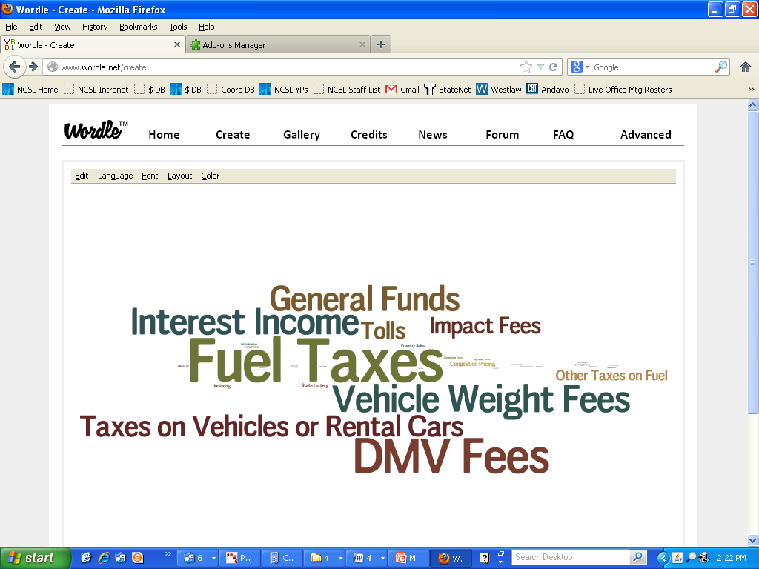
How Have States Funded Surface Transportation?
Note: States provide about half of all funding for roads, bridges, rail and transit—
compared to the federal contribution of about 20 percent.
10

Slide 11
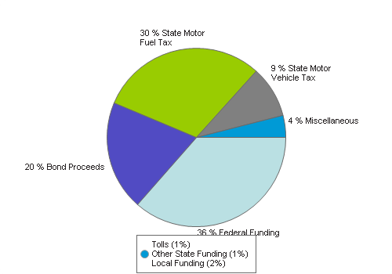
South Carolina 2010 Snapshot
11

Slide 12
Rank: State Controlled Miles
1. Texas: 80,476
2. North Carolina: 80,456
3. Virginia: 58,355
4. South Carolina: 41,584
5. Pennsylvania: 41,147
Average: 16,286

Slide 13
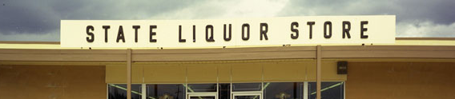
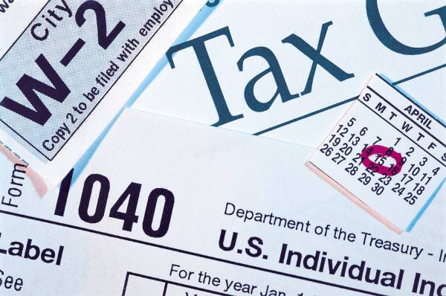
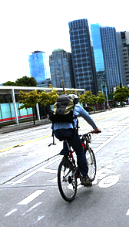
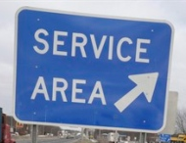


Trend 1:
Putting Everything on the Table
In recent years, legislatures have looked at many other options for transportation funding, from the traditional to the unprecedented.
13

Slide 14
Menu of Funding Options
Additional general fund
Sales tax dedication
Eliminating transportation revenue diversions to other uses.
Increase the gas tax or index the gas tax to inflation.
Add a motor fuels sales tax dedicated to transportation.
Increase motor vehicle registration and driver's license fees.
Severance tax
Casino tax
Naming Rights
Development agreements
Vehicle Miles Traveled Fee

Slide 15
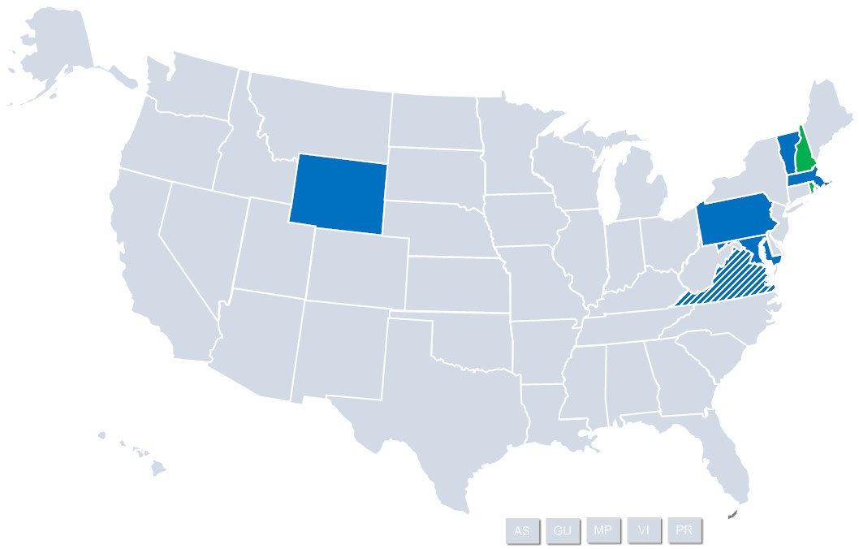
Trend 2: Tracking with the Economy
PA HB 1060
NH SB 367
(a simple increase with a nod to the economy)
VT HB 510
WY HB 69
(the only simple gas tax increase in 2013)
MA HB 3535
RI HB 7133
(indexing only)
 | 2013
 | 2014
MD HB 1515
DC B 199
VA HB 2313
15

Slide 16
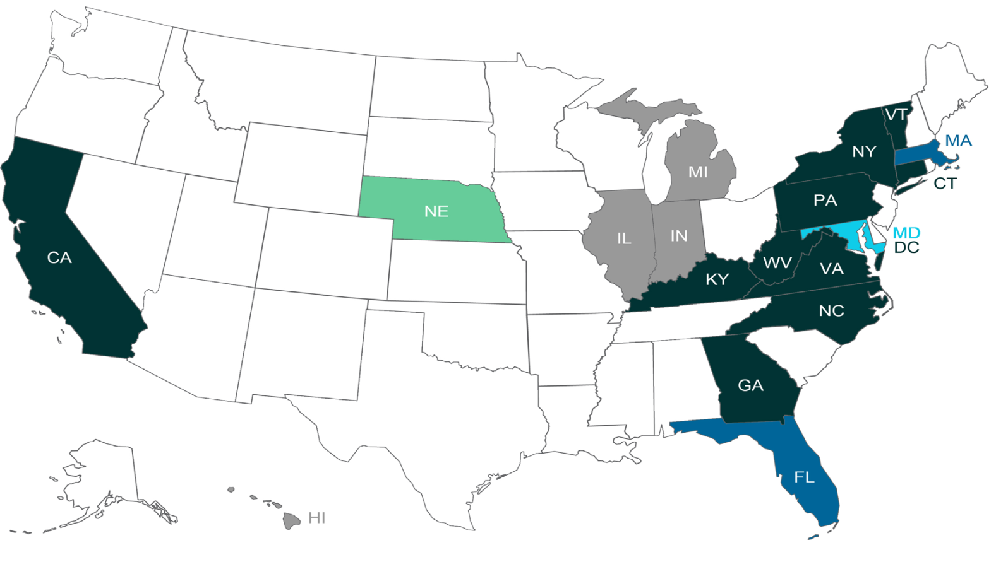

15 States and D.C. Now Have
Variable-Rate Gas Taxes
Plus R.I. as the 16th
(starting in 2015)
16
Source: ITEP, 2014; 2014 R.I. HB 7133.

Slide 17
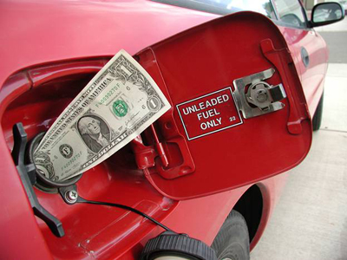
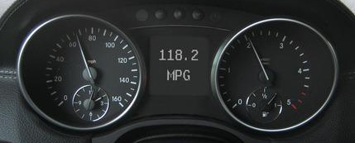
Is Raising Gas Taxes Enough?
“Even without alternative fuel vehicles, the fuel tax won’t keep pace and the system just won’t work.”
Sen. Bruce Starr, Ore.
“With higher efficiency standards and alternative fuel vehicles, government cannot continue to rely on the gas tax as a revenue source.”
Speaker Bill Howell, Va.
“The gas tax will always play a role in funding our transportation system, but eventually we will have to look at more stable sources as well.”
Rep. Judy Clibborn, Wash.
17

Slide 18
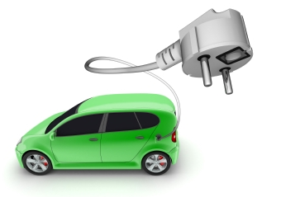
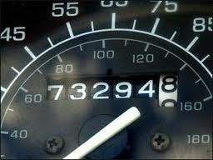
Trend 3:
Capturing All Users
Fees for alternative fuel vehicles or electric vehicles
Taxes on alternative fuels
Mileage-based user fees (also known as vehicle miles traveled or VMT fees)
18

Slide 19
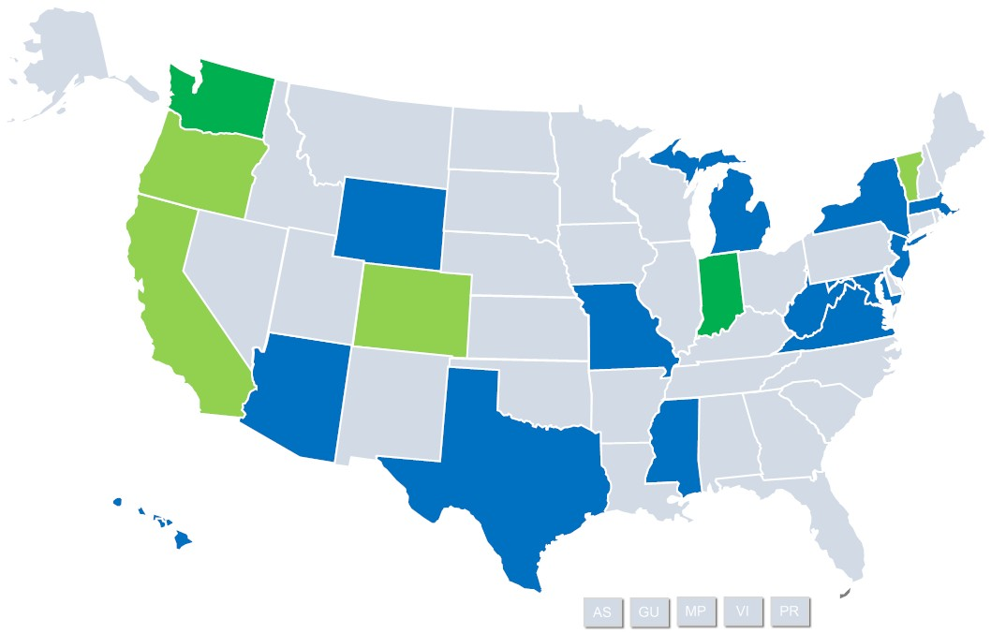
VMT Fee Legislative Activity
CO SJR 37 (2011)
IN HB 1104 (2014)
WA HB 2190 (2012)
WA SB 6001 (2014)
VT HB 770 (2012)
OR SB 810 (2013)
 | Considered
 | Enacted
 | Enacted in 2014
CA SJR 5 (2011)
At least 55 VMT-related bills have been
introduced in 19 states since 2008.
19

Slide 20

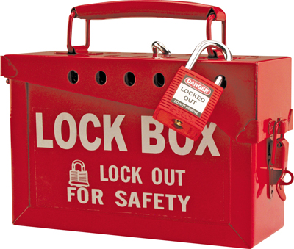
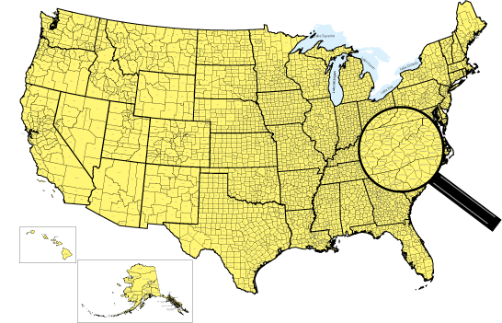
What Else Are States Considering?
Agency Consolidation
Revenue protection
Financing
Local flexibility
20

Slide 21
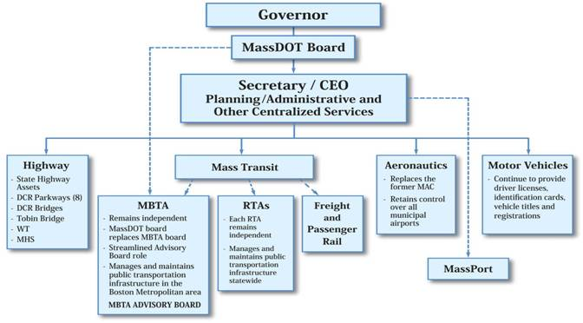
MassDot Creation 2009
Notes:
MassDOT represents a merger of the Executive Office of Transportation and Public Works (EOT) with the Massachusetts Turnpike Authority (MTA), the Massachusetts Highway Department (MHD), the Registry of Motor Vehicles (RMV), the Massachusetts Aeronautics Commission (MAC) and the Tobin Bridge. In addition, the Massachusetts Bay Transportation Authority (MBTA) and Regional Transit Authorities (RTA) are subject to oversight by the new organization. The new organization also assumed responsibility for many of the bridges and parkways formerly operated by the Department of Conservation and Recreation (DCR).

Slide 22
Impact of Mass. Reorganization
Improved Management: Development and use of performance metrics in project planning and delivery
Culture of Innovation
Better internal and external communication
Sufficient revenue still lacking
Much work remains
Source: 2013 Report by Mass. Taxpayers Fdn and Mass. Business Roundtable

Slide 23
Revenue Protection
35 states protect transportation revenues through the constitution or statute

Slide 24
How Have States Financed Surface Transportation?
General obligation or revenue bonds (44 states + DC + PR)
Design-build (authorized in 38 states + PR)
State infrastructure banks (SIBs) (34 states + PR)
Public-private partnerships (PPPs or P3s) (authorized in 33 states + PR)
TIFIA federal credit assistance (12 states + PR)
GARVEE bonds (33 states + DC + PR)
Private Activity Bonds (PABs) (6 states)
These tools leverage or borrow against transportation revenues. None of them—
including public-private partnerships (PPPs or P3s) —generate new revenues for states.
24

Slide 25
Local
    Local sales tax option for transportation
    Impact fees
    Gas tax add-on
    Special Transportation Districts/Authorities
25

Slide 26

Contact Details and Resources
NCSL is always seeking public and private funding partners for collaborative research and outreach initiatives that serve the needs of state legislatures.
Besides no-cost technical assistance to state legislative entities upon invitation, we also provide responses to individual requests for information.
Please contact us if you're interested.
Jim Reed
NCSL Environment, Energy and Transportation Program
Direct line: 303-856-1510
Jim.reed@ncsl.org
For details about specific state bills, see NCSL's online, searchable Transportation Funding and Finance Legislation Database:
http://www.ncsl.org/default.aspx?TabId=25720
26

