Slide 1
Fairness & Opportunity:
Bringing Student-Centered Education Funding To South Carolina Students
Matthew Joseph
December 2019

Slide 2
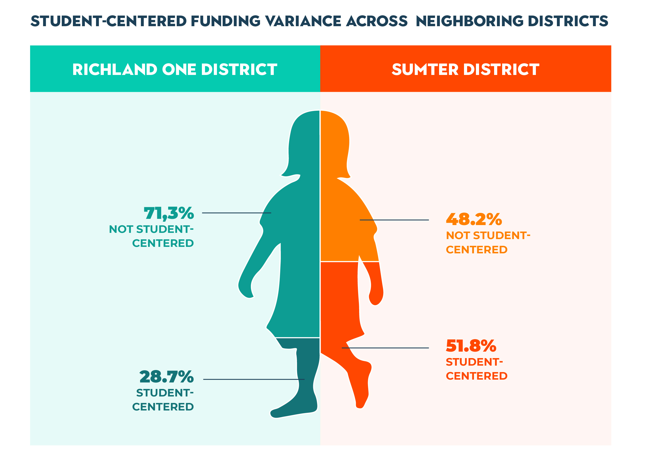
Summary of Study Findings
58 percent of funding in South Carolina is not student-centered, meaning that it is not based on the number and characteristics of students served. It can be higher in specific districts. This finding holds true for charter schools in South Carolina, brick-and-mortar, virtual, state-authorized and locally-authorized.

Slide 3
Principles of Student-Centered Funding
Student-centered funding means that all districts and schools are fairly funded based on the number and type of students they serve. Funding is not student-centered when it is locked into staffing positions, programs, districts or schools.
1
Every district and school receives the same base funding for each student they serve.
4
The amount of funding schools receive depends, in part, on student performance, so that districts and schools are encouraged to innovate and rewarded for success.
2
Additional funding is provided for serving students with disadvantages or special needs.
5
Districts and schools have significant flexibility in how they use the funding they receive, but they are held accountable for student learning and can learn from similar districts and schools that are performing better with the same or less funding.
3
All districts and schools, including traditional public schools and public charter schools, are equitably funded.

Slide 4
Benefits of Student-Centered Funding
Student-centered funding is more transparent, empowers districts and parents, is fairer, and incentivizes innovation and success.
1
More transparent. Easy to understand how much and why.
4
Fairer. All students receive similar resources, based on need.
2
Empowers district and school leaders. Flexibility to meet the unique needs of their students.
5
Incentivizes innovation and success. Focus is on outcomes, not inputs.
3
Empowers parents. Choosing the best school for their children while keeping critical services.

Slide 5
Overview of Education Funding in South Carolina
School funding in South Carolina is extraordinarily complex, with a multitude of funding streams each of which has its own allocation methodology.
1
$11,850 per student
4
Very complex array of additional funding
2
$1,500 above the average of southeastern states
5
Lack of transparency for districts
3
Straight forward core funding formula
6
Even less information on charter school funding

Slide 6
Student-Centered Funding in South Carolina
In South Carolina, 40 percent of funding is student-centered. This means that $6,844 out of $11,850 in funding per student is not based on the number or type students served by a district.
1
Local funding outside of formula
4
Transportation funding
2
State funding in lieu of local taxes
5
Various staff positions, programs and schools
3
Salary supplements & teacher supplies
6
No performance-based funding

Slide 7
Two Neighbors: Richland One and Sumter
In Richland One, 28.7 percent of funding is student-centered. This has profound implications for Richland One and neighboring Sumter.

Slide 8
Two Neighbors: Richland One and Sumter
In Richland One, 28.7 percent of funding is student-centered. This has profound implications for Richland One and neighboring Sumter.
Revenue | Richland One | Student-Centered | Not Student-Centered | Sumter | Student-Centered | Not Student-Centered
State & local formula; at-risk students; teacher fringe benefits | $4,549 | $4,549 |  | $4,770 | $4,770
Additional local funding | $9,505 |  | $9,505 | $2,453 |  | $2,453
State reimbursement for eliminated local taxes | $885 |  | $885 | $1,265 |  | $1,265
State funding for teacher retirement and salaries | $739 |  | $739 | $543 |  | $543
State funding for staffing, programs and schools | $197 |  | $197 | $184 |  | $184
Total | $15,875 | $4,549 | $11,326 | $9,216 | $4,770 | $4,446
 |  | 28.7% | 71.3% |  | 51.8% | 48.2%

Slide 9
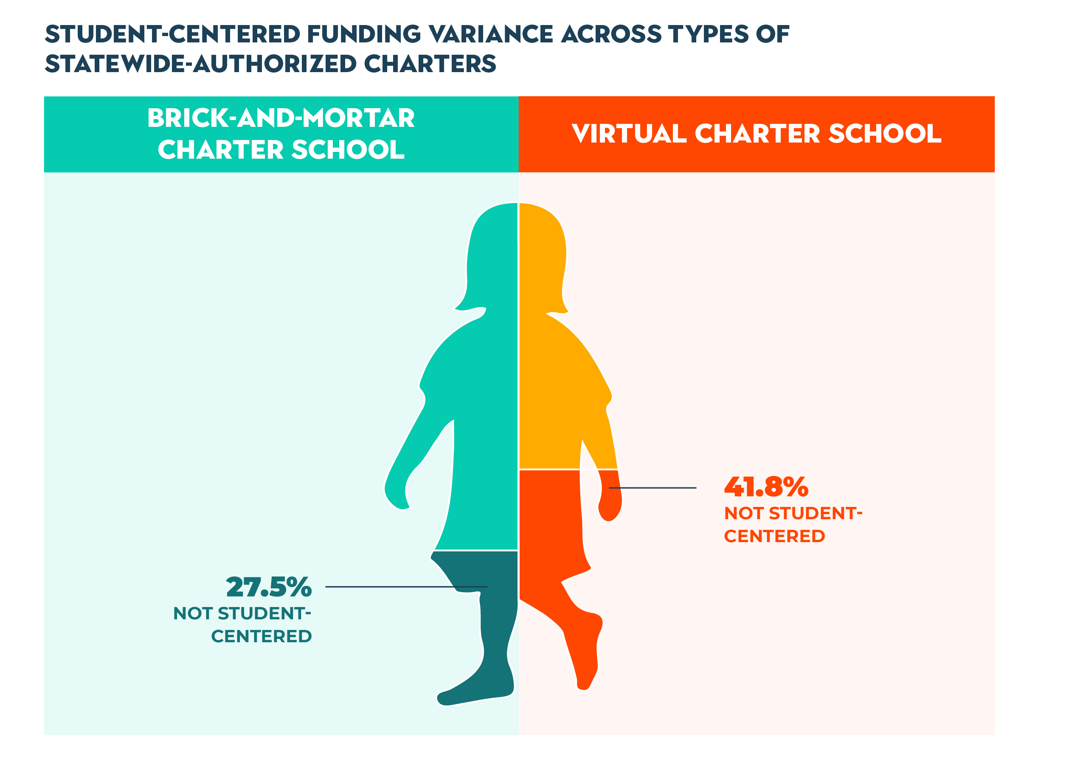
Student-Centered Funding for Charter Schools
For brick-and-mortar, state-authorized charter schools in South Carolina, nearly one third of funding is not student-centered. The situation is similar for locally-authorized charter schools. For virtual, state-authorized charter schools, even more is not student-centered

Slide 10
Student-Centered Funding for Charter Schools
For brick-and-mortar, state-authorized charter schools in South Carolina, nearly one third of funding is not student-centered. The situation is similar for locally-authorized charter schools. For virtual, state-authorized charter schools, even more is not student-centered
1
No local funding
2
No state funding in lieu of local taxes
3
Various programs not based on student enrollment

Slide 11
Beaufort & Two Nearby Charter Schools
Compared to Beaufort, more than 40 percent of funding for Bridges Prep Academy and Riverview Charter is not student-centered.
Revenue | Beaufort (Traditional School District) | Bridges Prep Academy (State-Authorized Charter School) | Riverview Charter (Locally-Authorized Charter School)
State & local formula; at-risk students; teacher fringe benefits | $4,454 | $4,454 | $8,165
Additional local or state charter supplement | $6,261 | $3,600 | $0
State funding in lieu of local taxes | $2,621 | $0 | $0
State funding for teacher retirement, etc. | $536 | $0 | $0
State funding for staffing, etc. | $161 | $0 | $0
State funding for transportation | $214 | $0 | $0
Other state and local funding | $144 | $0 | $0
Total | $14,391 | $8,054 | $8,165
 |  | 56.0% | 56.7%

Slide 12
Implications & Recommendations
1
Fold all state funding into the funding formula.
4
Ensure that funding follows students from school to school.
2
Make local funding student-centered.
5
Link funding to student performance.
3
Incorporate charter schools fully into the funding formula and provide them with equal access to local revenue.

