Slide 1
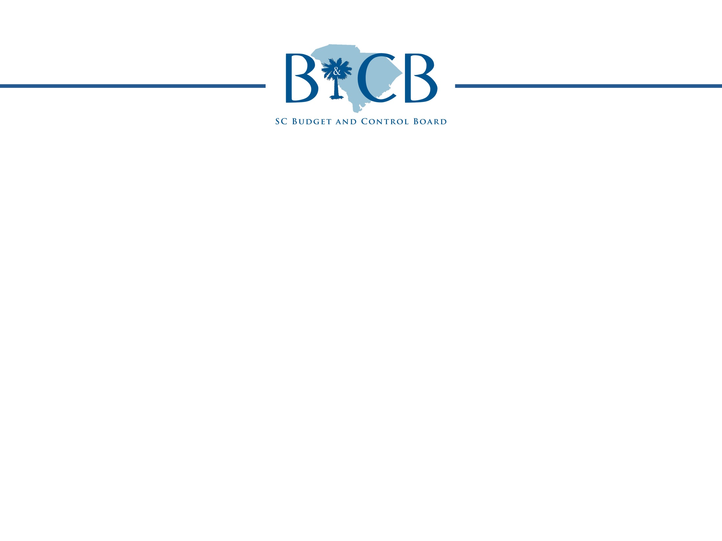

Cybersecurity Update
December 5, 2012

Slide 2

Agenda
Cybersecurity – A growing problem
Cybersecurity in other states (NASCIO/Deloitte Study)
  Structure
  Challenges
  Chief Information Security Officer
  Recommendations

Slide 3
Cybersecurity:
A Growing Problem

Slide 4
A Growing Problem
94 million records containing personally identifiable information (PII) exposed since 2009
The Department of Homeland Security:
  >650% increase in cyber incidents at federal agencies
  From 5,503 in FY 2006, to 41,776 in FY 2010

Slide 5
A Growing Problem
DATA BREACH COSTS
Avg. Cost Per Breached Record: $194 | Avg. Cost of Data Breach for an Organization: $5.5 million

Slide 6
A Growing Problem
New threats are emerging
  Decrease in:
    “Traditional” attacks such as physical attacks (stealing a laptop) or attacking web sites
  Increase in:
    Foreign state sponsored attacks - 6% to 12%
    External financial fraud - 4% to 12%

Slide 7
A Growing Problem
Hackers are more sophisticated and aggressive:
  Financially motivated - Steal data to make money
  Politically motivated
    “Hacktivists” are motivated by a political or social cause and desire to make political statements.
  Use new, rapidly changing technologies

Slide 8

A Growing Problem
“Cybersecurity may well become our
highest priority in the years to come.”
FBI Director Robert Mueller

Slide 9

A Growing Problem
Defense Secretary Leon Panetta warned that America’s enemies are taking aim at the systems that run everything, from the electrical grid to transportation systems to the nation’s financial infrastructure. The U.S. military is trying to get ready for a worst-case scenario, the rest of the government and the private sector must get moving now.

Slide 10
Cybersecurity
In Other States

Slide 11
Cybersecurity in Other States
Most states have a more centralized model of IT and
Cybersecurity Management
96% of states have a Chief Information Security Officer (CISO) now in place with some authority to set statewide policy, procedure and a security framework for agencies
  56% have authority over the executive branch agencies
  14% have statewide authority over legislative, executive and judicial government agencies
  12% their own agency only
  18% other

Slide 12
Cybersecurity in Other States:
Chief Information Security Officer
Most state CISOs operate in a federated environment where IT and security resources are spread across various state agencies and departments
California
  2010 law required each state agency to hire an Information Security Officer (ISO). The ISO reports to the state CISO and establishes a structure for the governance and management of security.

Slide 13
Cybersecurity in Other States:
Chief Information Security Officer
STATE CISOs ARE RESPONSIBLE FOR:
Cybersecurity planning and strategy | Program measurement and reporting
Information sharing | Cybersecurity monitoring
Incident management | Risk assessment and management
Awareness and Training | Compliance and monitoring
Cybersecurity governance (policies, procedures, architecture) | Vulnerability management

Slide 14
Cybersecurity in Other States:
Challenges
Challenges are the same as ours
Top 5 barriers to address Cybersecurity:
  Funding – 86%
  Increase sophistication of threats – 52%
  Inadequate availability of cybersecurity professionals – 46%
  Lack of visibility/influence within the enterprise (state) – 42%
  Emerging technologies – 36%

Slide 15
Cybersecurity in Other States:
Challenges
Budget/Funding
  Cybersecurity budgets average 1-2 % of overall IT budget
  17% of states don’t know – big problem

Slide 16
Cybersecurity in Other States:
Challenges
Staffing
50% report a staff of fewer than 5 employees
38% report 6 to 15
Outsourcing and
Staff Augmentation
On The Rise
Outsourcing has grown from 9% to 12% between 2010 and 2012
Staff Augmentation has grown from 22% to 28%
State of Delaware
Required to designate one to three ISOs
Provides the training and tools employees need
Created a 2 year ISO certification program

Slide 17
Cybersecurity in Other States:
Challenges
KEY COMPARISON: STATES VS. FINANCIAL INDUSTRY
Security Budget Increases | States: 14% Increase | Financial: >60% Increase
Year-Over-Year Trending | States: 4% report an increase of 1-5% | Financial: 39% report an increase of 1-5%
Dedicated Sec. Professionals | States: 50% have 1-5 FTEs | Financial: 47% have >100 FTEs

Slide 18

Cybersecurity in Other States:
Challenges
SURVEY RESULTS OF STATE CISOs
Only 14% feel they have appropriate executive commitment/adequate funding
70% have reported a breach
Only 24% feel confident in ability to protect state assets
Only 32% staff have the required cybersecurity competency
86% indicate “lack of sufficient funding” is the key barrier to address security
82% feel that phishing is the top cybersecurity threat
Notes:
Only 14% of state CISOs feel that they have appropriate executive commitment and adequate funding
70% of state CISOs have reported a breach
Only 24% of state CISOs feel confident in ability to protect state assets
Only 32% of state CISOs feel that staff have the required cybersecurity competency
86% of state CISOs indicate “Lack of sufficient funding” is the key barrier to address cybersecurity
82% of CISOs feel that Phishing is the top cybersecurity threat

Slide 19
Cybersecurity in Other States:
Challenges
Other state priorities are similar to ours
Top five initiatives for CISOs
  Risk Assessments 52%
  Training and awareness 46%
  Data protection 44%
  Cybersecurity strategy 44%
  Governance 42%

Slide 20
Recommendations:
What the State Security Experts Say
Manage Security at the Statewide Level
Create policies, processes and a security framework for all agencies to use.
Work Together
Security professionals are in high demand
Share Technologies and Competencies
Agencies can specialize in a certain discipline, such as identity management, and share their knowledge with other agencies
Skilled employees in one agency can be shared across the state

Slide 21
Recommendations:
What the State Security Experts Say
Don’t forget third party providers.
  Vendors help deliver products/services or manage critical functions
  Some have access to state personal and sensitive state data
New technologies are an opportunity
  Review and improve security measures and practices when deploying new technology.
  Cloud solutions and mobile solutions are examples

Slide 22
Recommendations:
What the State Security Experts Say
ID and report agency compliance requirements
  Compliance requirements and audit findings should be reported to state business leaders
  This is an opportunity to communicate security needs
Privacy Officer
  Name a statewide Privacy Officers
    Privacy officer decides what needs to be protected
    CISO determines how to protect data determine what data needs to be protected

Slide 23
Questions?
Jimmy Earley, Division Director
Division of State Information Technology
Phone: (803) 896-0222
Email: jearley@cio.sc.gov

