Slide 1

RSIC
South Carolina Retirement System
Investment Commission
Sarah Corbett
February 25, 2014

Slide 2
7.5% Actuarial Return Needed to Fund the System
The General Assembly sets the actuarial return.
In order to adequately fund the Retirement Systems, the Investment Commission must earn 7.5% on average each year over the next 30 years.
If the Commission fails to earn this amount, members and taxpayers will have to increase contributions in order to appropriately fund the system.
If the Commission achieves the 7.5% actuarial assumed rate of return over the next 30 years, and all other actuarial assumptions are met, then the unfunded actuarial liability of the plans will be zero.
Therefore, it is critical for the Commission to consider the effects of their decisions on the funded status of the plan.
2

Slide 3
Asset Allocation – Plan for Achieving 7.5% Return
Asset allocation is the mix of stocks, bonds and other assets in which a fund chooses to invest.
Asset allocation is arguably the most important decision that the Commission makes.
The asset allocation decision drives the risk, return and complexity of the portfolio. It is what drives the need for staff and operational tools and it is what drives the amount of investment management fees paid.
3

Slide 4
History of the Investment Commission
Amendment allowing SC Retirement Systems to invest in equities
Commission conducts first ALM with Mercer and the CEM benchmarking cost study
IFS report recommends changes to the structure
1997
1999
2001
2005
2006
2007
Retirement Systems begins investing in equities
Act 153 creates Investment Commission
Constitutional amendment ratified allowing the Commission to invest across all asset classes
4

Slide 5
The Commission
The RSIC is overseen by a 7 member body (the "Commission").
Commission members include:
  Reynolds Williams, J.D., CFP, Chairman (Appointed by: Senate Finance Committee Chairman Hugh Leatherman)
  Edward N. Giobbe, MBA, Vice Chairman (Appointed by: Governor Nikki Haley)
  Travis Turner, CPA (PEBA Interim Executive Director serving ex officio)
  Allen R. Gillespie, CFA (Appointed by: Ways and Means Committee Chairman Brain White)
  Rebecca Gunnlaugsson, Ph.D (Appointed by: Comptroller General Richard Eckstrom)
  Ron Wilder, Ph.D (Retiree Representative elected by the Commission)
  Curtis M. Loftis, Jr., State Treasurer (serving ex officio)
5

Slide 6
Appointed Commissioner Statutory Qualifications
Must meet at least one of the following
Chartered Financial Analyst (CFA)
Certified Financial Planner (CFP)
At least 20 years of professional actuarial experience
At least 20 years of professional teaching experience in economics or finance, ten of which must have occurred at a doctorate-granting university, master’s granting college or university, or a baccalaureate college as classified by the Carnegie Foundation
A Ph.D. in economics or finance from a doctorate-granting institution as classified by the Carnegie Foundation
A Certified Internal Auditor credential
6

Slide 7
Diversification
The statute reflects that the Commission has an obligation to diversify unless “the Commission determines that, because of special circumstances, it is clearly not prudent to do so”. (9-16-330(C)(1)) - Adopted 2005
The actions taken by the Commission to diversify the assets reflect statutory guidance.
7

Slide 8
What is Diversification and why did the Legislature Recognize the Importance of Diversifying the Assets of the System?
Diversification is often described as not putting all of your eggs in one basket.
The Commission now invest in many more “baskets” compared to 2006.
As you can see from the return numbers on slide 10, investment performance varies by asset class.
Put very simply, diversification is the opposite of taking concentrated risk. Concentrated risk is dependent upon a single outcome.
A diversified portfolio is structured to perform in different environments. Investing across multiple asset classes attempts to balance out returns over time to produce a more even return base – thus mitigating concentration risk and providing a better risk adjusted return.
8

Slide 9
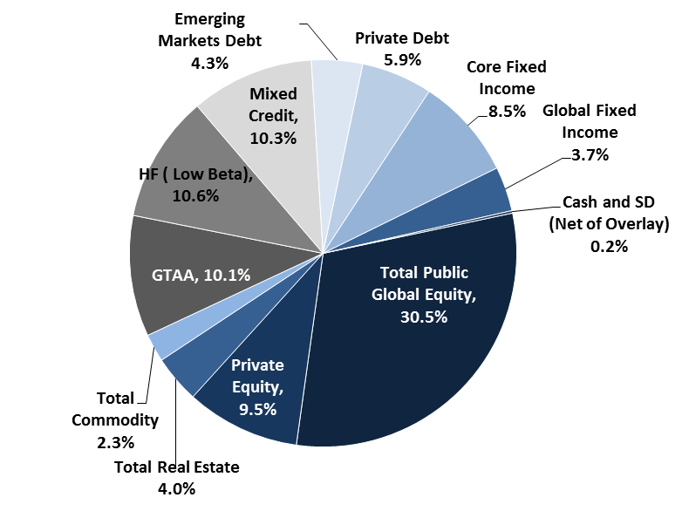
Changes in Diversification Over Time
Asset Allocation
(as of 6/30/06)
Asset Allocation
(as of 09/30/13)
Transitioned from 4 asset classes to a broadly diversified allocation of 12 asset classes

Slide 10
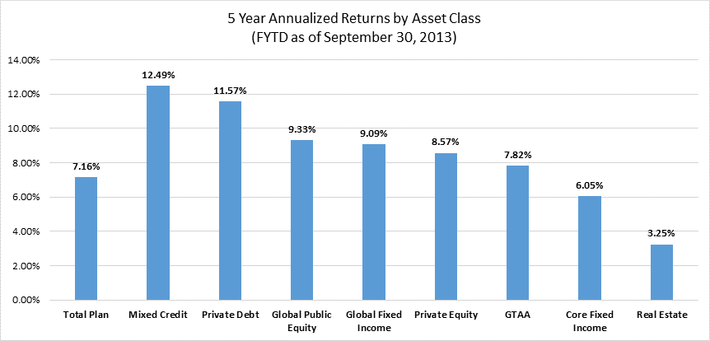
Diversification Produces Better Risk Adjusted Performance

Slide 11
Early Commission Decisions – Conscious Choices About Fees and Asset Allocation
So, the Commission knew it needed to diversify the assets of the trust fund.
But, what exact diversification should be done?
To answer that question, the Commission hired an independent investment consultant to conduct an asset liability modeling (ALM) study to determine the extent of diversification
The new asset allocation had “alternative” investments in it and they were going to be expensive
After the proposed asset allocation was completed, the Commission also hired Cost Effectiveness Measurement (CEM), a specialist in cost benchmarking for pension funds, to conduct a projection of investment fees under the new recommended asset allocation.
CEM advised the Commission that under the new asset allocation, approximately $200 million per year would be paid in investment management fees.
11

Slide 12
2006 Fee Projections
The CEM fee projection did not include performance based fees or pass through expenses – I will spend more time illustrating different types of investment fees later in the presentation.
For now, please note that the amount of management fees paid is very closely aligned with the original CEM estimate - $198 million for FY2013.
Based upon the net of fee risk and return characteristics developed by Mercer and in accordance with the statutory provisions regarding diversification of the portfolio, the Commission chose to proceed with changing the asset allocation and diversifying the investments.
12

Slide 13
Recent Asset Allocation Decisions
Hewitt EnnisKnupp (HEK) – Hired October 2012
Commission conducted year long search that culminated in hiring HEK
HEK works for the Commission – not for staff
HEK is a legal fiduciary
HEK has $4.3 trillion in assets under advisement worldwide
Experience working with public funds for over 30 years
Role of HEK expanded over role of prior consultant
13

Slide 14
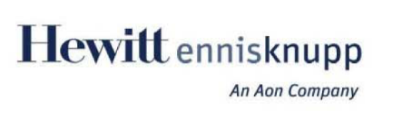
Data Presented from HEK ALM— February 2013
SCRS Asset Allocations Studied
Capital Market Expectations— 4th Quarter 2012 (10 and 30 year outlook)
Asset Class | Asset Allocation Adopted for FY14 (85% R-S) | Alternative 2: Same Risk Higher Return (91% R-S) | Alternative 3: Capped Private Market Investments (85% R-S)⁶ | Alternative 4: No Alternative Investments (60% R-S)
Global Equity¹ | 40% | 32% | 42% | 60%
Real Assets² | 8% | 9% | 6% | 0%
Opportunistic³ | 18% | 27% | 15% | 0%
Diversified Credit⁴ | 19% | 23% | 22% | 0%
Fixed Income⁵ | 15% | 9% | 15% | 40%
Total | 100% | 100% | 100% | 100%
10 Year Expected Return | 7.14% | 7.57% | 7.06% | 6.15%
10 Year Expected Risk | 11.54% | 12.52% | 12.81% | 12.98%
10 Year Sharpe Ratio | 0.506 | 0.501 | 0.450 | 0.374
10 Year Expected Inflation | 2.30% | 2.30% | 2.30% | 2.30%
30 Year Expected Return⁶ | 7.68% | 8.04% | 7.53% | 6.79%
30 Year Expected risk | 11.04% | 11.97% | 12.17% | 12.19%
30 Year sharpe ratio | 0.460 | 0.454 | 0.405 | 0.344
30 Year Expected Inflation | 2.30% | 2.30% | 2.30% | 2.30%
¹Global Equity is comprised of Global Public Equity and Private Equity
²Real Assets is comprised of Real Estate and Commodities
³Opportunistic is comprised of Hedge Funds and Global Asset Allocation (GAA)
⁴Diversified Credit is comprised of High Yield Bonds, Bank Loans, Emerging Market Debt, and Private Debt/Opportunistic Credit
⁵Fixed Income is comprised of core Fixed Income, International bonds, Intermediate Credit, Short Credit, Short Gov’t bonds, and Cash
⁶Private Market Investment (Private Equity, Private Debt, and Real Estate) and Hedge Funds are capped at 20% of the total asset allocation
Asset Allocation Review for the South Carolina Retirement System │ February 2013
14

Slide 15

Projected Funded Ratio (MVA Basis)
Adopted for FY14
Passive Portfolio
15

Slide 16
(ER + EE) Contribution Rate
Adopted for FY14
Passive Portfolio
16

Slide 17
Asset Allocation
There is not a right answer to asset allocation. Rather, asset allocation is a matter of choice and of risk tolerance. A simpler allocation would make our jobs easier as staff members. However, we must also adequately fund the system.
I present this information to you to share with you the data we analyzed to make the asset allocation decision.
The Commission has seriously reviewed asset allocation, has engaged appropriate experts with legal fiduciary responsibility, and has considered the effects of our decisions on the funded status and future required contributions to the plan.
17

Slide 18
Asset Allocation
There is no guarantee of future return.
As any mutual fund prospectus will tell us, past performance is no guarantee of future performance.
The Commission has complied with its fiduciary duties and taken into account appropriate data in setting the asset allocation.
We want to receive feedback from all of the stakeholders regarding asset allocation and how to best balance risk and return. If there are other asset allocations that can meet the goals of the plans, we are happy to review them.
18

Slide 19
Alternative Investment Definition
CFA Institute
Major categories of alternative investments include:
real estate
private equity
venture capital
hedge funds
closely held companies
distressed securities
commodities
19

Slide 20
What are Alternative Assets?
HEK has defined an “alternative” asset as one that has
limited liquidity;
very high trading turnover; or
material use of derivatives.
In our portfolio it includes*:
  Private Equity (9.5%)
  Hedge Funds (10.6%)
  Commodities (2.3%)
  Private Debt (5.9%)
  Real Estate (4.0%)
Alternative Investments Asset Classes
Private Equity | 9.5%
Hedge Funds (Low Beta) | 10.6%
Commodities | 2.3%
Private Debt | 5.9%
Real Estate | 4.0%
Hedge Funds in Other Asset Classes
Global Equity Hedge Funds | 1.2%
Mixed Credit Hedge Funds | 5.4%
Total Alternatives Including Multi-Asset Hedge Funds | 38.9%
*As of 09/30/13

Slide 21
Alternative Investments
Examples of Alternative Investments
Real Estate: Expected to generate capital gains as property values increase over time.
Residences
Office Buildings
Hotels
Private Equity: Generally consists of investments in private companies or buyouts of public companies, such as:
The Weather Channel
Toys-R-Us
Bojangles
Universal Studios Parks
Norwegian Cruise Lines
Whole Foods
Commodities: Basic goods that can act as a form of inflation protection, such as:
Crude oil
Gold
Natural Gas
Cattle
Corn
21

Slide 22
Deloitte Report
Commission hired Deloitte in April of 2011 to conduct a risk assessment
Deloitte completed risk assessment in September 2011
Since September 2011, the commission has made much progress
There are still items outstanding
22

Slide 23
Deloitte Progress
Since the issuance of the Deloitte report, the following items have been implemented:
  An Audit Committee of the RSIC Commission was established
  An Internal Audit and Compliance Department was established
    Internal Audit and Compliance Department has a direct reporting line to the Audit Committee and does not report through the COO or the CIO
    The Director of Internal Audit and Compliance was hired and recruited from the Stanford Endowment and the Internal Audit and Compliance Officer was recruited from Delta Airlines. Both are CPAs.
  Formal initial due diligence guidelines were adopted and implemented
    Includes a sourcing and disclosure form, intended to clearly disclose and document any potential conflicts of interest by Commissioner or Staff in the future prior to any investment being made
    Includes a completeness review by Internal Audit and Compliance prior to any investment being presented to the Commission (this ensures staff have followed the due diligence guidelines prior to a Commission vote)
  Formal on-going due diligence guidelines were adopted and implemented
    Includes a semi-annual documented review
    Includes a documented review of audited financial statements of investment managers
  An operational due diligence program was established and implemented
    Requires a review of operational abilities of investment managers prior to investment. Operational due diligence may veto an investment.
    Operational due diligence is performed by HEK and RSIC
23

Slide 24
Deloitte Progress Continued
  Formal Joint Valuation policies were adopted between PEBA and RSIC
  Formal Memorandum of Understanding (MOU) was established between PEBA and RSIC
  Formal management representation letter provided to PEBA and external auditor annually
  A research management/contact management database program was purchased and implemented
    This is a tracking and reporting tool
  Additional staff members were recruited— the positions previously did not exist
    Director of Reporting
    Director of IT
    Investment Officers (5)
    Senior Legal Officer
    Reporting Analysts (3)
    Senior Risk Management Officer
    Operational Due Diligence Officer
  Compliance Policies have been established
    Whistleblower Policy
    Personal Trading Policy
    Code of Ethics Policy
    Gifts and Conflicts Policy
  Implemented annual compliance certification from external managers
  Implemented a Non-Disclosure Agreement (NDA) with the STO
    Implemented a technology solution to provide for document sharing with the Treasurer’s staff and Commissioners
  Implemented formal legal sufficiency letter to accompany every new investment funding
24

Slide 25
Deloitte Progress Continued
  Created and implemented placement agent policy
  Revised governance policies were adopted by the Commission in May 2013
  Improved fee validation procedures and collection process
    Disclosed investment fees by manager in the 2012 CAFR
    All fees were published in the 2013 audited financial statement
    Migration to quarterly validation currently underway
  Conducted year long search for new Investment Consultant
The following items remain in progress and need to be addressed:
  Develop the Operational Infrastructure (This requires technology and outside services or internal FTEs). This is a very large item and may need additional budget.
    Risk System
    Private Markets System
    Data Warehouse
    Order Management System
  Fully Develop Risk Management function
  Develop compliance oversight
    Implement Compliance Systems
25

Slide 26
Oversight Structure
  Financial Statements are prepared by PEBA and audited by an outside auditing firm, Clifton Larson Allen, which is hired by the State Auditor’s Office and audits many other public pension funds with alternative assets.
  Each fund is audited.
  RSIC has an internal audit and compliance department, which reports to the Commission’s Audit Committee— not to the COO or CIO.
  The State Auditor reviewed our reported administrative expenditures and investment fees for FY12.
  Investment Consultant- Consultant reports directly to the Commission.
  A fiduciary audit is currently underway and is being conducted by Funston, a firm specializing in governance and public pension funds and selected by the Inspector General’s Office.
26

Slide 27
Oversight Structure
  Title 2, Chapter 2 of SC Code provides for legislative “oversight studies and investigations on all agencies within the standing committee's subject matter”.
  The Inspector General conducted a review in 2013 and found “no criminal conduct or wrongdoing was uncovered in the six issues reviewed.”
  The Governor may remove any Commissioner for “malfeasance, misfeasance, incompetency, absenteeism, conflicts of interest, misconduct, persistent neglect of duty in office, or incapacity.” SC Code 1-3-240 (C)
27

Slide 28
Valuation
The values of private equity, real estate, and private debt investments are determined by the investment managers based upon documented valuation policies.
Each fund is audited annually by a reputable external audit firm and the valuation of the private equity investments are a subject of review during those audits.
Staff at both RSIC and PEBA review the external audits and ensure they have clean audit opinions and are conducted by reputable firms.
As part of receiving a clean external audit, managers must value the assets at fair value according to the Financial Accounting Standards Board (FASB) accounting guidance.
Additionally, some managers have their assets valued by independent third party valuation agents or appraisers on a regular basis.
A joint valuation team including staff members of both RSIC and PEBA meet at least quarterly to review valuation topics.
28

Slide 29
Valuation
The Treasurer’s complaints about our process for valuation have been reviewed by the Inspector General as well as the external auditor for PEBA.
After reviewing the Treasurer’s complaints in detail, the IG found no wrongdoing and the external auditor continued to provide a “clean” audit opinion regarding the financial statements of PEBA.
29

Slide 30
Fee Reporting – Audit Opinions
The financial statements of PEBA have always contained the activity of the Investment Commission.
The financial statements have always been prepared in accordance with Generally Accepted Accounting Principles (GAAP) and the financial statements have always been reviewed by an external audit firm hired by the State Auditor’s office.
Those audit firms have always provided a clean audit opinion.
30

Slide 31
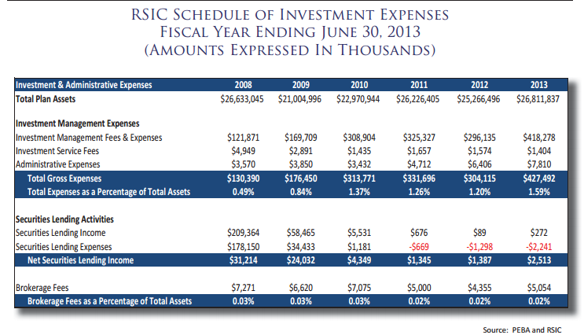
RSIC has been disclosing fees paid in AIR for years.
31

Slide 32
Net of Fee Returns is the Bottom Line
While fees are important, the net of fee return we receive on our investments is what’s really important.
Low fees do not directly translate into higher returns.
For example, the 5 year return for Private Debt is 11.57% net of fees and the Core Fixed Income 5 year return is 6.05% as of September 30, 2013.
We paid more for the Private Debt asset class than we did for the Core Fixed Income asset class, but net of those fees, we earned significantly higher returns in Private Debt than Core Fixed Income.
32

Slide 33
Fees and Financial Statements FY12— No change to the bottom line
*Beginning FYE 2013, PEBA began to include the total fee amount in the CAFR financial statements. As you can see illustrated, the inclusion of this number does not change the end of the year balance. This is important, as the Net Asset Value of the plan is what the actuaries use to project the health of the plan, along with future contributions.
33

Slide 34
Fees Change as Asset Allocation Changes
As our allocation to private equity, private debt, and hedge funds has increased, so have our fees.
Private equity, private debt, and hedge funds have much higher fee structures than traditional asset classes.
To materially change the amount of fees we pay, we will need to materially change our asset allocation.
So, the question of fees is necessarily a question of asset allocation.
34

Slide 35
Fees Move in Tandem with Asset Allocation
Source: Bank of New York Mellon and 2012-2013 AIR.
As our allocation to private equity, private debt, and hedge funds has increased, so have our fees
35

Slide 36
Back to the Starting Point
If asset allocation is the problem we need to solve, the question of fees takes us right back to the ALM study conducted last year.
Asset allocation should be decided on based upon expected return and risk.
If there are other asset allocations that can meet the goals of the plans, we are happy to review them.
36

Slide 37
The Technicalities of Fee Reporting:
Netted or Invoiced
Fees can be directly invoiced or “netted”.
What does netted mean? It means taken directly out of the account vs. paid for through an invoice.
If you invest in a mutual fund, you do not pay the mutual fund with a check. Rather, they deduct or “net” their management fees out of the account. These fees are not broken out directly on your statement.
Institutional funds often work the same way. We negotiate the fee terms during the contract negotiation and investment due diligence process. Then the manager may net the fees out of our account.
We monitor the amounts that have been deducted from our account at least annually.
37

Slide 38
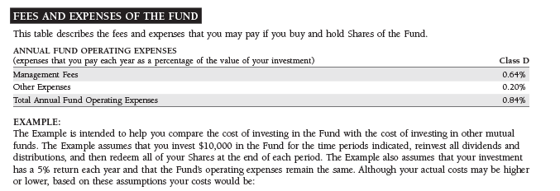
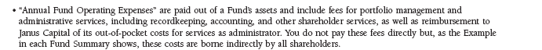
Investment Management Fees—Example of a Mutual Fund fee structure:
Source: 2014 Prospectus for Janus Venture Fund
38

Slide 39
Generally Accepted Accounting Principles
What is reported in audited financial statements is governed by either the Governmental Accounting Standards Board (GASB) for governments, or the Financial Accounting Standards Board (FASB) for non-governmental entities.
Accounting regulations are created in an effort to make financial statement entities as comparable as possible.
39

Slide 40
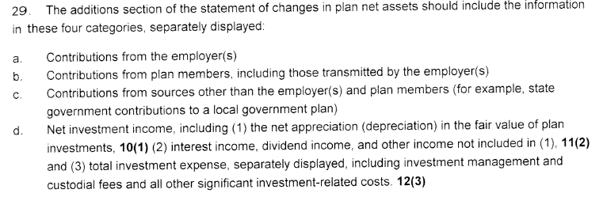
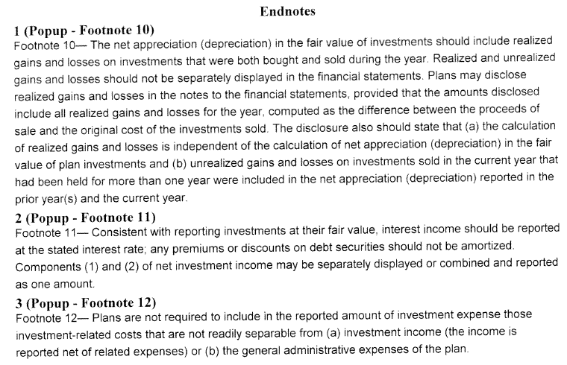
GASB Guidelines are not clear on fees.
40

Slide 41
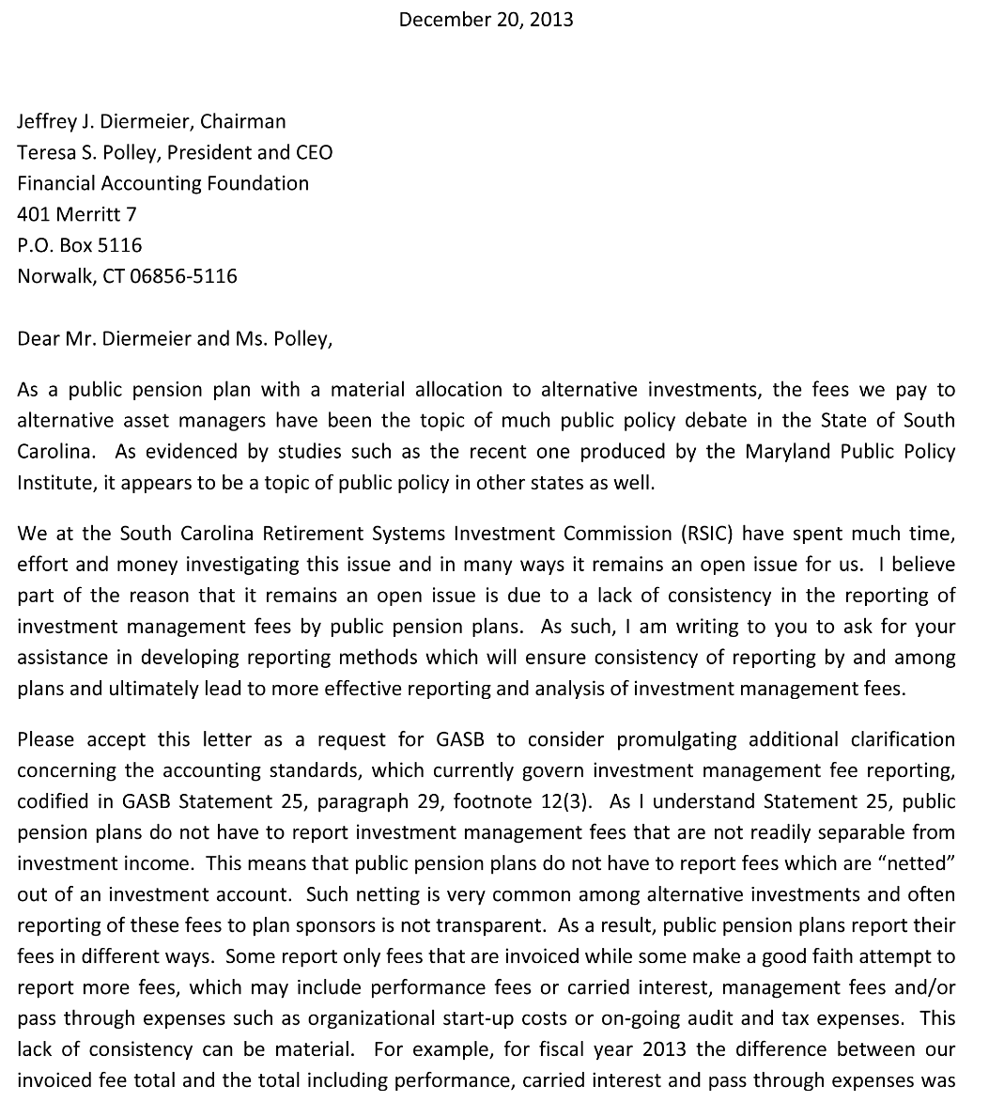
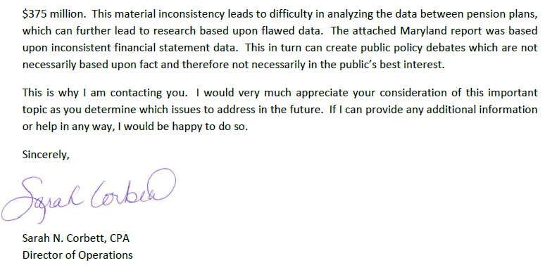
RSIC has written to GASB to add clarity to their guidelines:
41

Slide 42
So why is the GASB Guidance Important?
Because not all funds report the same
The differences in reporting can be material
This is in part because of the types of fees that aren’t reported
The Public Retirement Association of Minnesota has an alternative allocation of $2.1 Billion, but they report no fees paid to alternative managers.
New Jersey shows an allocation of 15.66% to Hedge Funds and Private Equity but they only report $13 million of investment expense in their CAFR and financial statements.
42

Slide 43
The Technicalities of Fee Reporting:
Types of Fees
Management Fees (47.3% of FY13 fees)
Management fees are those fees that are paid to manage assets. Management fees are paid to every external manager.
Can be Invoiced or Non-Invoiced
Often disclosed
Performance Fees (43.3% of FY13 fees)
Also known as Profit Sharing, Incentive Fees, or Carried Interest. Performance fees are paid to managers as a share of income earned on an investment. Performance fees are typically paid on Private Equity, Private Debt, Real Estate and Hedge Fund Investments.
Performance fees paid will vary from year to year based upon investment performance
Typically Netted
Not typically disclosed
Other Expenses (9.3% of FY13 fees)
Pass through expenses such as set up organizational costs, legal costs, taxes, and audit fees.
Typically Netted
Rarely disclosed
43

Slide 44

Disclosure Options in Investment Fees & Expenses
Note: In each method, the Net of Fees Return is still 9.99%
Model
$418mm
$417mm
$378mm
$196mm
$42mm
44

Slide 45
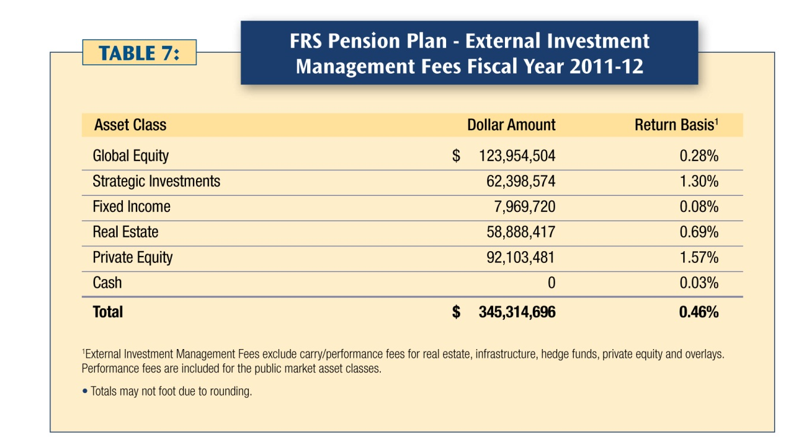
Florida Retirement System— Fee Disclosure Example
45

Slide 46
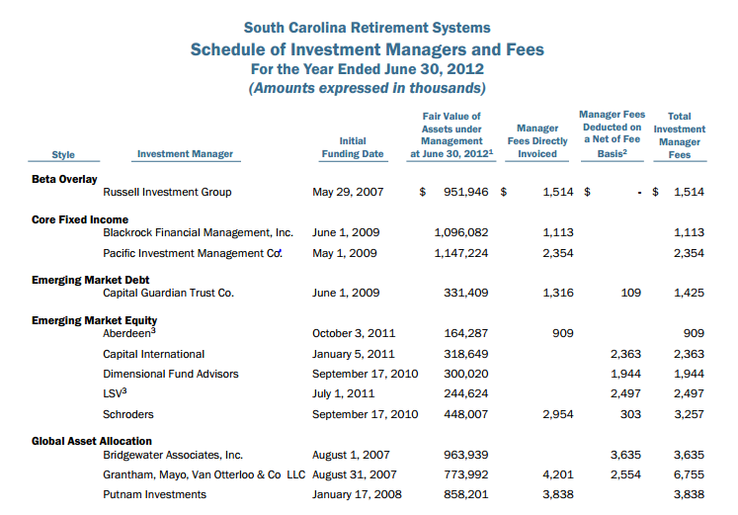
PEBA has included investment manager fees in their investment section:
46

Slide 47
So are we paying too much in fees?
So, are we paying too much in fees? The steps that we have taken to answer this question so far are: 1) engaged HEK to do fee study and 2) CEM will do a fee study as part of the fiduciary audit through the IG’s Office. The fee study has been completed by HEK and has shown that on an asset class by asset class basis “RSIC’s fees are generally low relative to peers”. The CEM study is currently underway and we look forward to reviewing those results.
Also, of most concern to us is the overall net of fees return.
The asset allocation that we have adopted is projected to provide the best rate of return over the long run and when compared to a simple 60/40 portfolio is expected at the end of 10 years to produce a funded status that is $2.7 billion better and employer contributions that are $100 million less.
47

Slide 48
117.126 (GP: Fiduciary Audit)
“Of the funds authorized for the Retirement System Investment Commission, the commission shall transfer $700,000 to the Office of Inspector General. The funds transferred shall be utilized by the Inspector General to employ a private audit firm to perform the fiduciary audit on the Retirement System Investment Commission as required by Section 9-16-380 of the 1976 Code, as amended.”
Funston Advisory Services, LLC
48

Slide 49
Funston Advisory Services (FAS) Background
The core competencies and experience of the FAS team include governance, strategy, risk, investment operations, investment accounting, and stakeholder engagement
Over the past three years, FAS has demonstrated its ability to address complex fiduciary and governance issues at
  the California Public Employees’ Retirement System (CalPERS),
  the Oregon Office of the State Treasurer and Oregon Investment Council,
  the Common Retirement Fund (“CRF”) managed by the Office of the New York State Comptroller,
  and the School Employees Retirement System (SERS) of Ohio.
49

Slide 50
Qualifications of the Funston Staff
Retired Executive Director of the State of Wisconsin Investment Board (SWIB) (June 2012)
Prior CEO of the Orange County Employees Retirement System in California
Former Chief Investment Officer for The Kellogg Company and the New York City Retirement Systems
Chief Financial Officer for the School Employees Retirement System (SERS) of Ohio from 1999 until 2010
Attorney who heads the Institutional Investor Legal Services team at Reinhart Boerner Van Deuren S.C.
Former legal counsel to the State of Wisconsin Investment board (SWIB) for more than 21 years (9th largest public pension fund in the United States)
Retired Chief Operating Officer and Chief Financial Officer for the State of Wisconsin Investment Board (SWIB) (2010)
Prior Deputy Comptroller for pensions for the City of New York
50

Slide 51
Funston Advisory Services Recommendations
Many recommendations are expected from the fiduciary audit provided by Funston Advisory Services
Recommendations will be implemented into RSIC as efficiently and effectively as possible
51

Slide 52
A Path Forward
We have heard from the constituent groups that the current combative environment at the Investment Commission is a cause for concern among members of the system. As an employee of the Commission and a long term member of the system myself, I echo that concern. As such, I wanted to provide this committee with ideas about a path forward – a path toward peace, toward constructive working relationships, toward dialogue and change.
We have several projects that are underway to improve operationally, but we may need more funding from the legislature to accomplish it. It will take time to fully procure and implement all of the technology needed. As discussed earlier, this is a large and important project.
We should listen to the recommendations of the fiduciary audit firm. The Trust Fund is paying $700,000 to conduct this audit. Funston is an appropriately qualified firm, having staff members that were previously CEOs, CIOs, CFOs and Legal Counsel to other large, sophisticated public pension funds.
I expect Funston to have recommendations in approximately April of this year. All parties should be held accountable for implementing the recommendations that will be forthcoming.
Finally, we must have a dialogue about fees that is focused on fees paid, net of fees returns, risk and overall asset allocation – not fees alone. And we must make sure our time is adequately spent on other important tasks necessary for managing and monitoring our portfolio as well.
52

