Slide 1
CONTRACEPTION
Tricia Seal, MD FACOG

Slide 2
OBJECTIVES
Review the physiology of the menstrual cycle and early pregnancy
Review the sites of intervention that contraceptives act upon to prevent pregnancy
Review the mechanisms of action and effectiveness of different types of contraceptives
Permanent methods
Barrier contraceptives
Systemic hormonal methods
Locally acting methods
Emergency/ Postcoital contraceptives

Slide 3
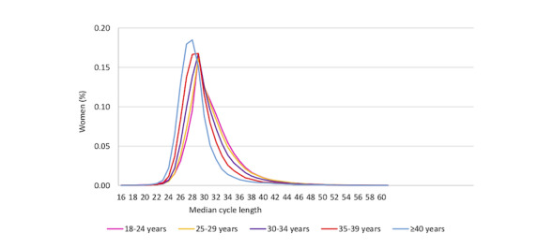
THE MENSTRUAL CYCLE
After menarche (avg 12yo), the ovary and the brain are in a continuous conversation
Normal cycle is 21-35 days (every 3 to 5 weeks)
80-85% of women aged 18-40 have a normal cycle
15-20% have irregular cycles
Adolescents have irregular cycles due to an immature brain-ovary connection
Women in perimenopause also have irregular cycles due to an overmature brain-ovary connection
Pregnancy dating is based on a 28-day cycle (4 weeks)

Slide 4
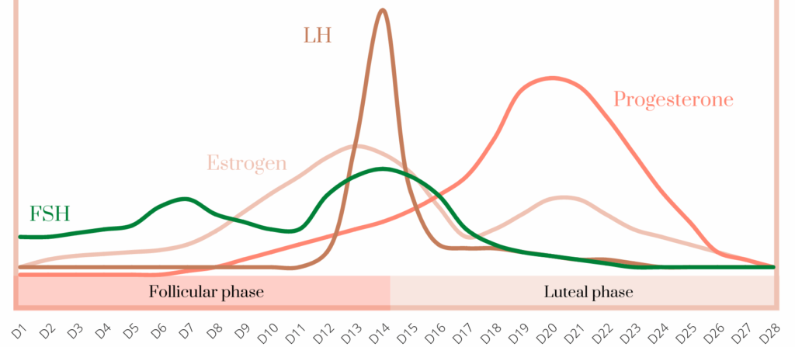
THE MENSTRUAL CYCLE
Last menstrual period (LMP) day 1 is the first day of bleeding
Typically bleeding lasts 2-5 days in a normal cycle
During this time the brain stimulates the ovary to create a follicle for ovulation (FSH)
As the follicle grows the ovary releases hormones (Estrogen) that change the brain’s signaling, thickens the uterine lining, and thins cervical mucous
In the middle of the cycle, the brain releases a spike of hormone (LH) that causes egg release within 72 hours

Slide 5
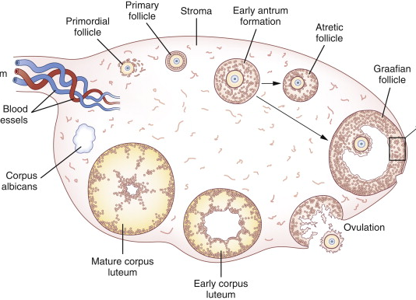
THE MENSTRUAL CYCLE
The egg enters the fallopian tube and survives for 12-24 hours unless fertilized
The ruptured follicle of the ovary (corpus luteum) starts secreting progesterone hormone that matures the uterine lining
If pregnancy does not occur, the corpus luteum resolves in around 14 days
The decrease in progesterone hormone causes menstruation to occur

Slide 6
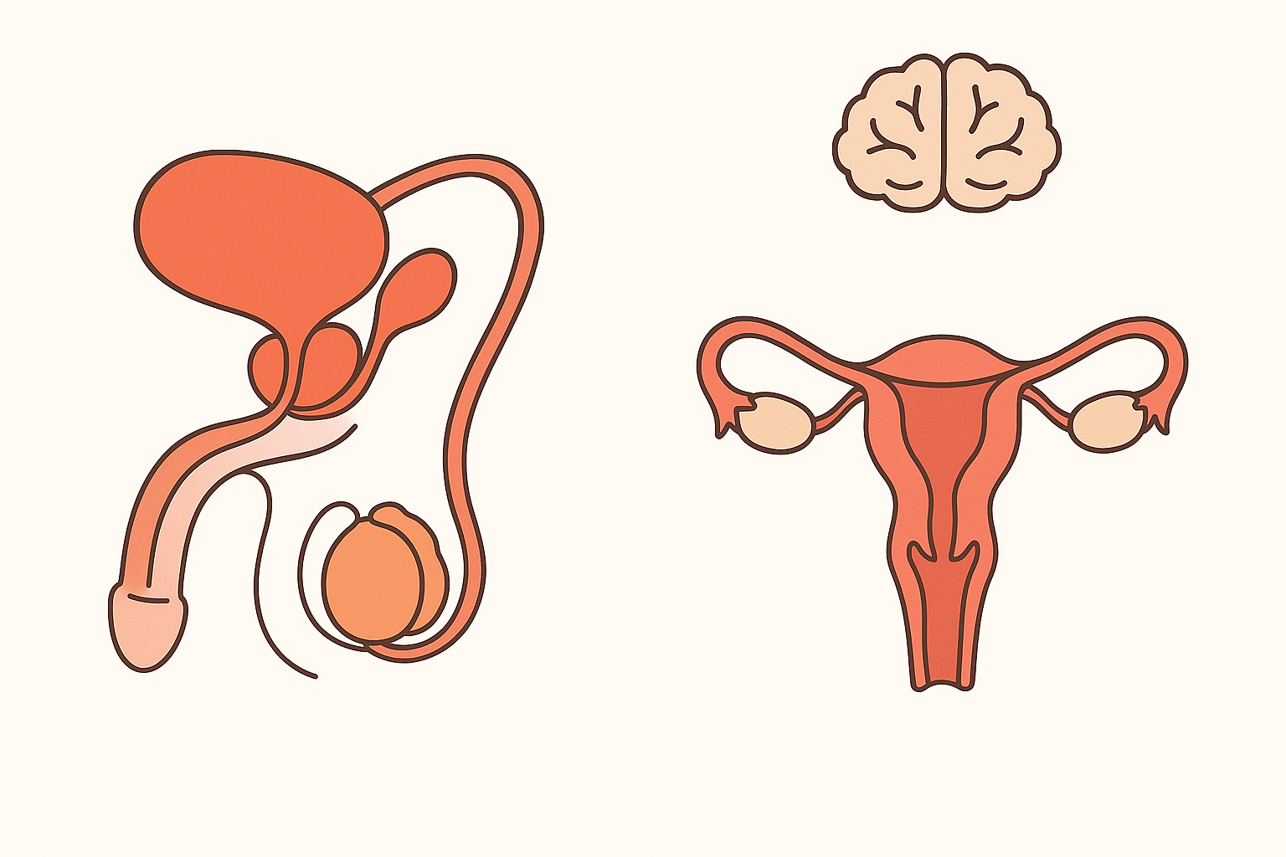
EARLY PREGNANCY
Sperm is made in the testicle and travels via the vas deferens to be added to semen
Semen is deposited into the vagina by sexual intercourse
The sperm penetrate the thin, slippery mucous of the cervix and enter the uterine cavity
The sperm enter the fallopian tube

Slide 7
EARLY PREGNANCY
The sperm fertilize the egg
The fertilized egg moves down the fallopian tube and enters the uterine cavity in 6-10 days
The fertilized egg implants into the thickened uterine lining
With implantation, pregnancy (HCG) hormone can be detected maternally
HCG hormone causes the ovarian corpus luteum cyst to continue to secrete progesterone hormone

Slide 8
CONTRACEPTION
A method, device, or medicine for preventing pregnancy

Slide 9
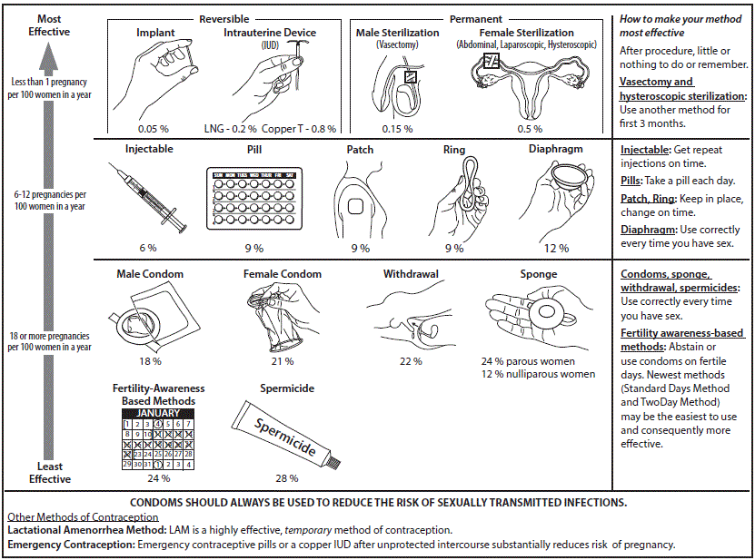
CONTRACEPTIVE EFFICACY
Described as a percentage of efficacy
Per 100 women using the contraceptive method in a year
i.e. 92% effective means that 8 women will become pregnant within a year of method use
Typical use is typical/most users using the contraceptive method
Abstinence is the most effective method of contraception

Slide 10
PERMANENT CONTRACEPTION
Performed via a surgical procedure that alters anatomy
Permanent and irreversible
Female – 99.5%
Disruption of tube
Removal of the tube
Via abdominal surgery, can be done around the time of delivery or by laparoscopic surgery
Male – 99.85%
Interruption of the vas deferens
~3 months to work
Can be done in the office setting

Slide 11

NATURAL METHODS
Abstinence – 100%
Withdrawal Method – 78%
Requires partner cooperation
Avoiding fertile times in the menstrual cycle – 76%
Only works for women with regular, predictable cycles
Can be ineffective during times of illness, stress
Requires partner cooperation
Lactational Amenorrhea – 98%
For the first 4-6 months of exclusive breastfeeding and no period

Slide 12
BARRIER METHODS
Preventing sperm from reaching the cervix
Male condoms – 82%
Female condoms – 79%
Contraceptive sponge – 76%
Contraceptive diaphragm – 88%
Must be used with every act of intercourse
Spermicide must be used with contraceptive sponges and diaphragms
Spermicide alone – 72%

Slide 13
SYSTEMIC HORMONAL METHODS
Act by over-riding the constantly changing hormones that the brain and ovary use to “talk”
Causes “negative feedback” that prevents the brain from stimulating ovarian follicle development and ovulation
Progesterone is the primary contraceptive hormone

Slide 14
SYSTEMIC HORMONAL METHODS
Progesterone
Prevents ovulation
Thickens cervical mucous
Thins the uterine lining
Decreases tubal motility
Some have estrogen added to create a regular bleeding profile
(Most pills, the patch, the ring)

Slide 15
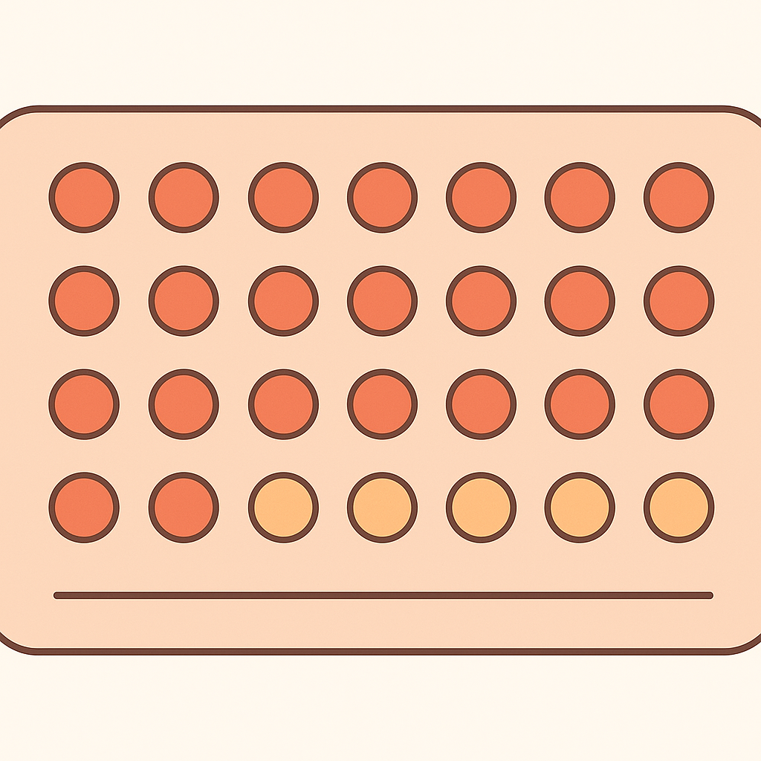
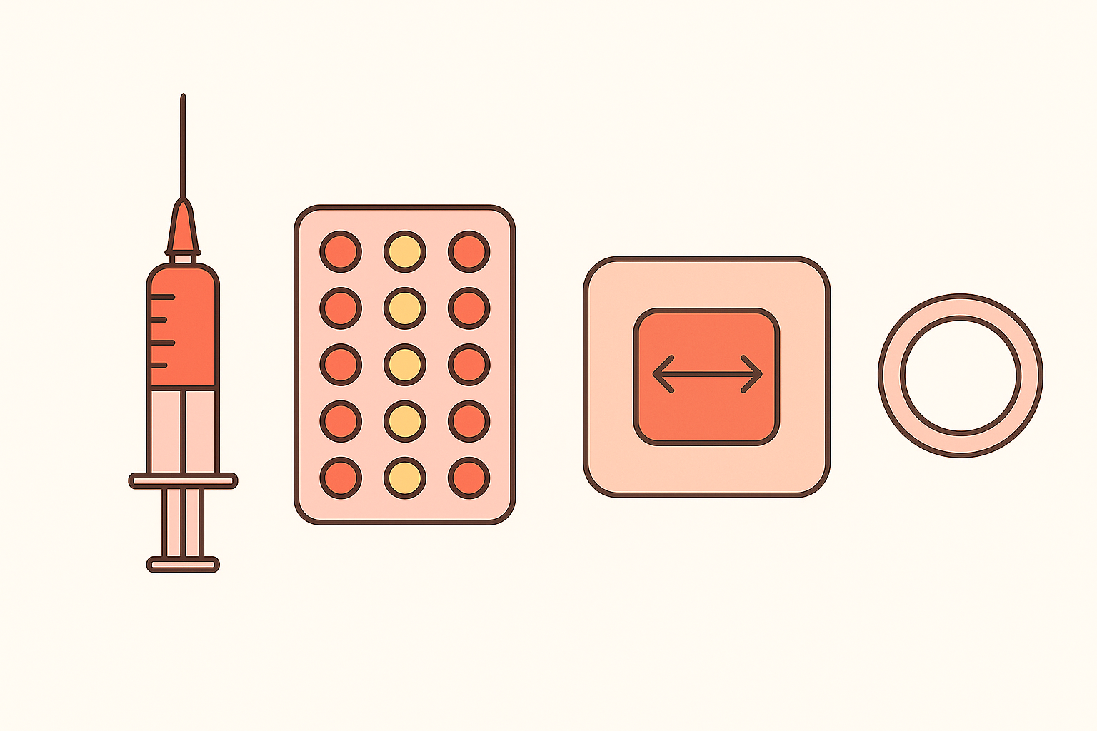
SYSTEMIC HORMONAL METHODS
Oral contraceptive pills - 91%
Taken daily
Contraceptive patch – 91%
Placed on the skin once a week
Vaginal ring – 91%
Placed in the vagina once a month or once a year

Slide 16

SYSTEMIC HORMONAL METHODS
Depo-provera – 94%
Injection given every 3 months
Subdermal implant – 99.95%
Implanted in the office
FDA approved for 3 years of use

Slide 17
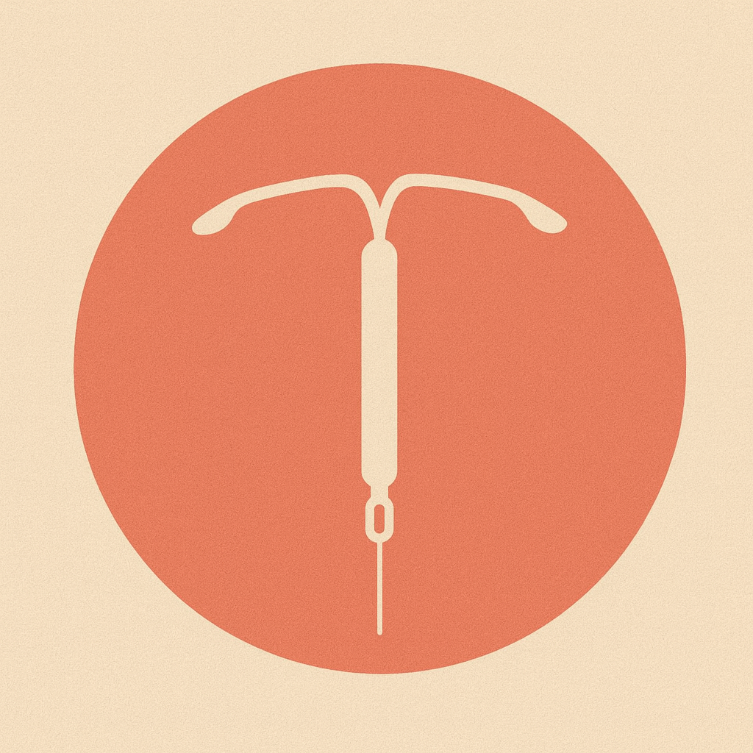
LOCAL HORMONAL METHODS
Hormonal IUDs – 99.8%
Progesterone hormone (levonorgestrel) embedded in device
Lasts for 3, 5, or 8 years depending on type
Have local progestin effects to prevent fertilization
Thicken cervical mucous and make impenetrable to sperm
Thin uterine lining
Reduce tubal motility

Slide 18
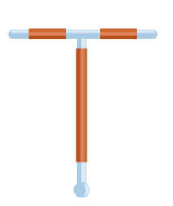
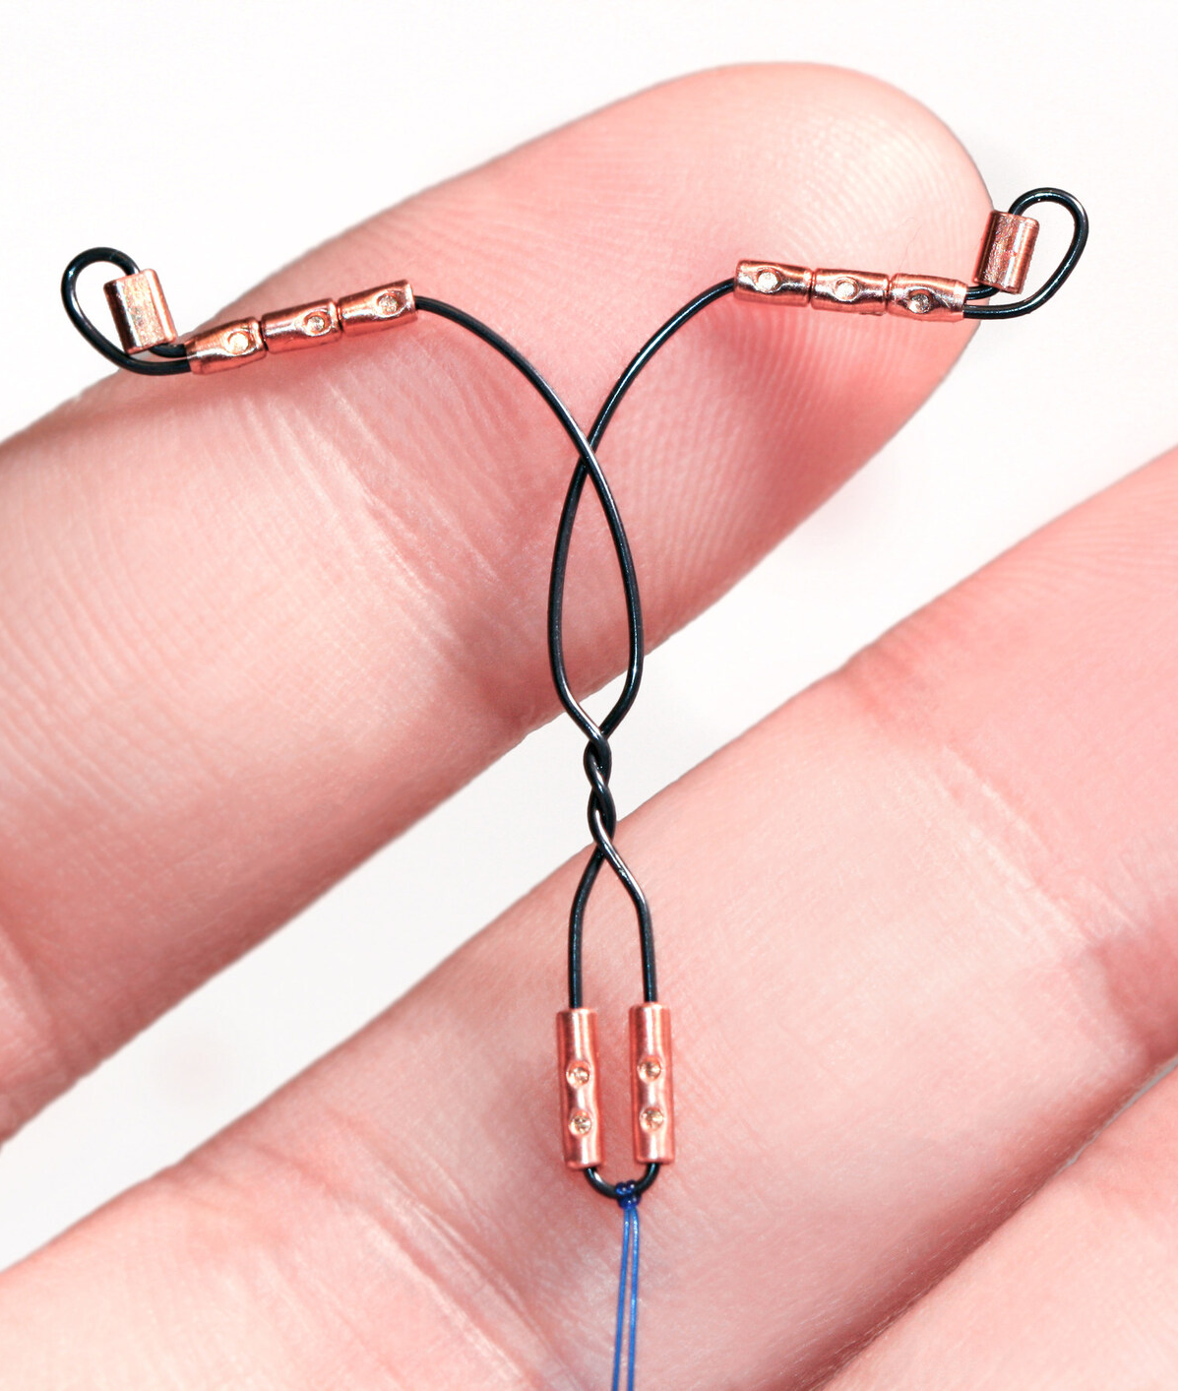
NON-HORMONAL LOCAL METHODS
Metal-containing IUDs – 99.2%
Copper
FDA approved for 10 years
Copper and Nitinol (nickel-titanium)
FDA approved for 3 years
IUD releases copper ions
Creates a localized cytotoxic inflammatory response
Affects egg viability
Affects sperm motility and viability
Affects the acrosomal reaction (ability of sperm to penetrate the zona pellucida to fertilize the egg)

Slide 19

EMERGENCY/POSTCOITAL CONTRACEPTION
Prevents pregnancy after sex occurs
Oral options delay ovulation/egg release
Progesterone hormone (Levonorgestrel) – 85%
Works up to 72h after unprotected intercourse
Selective progesterone receptor modulator (ulipristal acetate) – 85%
Works up to 5 days after unprotected intercourse
Metal IUD’s
Copper IUD - >99%
Copper ions are toxic to gametes

