Slide 1

South Carolina Area Health Education Consortium (Agency H53)
Ways & Means Healthcare Budget Subcommittee January 29, 2019

Slide 2
Accountability Report Highlights
The South Carolina Area Health Education Consortium is its own state agency. The AHEC budget is separate from MUSC, however all administrative and financial activities are conducted within the MUSC system. Consequently, the Accountability Report from MUSC includes information about the South Carolina AHEC.

Slide 3
Requests
South Carolina AHEC has no:
Proviso requests
Capital budget requests
Non-recurring budget requests

Slide 4
Three Year Funding
 |  | FY 15-16 | FY 16-17 | FY 17-18
Recurring | Appropriation | $9,772,208 | $10,222,208 | $10,590,804
General Funds | Expenditures | $9,772,208 | $10,222,208 | $10,590,804
Non-Recurring | Appropriation | $200,000 | $0 | $0
General Funds | Expenditures | $205,814* | $194,186* | $0
Federal Funds | Authorization | $844,700 | $844,700 | $844,700
 | Expenditures | $490,024 | $501,704 | $436,330
Other Funds | Authorization | $2,808,927 | $2,808,927 | $2,808,927
 | Expenditures | $4,103,670** | $2,370,328 | $1,456, 968
Total Funds | Approp./Auth. | $13,625,835 | $13,875,835 | $14,244,431
 | Expenditures | $14,365,902 | $13,094,240 | $11,027,134
*Funds carried forward from prior year
**Expenditures include $1,955,718 transferred from Palmetto Health and expended for the SC DHHS Teaching Supplement

Slide 5
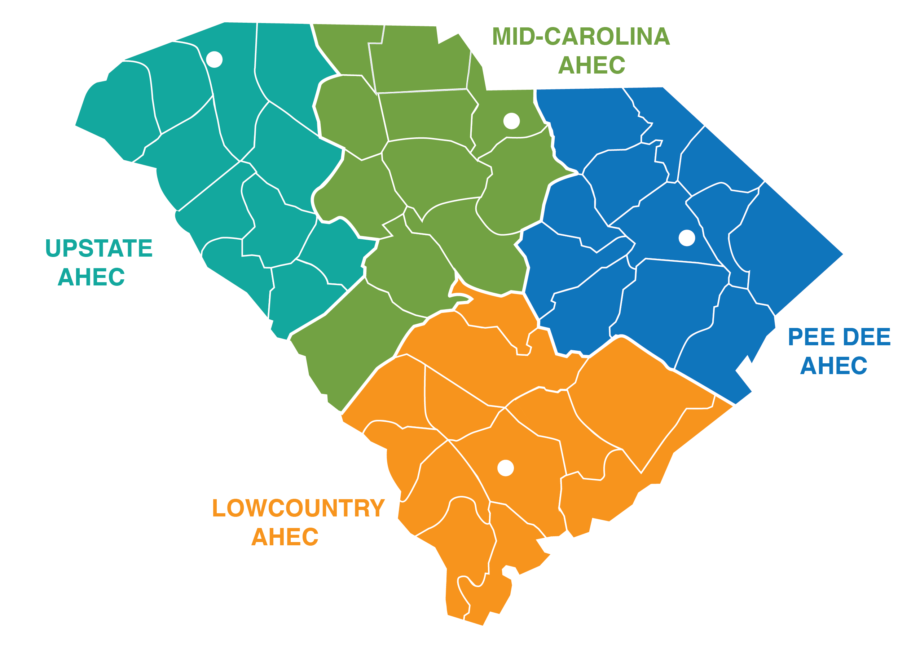
South Carolina AHEC
4 regional centers serve the entire state
1 program office housed at MUSC

Slide 6
What We Do
The South Carolina AHEC connects students and professionals with the tools, training and resources necessary to provide quality healthcare, with a focus on primary care in rural and underserved communities.
We provide education, recruitment and retention programs to build and support the healthcare workforce South Carolina needs.

Slide 7

Program Areas
Health Careers Pipeline Programs
Prepare underrepresented students for academic success and entry into health professions programs
Continuing Professional Development
Provides education for health care professionals to enhance their clinical skills and maintain licensure
Health Professions Student Programs
Facilitate health professions student training placements in rural and underserved communities
Telehealth Education
Educates students and heath care professionals about emerging trends in telehealth and technology
Graduate Medical Education
Supports high-quality family medicine residency training in South Carolina
SC Office for Healthcare Workforce
Analyzes and provides information about the health care workforce in South Carolina. Learn more at www.scohw.org
Recruitment & Retention Programs
Offer financial incentives to clinicians who want to practice in rural and underserved communities

Slide 8
Statewide Collaborations
South Carolina AHEC partners with:
34
29
16
Institutions of Higher Education
Middle and High Schools
State-Funded & Statewide Organizations
379
204
115+
Health Professions Preceptors
Community-Based Training Sites
Healthcare Partners & Organizations

Slide 9
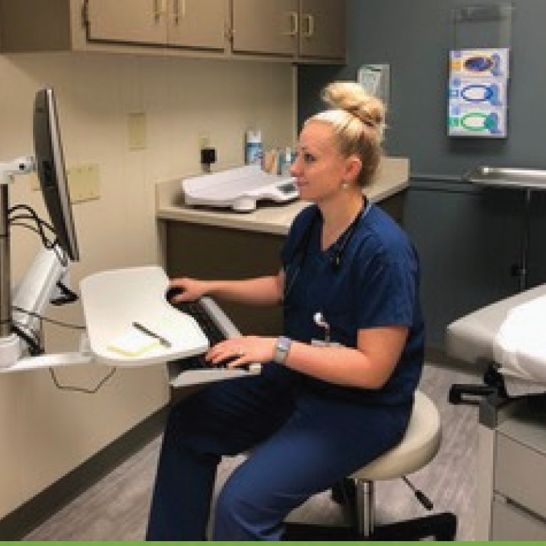
Rural Success Stories
The Rural Physician Incentive Grant Program has been an incredible blessing for me and my career as a family medicine physician. After the great accomplishment of graduating from residency I was still faced with an extensive amount of debt that accumulated from attending a private medical school.
I knew that I wanted to stay and practice locally, near my residency, but unfortunately student loan repayment was not an option in the position I desperately wanted. Thanks to the Rural Physician Incentive Grant Program, I felt confident in accepting a position in an underserved area of South Carolina.
I knew that the money from the grant would present an excellent way for me to continue paying off my medical school debt and still serve the community by filling the role of a much needed primary care physician.
Without this grant, I may have had to pursue my career elsewhere, however, now I am blessed to be able to continue to do what I love, full scope family medicine.
Dr. Holly Munson
^{FY18 Incentive Grant Recipient}
^{Practicing in Walhalla}
Seneca Family Medicine Residency Program Graduate

Slide 10
Recurring Budget Requests Agency Priority #1
Rural Physician Program
Amount: $250,000

Slide 11
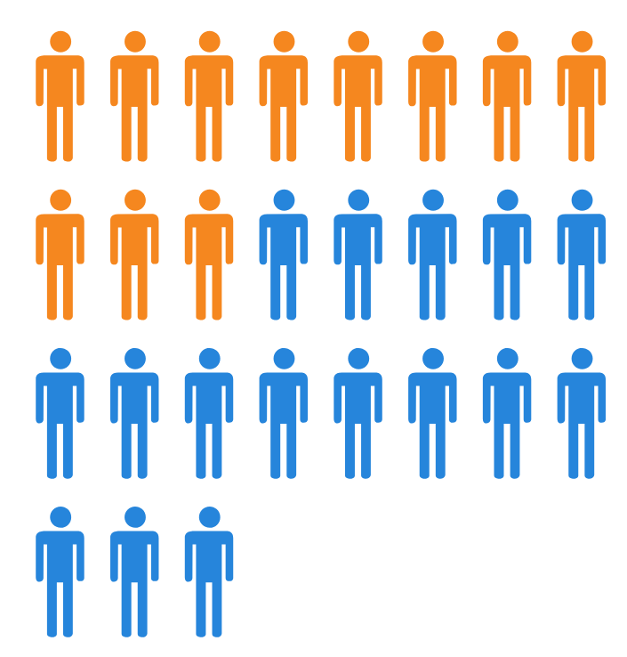
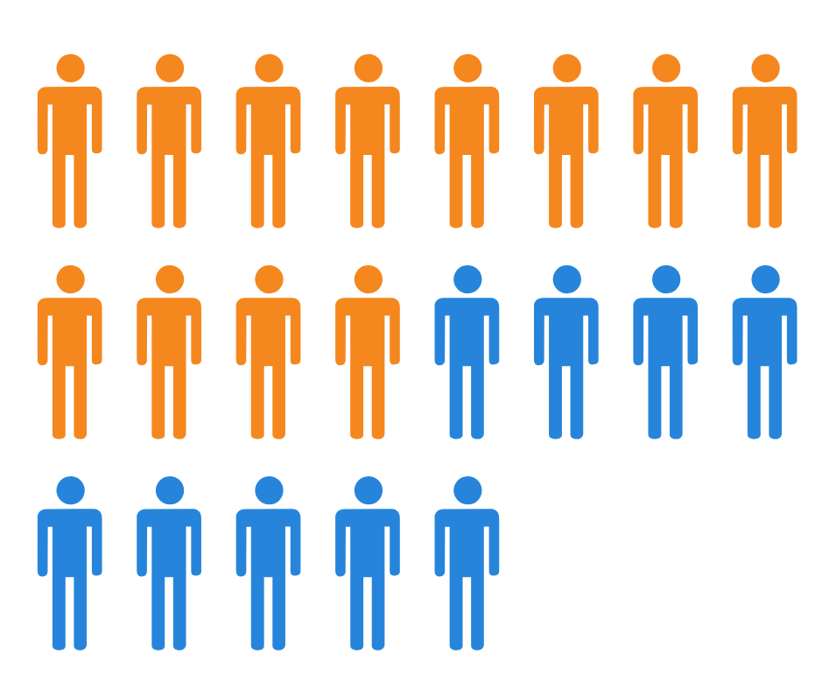
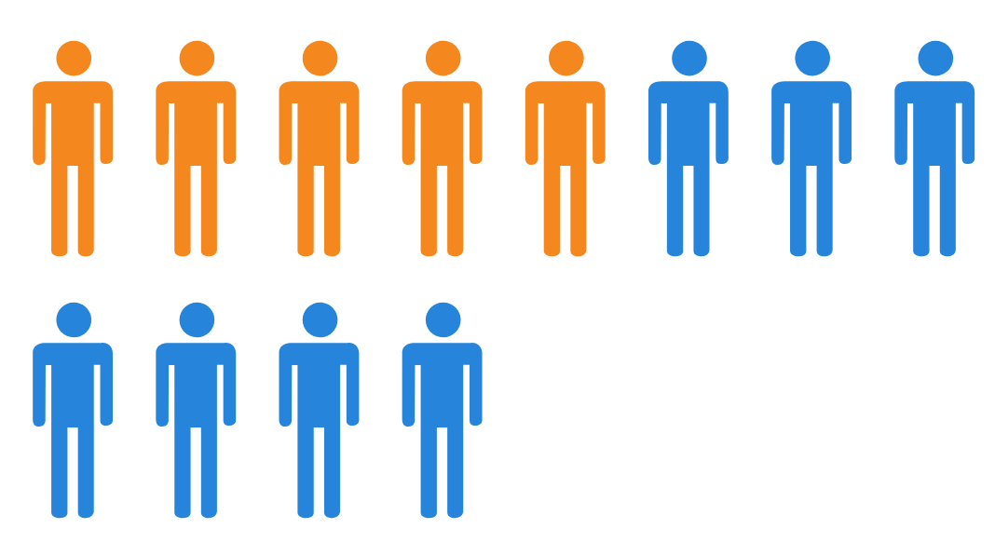
Program Update
Additional recurring funds allocated in FY17-18:
$167,287
FY 17
FY 18
FY 19
Total: 12
Advanced Practice Providers: 5
Physicians: 7
Total: 21
Advanced Practice Providers: 12
Physicians: 9
Total: 27*
Advanced Practice Providers: 11
Physicians: 16
*Some contracts pending

Slide 12

Rural Physician Program
Initiated in 1989 by South Carolina Legislature
SC Code of Laws,
Section 59-123-125
Incentive grants for physicians & advanced practice providers to practice in rural & medically underserved communities
Current funding: $667,287

Slide 13
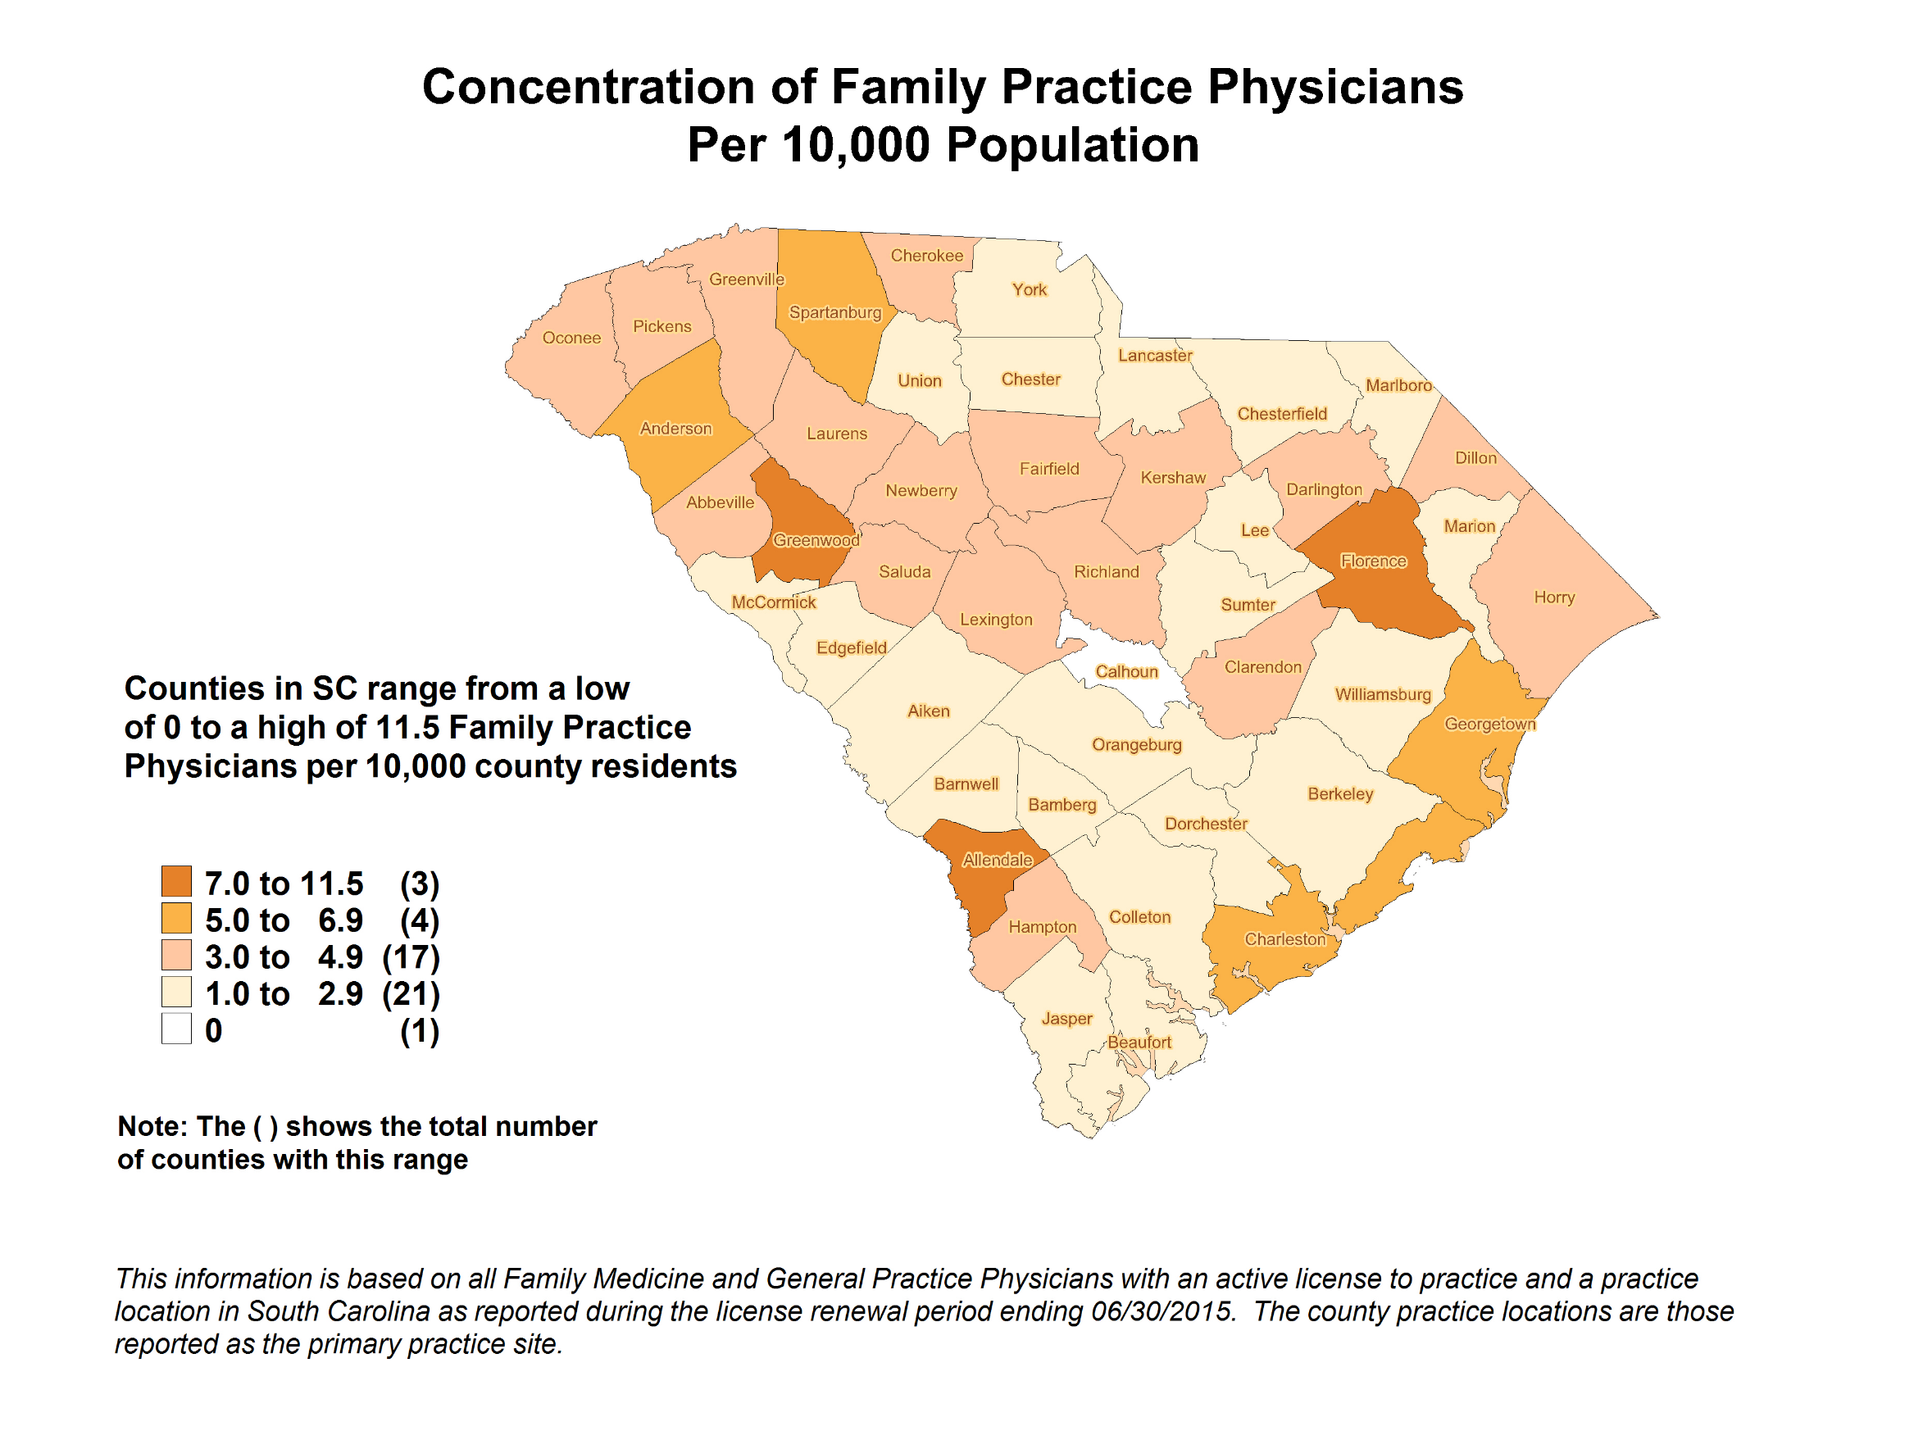

2016 South Carolina Health Professions Data Book, South Carolina Office for Healthcare Workforce. www.scohw.org

Slide 14
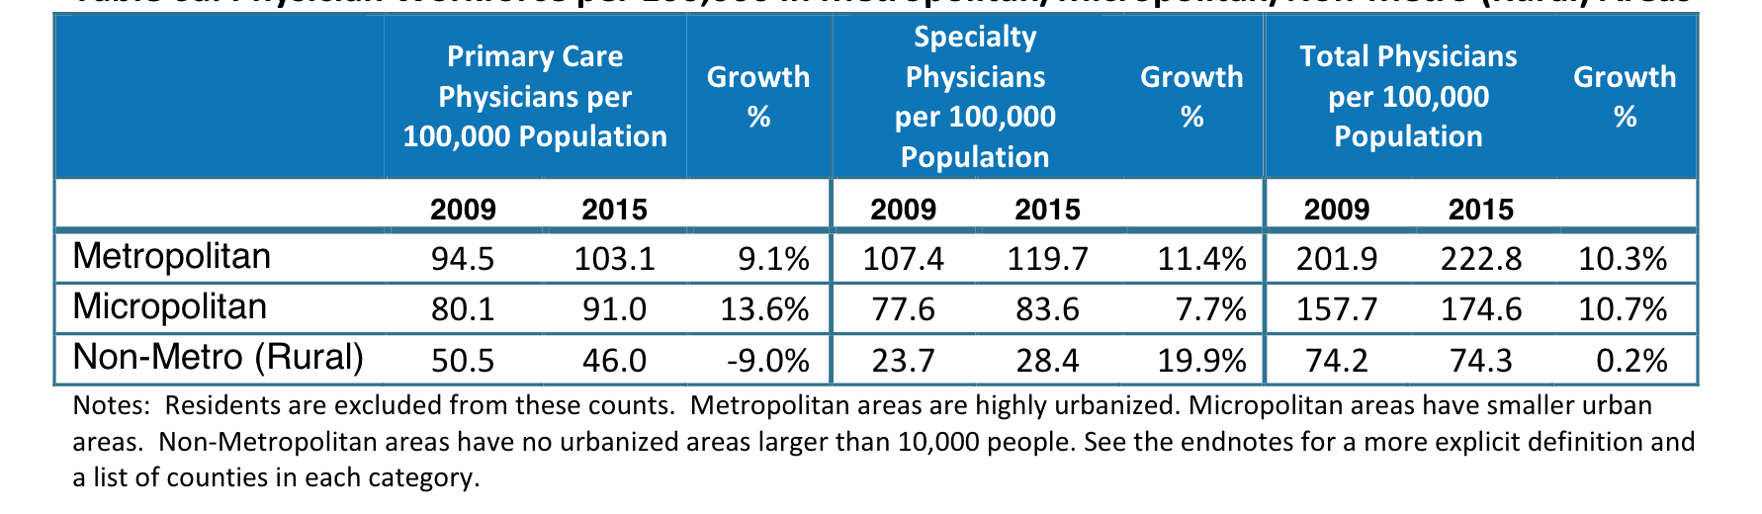
Physician Workforce in SC
Physician Workforce per 100,000 in Metropolitan/Micropolitan/Non-Metro (Rural) Areas
Non-Metro Counties: Allendale, Bamberg, Barnwell, Chesterfield, Clarendon, Colleton, Dillon, Hampton, Lee, Marion, McCormick, Williamsburg
South Carolina Office for Healthcare Workforce. (September 2017). Changes in the Established Physician Workforce in South Carolina: 2009 - 2015. www.scohw.org

Slide 15
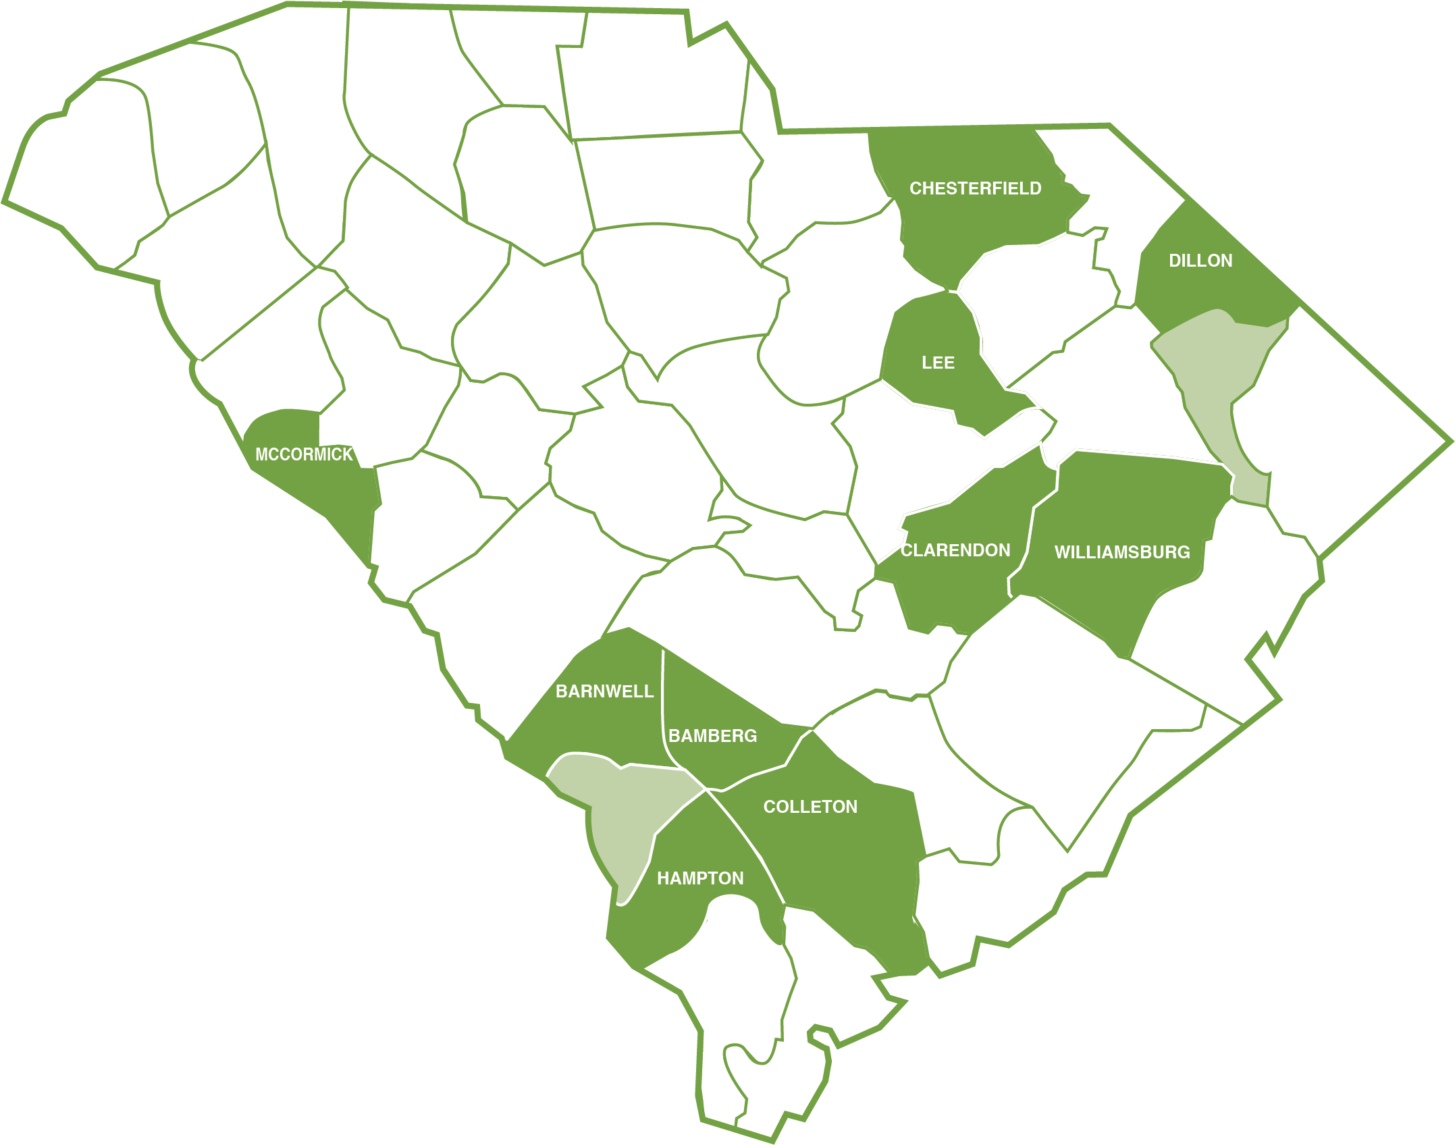
Filling the Gaps
7
4
3
2
43
Providers Funded for Counties of Greatest Need
Incentive grant recipients funded FY13-19
(Physicians and AP Providers)
4
5
2
5
6
5

Slide 16
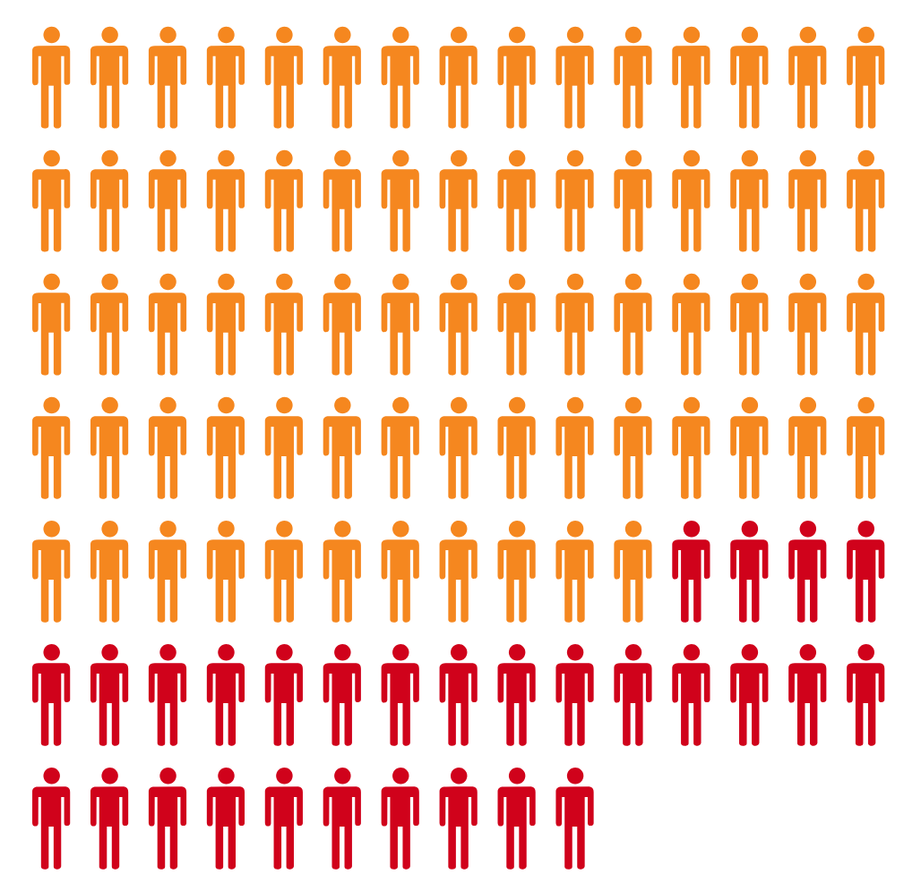
SC Clinicians Turned Away
More eligible providers than available funds
Additional funding will go directly to additional clinicians
^{Unable to fund since FY17}
Total: 102
Advanced Practice Providers: 72
Physicians: 30

Slide 17
Return on Investment
^{Return on Investment:}
$1
1
1
Invested in Primary Care
Physician in
South Carolina
Physician in
South Carolina
=
=
=
$13
11.9
$76,118
Savings in
Downstream
Costs¹
Jobs Supported²
State and local tax revenue generated²
¹Delivering value in healthcare starts with increased primary care investment. Medical Economics, August 6, 2018: http://www.medicaleconomics.com/health-law-and-policy/delivering-value-healthcare-starts-increased-primary-care-investment
²The national economic impact of physicians. Prepared for The American Medical Association by IQVIA. Retrieved 12/4/18 from https://www.ama-assn.org/sites/ama-assn.org/files/corp/media-browser/public/2018-ama-economic-impact-study.pdf

Slide 18


Program Outcomes
451
88
87%
72%
Physicians
Advanced
Practice Providers
Physicians
Advanced
Practice Providers
Received rural practice grants from the rural physician program since its inception
Rural incentive grant recipients still practicing in South Carolina*
*Contract completers initially funded 1995-2014 based on active license in 2015-2016. Source: SC Office for Healthcare Workforce.

Slide 19
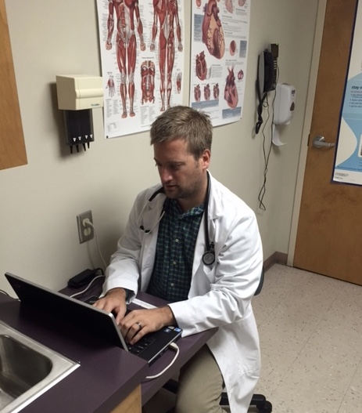
Rural Success Stories
Practicing in rural South Carolina exposes me to some very ill patients with limited financial resources. These are people in need. With few specialists available, this community allows me to practice family medicine in the fullest sense . . .
When I was looking around for a job, I had several practices in mind. I happened to really like everything about this one rural practice. With the Incentive Grant Program, it made it that much easier to choose my current employer . . . I am very impressed with this Incentive Grant program. There are very few places in the country that offer such a great incentive to work in an underserved community.
Dr. Kyle Gehres
^{FY16 Incentive Grant Recipient}
^{Practicing in Dillon}
McLeod Family Medicine Residency Program Graduate

