Slide 1
House Ways and Means Healthcare Subcommittee Budget Request FY19-20 for the Medical University Hospital Authority Presented by Dr. Patrick Cawley, CEO, MUSC Health January 29, 2019

Slide 2
MUSC Overview
“ Leading Health Innovation for the Lives We Touch”
MUSC is SC’s Only Comprehensive Academic Medical Center
Patient Care:
U.S. News & World Report ranked MUSC #1 hospital fourth year in a row in SC
statewide tertiary care
over 1 million patient visits per year
Education: MUSC has graduate and professional programs in every dimension of health care (2,965 students).
Research: MUSC continues to lead the state in biomedical research funding. MUSC’s total amount of funding for FY18 is $276.5 million.
Economic Impact: MUSC has an annual $3.8 billion economic impact in the Charleston Metro Area and employs approximately 14,000.

Slide 3
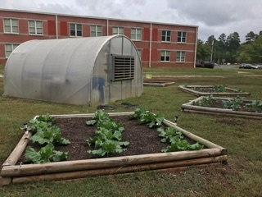
Update on the SC Telehealth Alliance & Statewide Health Innovations

Slide 4
Telehealth Highlights
MUSC’s designation by the Health Resources and Services Administration, an agency of the U.S. Department of Health and Human Services, as a National Telehealth Center of Excellence – a $2.6 million dollar award to date – means MUSC is being called upon to shape and inform national telehealth policies.
Under MUSC leadership, the SC Telehealth Alliance now includes over 460 sites and over 40 state agencies and non-profits are engaged in its strategy.
South Carolina is projected to conduct over 400,000 telehealth interactions this year, an increase of over 1.5 times the volume in 2017.
MUSC virtual urgent care visits have more than doubled over the last year with approximately 3,000 visits completed in 2018.
School-based telehealth is now in over 100 schools in 18 districts with 80% staffed by MUSC.
MUSC offered free direct-to-patient telehealth care during Hurricane Florence, providing over 150 encounters during the storm.
Mortality data indicates that Tele-ICU saved over 300 lives last year.
MUSC telestroke is now in nearly half of SC hospitals with quality and time-to-treatment metrics greatly exceeding national benchmarks with the most rapid improvement above these national standards occurring in rural communities.
85% of telestroke patients remain in their community hospitals for care, where their functional quality of life outcomes are equivalent to those who are transferred to higher levels of care, resulting in a savings of $5,000 per patient.
MUSC addiction medicine specialists are connecting to rural alcohol and drug treatment centers, providing gold standard treatment to combat opioid abuse.

Slide 5
Statewide Collaboration Telehealth Service Connections by County

Slide 6
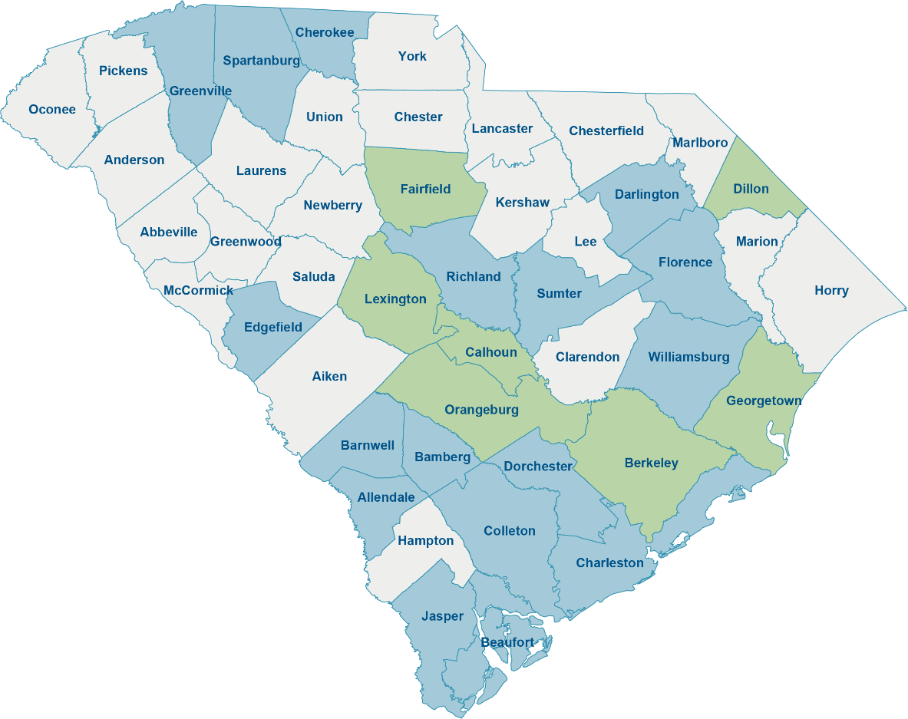
School-based Telehealth Network
In 2018, the network expanded into over 20 new schools and expanded into 6 new counties.
MUSC has partnered with Palmetto Health to lead the SCTA school-based telehealth workgroup and school-based telehealth expansion.
One of the fastest growing school-based telehealth networks in the country!
School-based telehealth is associated with decreased emergency department use among children with high-cost diseases such as asthma in rural communities.
Current
*Services vary by county to include acute care and chronic disease management, mental health, and group health education.
Programs in Development

Slide 7
Telestroke Care 85% of telestroke patients now remain in their community

Slide 8
Tele-ICU Monitoring Continues to Expand Across SC
>9,400
SC patients monitored in 2018
>300
Lives potentially saved in 2018*
*Actual versus predicted ICU mortality

Slide 9
Recurring Request for Telehealth ($4 million)
Enhanced recurring funding will be applied to:
100% of rural hospitals will be offered telehealth support
Expanded specialty consultative support
Critical care support network
100% of the counties with the highest prevalence of diabetes equipped for diabetes remote monitoring
100% of counties receiving school-based telehealth support
100% of rural primary care providers connected to specialists via e-consult

Slide 10
MUSC Supports Suggested Study Proviso
MUSC supports the SC Hospital Association’s proviso request to review federal telehealth reimbursement coverage and report to the General Assembly.
Suggested Language:
The Department of Health and Human Service and the Public Employee Benefit Authority shall each review federal additions to telehealth coverage established under the Bipartisan Budget Act of 2018, the SUPPORT for Patients and Communities Act, and other recent federal legislation and/or regulation, and no later than October 1, 2019, each transmit reports to the Governor and the Chairmen of the House Ways and Means Committee and the Senate Finance Committee on how they intend to broaden their service-based coverage to align with these federal changes and to improve the sustainability of telehealth services.

Slide 11
Update on Statewide Health Innovations
Mental and Behavioral Health: Combatting Opioid Addiction
Opened Charleston-based clinic, completed 8 patient cohorts in FY18 yielding excellent short-term outcomes
94% of the patients exited the program on no opioid pain medications
79% reported that pain interferes less with their daily activities than it did upon entering the program
Chronic Disease: Combatting Childhood Obesity
Barnwell District 45 and Anderson District 4 FY18 engagement culminated implementation of Docs Adopt School Health Initiative (DASHI) program as well as garden training and installation in Fall FY19.
Cancer: Combatting Cancer Rates through Preventative Health & Screenings
In FY18 MUSC’s Hollings Cancer Center and Clemson’s Sullivan Center mobile units visited 14 sites together, screening a total of 186 patients for breast and cervical cancer as well as cardiovascular disease.
Women and Children’s Health: Combatting Infant Mortality
Mother’s Milk Bank of SC expanded donor milk depots into Anderson, Barnwell, and Williamsburg Counties bringing total SC sites to 23.
Health Extension Agents
1 per county hired for Anderson, Barnwell, and Williamsburg
Program-specific training completed in Fall FY19
Agents will enhance each of the 4 programs by directly engaging the community
Recruiting, education, needs assessments, outcomes, follow-up

Slide 12
Future Plans for Statewide Health Innovations
Expand Existing Programs:
Combatting Infant Mortality
Open optimal density of depots in all counties throughout SC
Expand Health Extension network to optimize depot utilization, lactation education/support, and ultimately reduce infant mortality in SC
Combatting Childhood Obesity
Expand DASHI/gardens to all school districts in the 3 county focus
Strategically expand DASHI/gardens throughout SC
Combatting Opioid Addiction
Enhance recurring efforts leveraging Health Extension network
Increase access to opioid education and management via mobile units
Increased payor engagement and participation to create self-sustaining model
Combatting Cancer Rates though Preventative Health & Screenings
Enhance recruiting and patient follow-up via expansion of Health Extension network in current 3 counties
Improve clinic efficiencies via Epic Electronic Health Records implementation
Exploring opportunities for adding a new program in diabetes
Exploring additional partnership opportunities with Clemson, SC State, USC, and the VA

Slide 13
Request for Conformity for the Statewide Trauma Registry
The Statewide Trauma Registry (STR) is housed at DHEC (S.C. Code Section 44-61-510).
In its present state, DHEC prevents any analysis of the quality of trauma care that is rendered.
The STR suffers on multiple fronts:
There is no portion of the state budget which consistently supports this dataset.
Any data abstracted from the STR is blinded by the trauma center, preventing any meaningful analysis of the patterns of care, the preventability of the morbidity and mortalities which occur, nor any understanding of the value of the care that is rendered at the expense of the study taxpayers.
Non-trauma centers in SC that frequently treat injured patients, do not have to report their data to the STR. The lack of data prevents any meaningful understanding of the efficacy of the state trauma “system.”

Slide 14
Request for Conformity for the Statewide Trauma Registry
In an attempt to better understand the state trauma system, to understand the value of the care that is rendered to trauma victims, and to understand the needs of the injured patients within the state, we propose that the following actions be taken:
the STR be funded in perpetuity;
any medical facility within the state treating injured patients be mandated to report their data to the STR;
any data requested from the STR be unblinded, thereby facilitating an understanding of the value of the care that has been rendered;
the state declare a moratorium on the designation of any new trauma centers until a formal needs assessment can be carried out in accordance with the American College of Surgeons Committee on Trauma guidelines;
any further trauma center promulgation should be approved by the State Trauma Advisory Council; and
in order to better understand pediatric trauma care in SC, the State Trauma Advisory Council membership be revised to include a pediatric surgeon.

Slide 15
Suggested Statewide Trauma Registry Proviso
DHEC: (State Trauma Registry) From the funds appropriated or authorized in the current fiscal year, the Department of Health and Environmental Control shall require through the State Trauma Registry, that all state verified trauma centers are required to submit relevant patient care data. The Department may develop appropriate policies or regulations to ensure data is collected by all trauma centers no later than January 1, 2020.

Slide 16
University Recurring Budget Requests
College of Pharmacy Building Renovation Debt Service – $4,850,471
Pension Employer Contribution Recoupment – $13,248,116
Additional Positions – 134 (132 other, 2 federal)
Federal Fund Changes – $8,128,280

Slide 17
University Capital Budget Requests
Capital Renewal – $25,000,000
Interprofessional Health/Innovations Projects – $53,000,000
Renovation Projects – $15,000,000

Slide 18
MUSC Health 2018 Highlights
RANKED SPECIALITIES
Cancer
Ear, Nose, and Throat
Gynecology
Nephrology
Orthopedics
MUSC Health was listed as one of 100 great hospitals in Becker’s Hospital Review.
MUSC Health was named as one of America’s Best Large Employers and one of the Best Employers for Diversity by Forbes.
PEDIATRIC RANKED SPECIALTIES
Cancer
Cardiology & Heart Surgery
Gastroenterology & GI Surgery
Nephrology
Orthopedics
Urology

